Slide 1
Factors affecting accuracy of EWT
anxiety

Slide 2
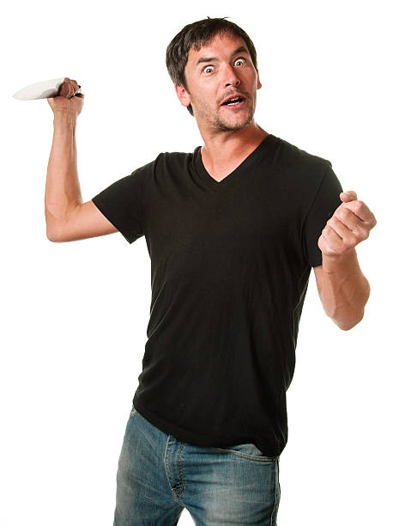
How well do you remember the preparation work?
Get into PAIRS and number yourself 1 and 2 (some of you will be moving around after task one)
You have two minutes to look through your preparation work
Task one:
Write out all of the details of Loftus’s weapon focus study on a MWB
You must include:
IV and DV
Experimental design
Results- actual percentages

Slide 3
Anxiety of the Witness: Loftus (1979)
IV
DV
Procedure
Participants were exposed to one of two situations
They overheard a low key discussion in a laboratory about equipment failure. A person then emerged from the lab holding a pen with grease on his hands
They overheard a heated and hostile exchange between people in the laboratory. After the sound of broken glass and crashing chairs, a man emerged with from the lab holding a knife covered in blood
Ps were given 50 photos and asked to identify the person who had come out of the laboratory

Slide 4
Anxiety of the Witness: Loftus (1979)
Findings
Those who witnessed the man holding the pen, correctly identified the person ___% of the time
Those who witnessed the man holding the knife, correctly identified the person ___ % of the time
49
33

Slide 5
Number 2s now move clockwise
On MWB- Write down the details of Yuille and Cutshall’s research on eye-witness testimony from a real life crime
You should include:
What did they witness? How many witnesses were there?
A shop keeper shooting a thief dead. 13 witnesses
How long after the event were they interviewed?
5 months after the event
What did they compare this interview to?
Police interviews conducted immediately after the event
What % accuracy was recorded for those who were reported as feeling high anxiety?
88%
What about those who reported low anxiety?
75%

Slide 6
Number 2s now move clockwise
ON MWB
Loftus’s study suggests that anxiety reduces accuracy, but Yuille & Cutshall’s study suggests anxiety increases the accuracy of EWT
What reasons could there be for these differences in the results?

Slide 7
Possible reasons for the differences in results
The participants in Loftus’s study may not have been experiencing anxiety, as they knew they were in a safe, experimental set up, but they may have remembered less about the person holding the knife because it was a more unusual situation and they were focusing on other details
Alternative explanations suggest that the better recall in the anxiety condition of Y&C’s study can be explained by the physiological arousal triggering the fight and flight response, which actually increases our alertness and improves our memory for the event
Unreliable, and therefore inconclusive
What does this mean for the research into the effects of anxiety on EWT?

Slide 8
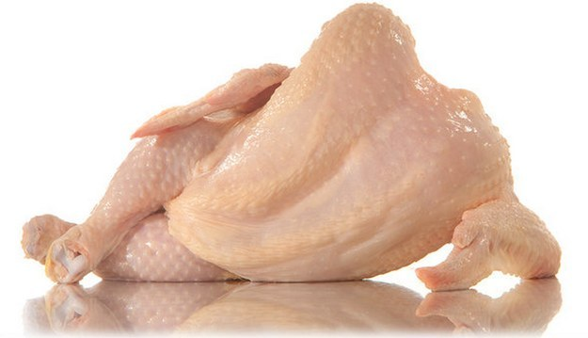
Number 2s now move clockwise
Johnson & Scott showed an incident in a hairdressing salon. In one condition, the confederate appeared with a raw chicken and in the other, he appeared with a handgun. There were just as many inaccurate details produced in the first condition as in the second
On MWBs:
What common emotion do you think was being experienced in each condition of the above experiment that would explain the similarity in outcomes?
Surprise
How can we use this to explain the findings of Loftus’s 1979 experiment?
The participants in the ‘knife’ condition may have
experienced surprise, which would explain why they
remembered less
This means that Loftus’s study may lack….?
Internal validity, as she is not
measuring what she claims to be
measuring

Slide 9
Number 2s now move clockwise
ON MWB
Pick the right statement to create a perfect PEEL evaluation point:
The research in this area has useful applications in the field of psychological research
The research in the area has useful applications for those working in education
The research in this area has useful applications in the justice system

Slide 10
Number 2s now move clockwise
ON MWB
Pick the right statement to create a perfect PEEL evaluation point:
Recognising the role of anxiety in EWT has meant the police proceed with extreme caution when pursuing lines of enquiry
Recognising the role of anxiety in EWT has meant the police no longer use evidence from witnesses who have experienced anxiety
Recognising the role of anxiety in EWT has meant the police understand that the more anxious someone is, the more reliable their testimony is

Slide 11
Number 2s now move clockwise
ON MWB
Pick the right statement to create a perfect PEEL evaluation point:
Today criminal investigators rarely use eye-witness testimony, and instead look for alternative evidence, such as DNA sampling or CCTV footage that acts as more reliable evidence
Today criminal investigations tend to rely on Eye witness testimony, as it is more reliable than other types of evidence, such as DNA sampling or CCTV footage, which is prone to errors
Today criminal investigations rarely rely on Eye witness testimony alone and instead commonly look for alternative evidence, such as DNA sampling or CCTV footage that could be used to collaborate the witness’s testimony

Slide 12
Number 2s now move clockwise
ON MWB
Pick the right statement to create a perfect PEEL evaluation point:
Therefore, research into the effect of anxiety on EWT has had positive benefits to criminals, who are less likely to get convicted for crimes they didn’t commit
Therefore research into the effect of anxiety on EWT has had positive benefits for the criminal justice system by reducing the chances of erroneously convicting the wrong person
Therefore, research into the effects of anxiety on EWT has had a positive effect on the police force, because it means less time is spent interviewing witnesses and therefore, less resources are wasted unnecessarily

Slide 13
Number 2s now move clockwise
Write a snap plan for the following essay:
Discuss research into the effect of anxiety on eye witness testimony (16 marks)
Think about:
What will the AO1 consist of?
Which three PEEL points will you use?

Slide 14
Now individually answer the following question:
Melissa was on her way to college when she saw a man attack a cyclist and steal his bike. She was really upset about what she had seen, and when she got to college, everyone wanted to talk to her about it. Luke asked her whether the man was wearing a brown jacket
From the description above, identify three factors affecting the accuracy of eyewitness testimony. How might each factor affect Melissa’s memory of the event? (6 marks)

Slide 15
Mark Scheme
1 mark for each factor mentioned in the stem
Plus:
1 mark each for stating how the factor might affect Melissa’s recall
Content:
Anxiety/upset – Melissa’s memory may be worse because of the anxiety of seeing the cyclist attacked, OR better because she was more alert, due to the anxiety of seeing the cyclist attacked, as her ANS would have been triggered
Post-event discussion – Melissa’s memory may be less accurate because she may have incorporated elements of the discussion with her friends at college into her memory of the event
Leading Questions – Melissa may incorrectly recall what the man was wearing because Luke’s questions suggested that the man was wearing a brown jacket
Other factors affecting EWT are not creditworthy because they do not appear in the stem.

Slide 16
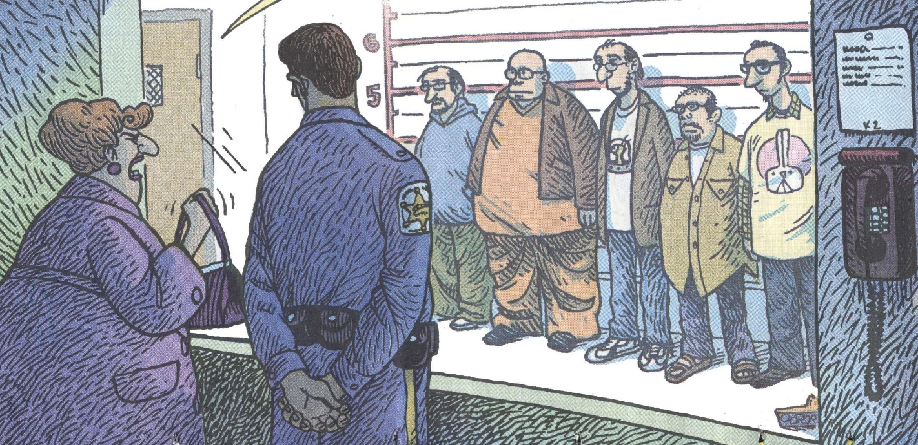
Quizlet recap

