Slide 1
Attachment
Paper 1 Introductory Topics

Slide 2
Psychopathology - recap
Complete Tracking Test 2 –
21 Questions – 20 minutes

Slide 3
Mini Whiteboards
What things can a baby do instinctively from birth?
What things will it learn and how will it learn them?
What does a baby need to survive in the first few days of life?
How then does a baby survive?
How does a baby communicate?
List all the reasons that make us want to look after babies?
How does your childhood relationships with your parents/carer impact on your relationships as adults and with your own children?

Slide 4
Now on the big boards.
Define attachment , including what behaviours you think a child would display who is attached. (3 marks)
A two-way, enduring, emotional bond between two individuals, in which the following behaviours are displayed.
1. Seeking proximity, especially at times of stress.
2. Distress on separation and pleasure when reunited
3. Secure base behaviour-so infants are happy to explore but regularly return to attachment figure.

Slide 5
Is this baby attached? Use the definition to answer the question.

Slide 6
Reciprocity
https://www.youtube.com/watch?v=JPejofp9BnQ
Neonate (baby) Reflexes
https://www.youtube.com/watch?v=_JVINnp7NZ0
Different types of crying in babies
https://www.youtube.com/watch?v=ValdMXD5wQI

Slide 7
Research methods
How do researchers measure the behaviour of babies?
Especially new-borns?
How would I measure if babies showed a preference for looking a face-like stimuli?
If it is through observation, how do they ensure they are reliably observed?

Slide 8
Reciprocity and interactional synchrony
On your whiteboards define reciprocity and interactional synchrony in terms of attachment.
Reciprocity- Infant and caregiver are both active contributors in the interaction and are responding to each other.
Interactional synchrony-The interaction is rhythmic and can include infant and caregiver mirroring each other’s behaviour and emotion. The infant and caregiver’s behaviours are moving in the same, or a similar, pattern.

Slide 9
Inter-observer reliability
The extent to which there is an agreement between two or more observers involved in observations of a behaviour.
So you should always have at least two observers when carrying out an observation
Observations should be consistent (reliable) so observers should produce the same record and a general rule is if there is 80% or above agreement that the data has high inter-observer reliability.
Sometimes inter-observer reliability is expressed as a correlation co-efficient, so here we are looking for a over +.80 for high inter-observer reliability.

Slide 10
Research methods-controlled observation
Meltzoff and Moore (1977) used 4 different stimuli; adults displayed one of three facial expressions and a hand gesture and the child’s response was filmed and identified by independent observers who had no knowledge of what the children had just seen.
The behavioural categories were mouth opening, termination of mouth opening, tongue protrusion, termination of tongue protrusion. Each observer scored the tapes twice so that inter-observer reliability could be calculated. All scores were greater than .92. An association was found between the expression or gesture the adult has displayed and the babies actions.

Slide 11
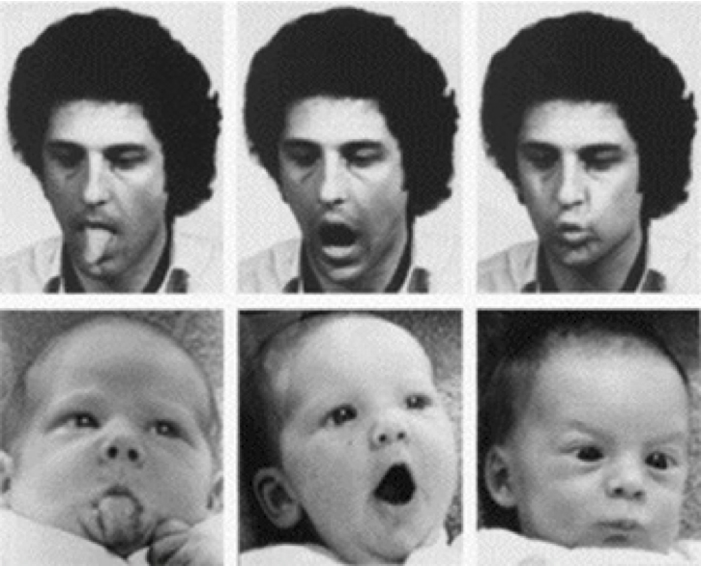

Slide 12
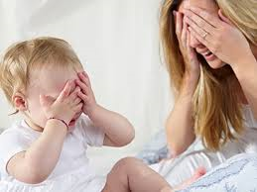
ACTIVITY
A psychologist is carrying out an observation of 10 month old Felix and his mum that lasts 10 minutes.
He sits in a room with them whilst they play and used a stopwatch and also writes his observations in a notepad to analyse later.
He observes that the interactions between them are almost totally equal, with Felix being timed as being “active” for 8mins 35 seconds and mum for 7 mins 5 seconds with some overlap where both are active at the same time.
Some of his observations of their behaviour are as follows. “Felix is playing with a car, he looks at his mum and says beep-beep and his mum responds by saying honk-honk”
“F covers his face with his hands and then uncovers them saying “peek-a-boo”, mum covers her face and does the same saying peek-a-boo”
“Mum is capping her hands and singing but F rubs his eyes and frowns and mum immediately stops singing and pulls a sad face and strokes his face and then they are both quiet for 10 seconds whilst she strokes his face and he strokes her face”.
The researcher has observed similar patterns of behaviour in mothers and children as young as 3 weeks old.
Find one example or piece of evidence of reciprocity in the scenario above and justify your answer
Find one example of interactional synchrony in the scenario above and justify your answer
“The researcher has observed similar patterns of behaviour in mothers and children as young as 3 weeks old” What does this comment tell us about mother-child interactions?
What are two problems with the way that this research has been carried out
How could you change the research design to address the problems mentioned?

Slide 13
ACTIVITY
Find one example or piece of evidence of reciprocity in the scenario above and justify your answer
Evidence-He observes that the interactions between them are almost totally equal, with Felix being timed as being “active” for 8mins 35 seconds and mum for 7 mins 5 seconds with some overlap where both are active at the same time.
Example- any of them as in all of them there is a two way interaction between the mother and child
Find one example of interactional synchrony in the scenario above and justify your answer
Peek-a-boo-mirroring
Rubbing of eyes stoking of face –synchronised interactions both calming down so moving in same direction
“The researcher has observed similar patterns of behaviour in mothers and children as young as 3 weeks old” What does this comment tell us about mother-child interactions?
That the behaviour is innate as can’t have been learnt at this early stage.
What are two problems with the way that this research has been carried out
He is in the room with them which could change behaviour, he is writing his notes down so may miss important info, only one observer so issues with subjectivity.
INTRODUCE IDEA OF Inter-observer reliability
How could you change the research design to address the problems mentioned
Two way mirror so not in room, record the observation so notes not needed and also can use more than one observer and use the footage to improve reliability.

Slide 14
Homework
Another test on Psychopathology!
Mini-mock using real exam questions (max 8 marks)
24 marks in total – 30 minutes
Focus on Depression and OCD

