Slide 1
The influence of early attachment
Attachment 11

Slide 2
Re-cap task
Summarise the effects of institutionalisation – provide 3 bullet points

Slide 3
The effects of institutionalisation:
Some of the negative outcomes shown by the Romanian children could be overcome through adequate substitute care. Remember at aged 11 just under half of the children in Rutter’s study had normal levels of functioning.
But intervention should take place before 6 months of age as those adopted after tended to have lower IQ’s and be less physically developed.
Many children, especially those who had been adopted later, displayed disinhibited attachment - characterised by a lack of close, confiding relationships, rather indiscriminate friendliness and clingy, attention-seeking behaviour, a relative lack of differentiation in response to adults (treating them all alike, a tendency to go off with strangers and a lack of checking back with a parent in anxiety-provoking situations.
Some research shows that the negative physical effects of institutionalization can be reversed by 10 1/2.
Separation from mother alone is not sufficient to cause negative outcomes as British children had been separated but were not developmentally delayed
The effects of Romanian orphans are still not fully clear as they still need to be followed into adulthood to see if the negative effects can still be overcome with more time.

Slide 4
This half-term
Date | Topic
Fri 28th | Influence of Early Attachments; Attachment Revision
Fri 5th May | Attachment ‘Mini mock’ Test
Fri 12th May | Preparation for Progression Exam
 | PROGRESSION EXAM Approaches Research Methods Biopsychology
Next half-term | Social Psychology

Slide 5
Testing your assumptions
Task one
You will have a multiple choice quiz that you need to do alone, with no notes and in silence. There are questions that cover material we haven’t looked at but you should be able to work the answers out based on previous learning of the internal working model and Ainsworth’s types of attachment.
You can use the next slide to help you if you need it.

Slide 6
A Reminder…
The internal working model suggests that a child's first relationship with their primary caregiver shapes all future relationships. The continuity hypothesis is based on this and says that the specific attachment type of a child is reflected in their adult relationships.
Avoidant- avoids social interaction, no separation anxiety, low stranger anxiety
Resistant-Very distressed on separation, clingy with mother, low exploration, seeks and reject intimacy.

Slide 7
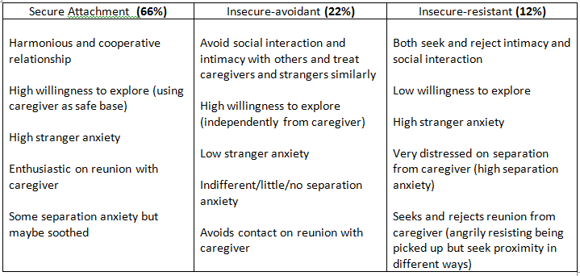
To help…

Slide 8
Answers
1. The internal working model is part of what theory?
C. Bowlby’s monotropic theory
2. The internal working model would predict which of the following if a child has a secure relationship with their primary caregiver?
A. They will find it easy to form friendships
3. Thinking about the internal working model which type of child do you think will be least likely to be a bully and be bullied?
A. Secure
4. Thinking about the internal working model which type of child do you think will be most likely to be a bully?
B. Insecure resistant
5. Thinking about the internal working model which type of child do you think will be most likely to be a victim of bullying?
C. Insecure avoidant

Slide 9
Answers
6. Thinking about the internal working model which type of child do you think will be most vulnerable to loneliness as an adult?
B. Insecure resistant
7. Thinking about the internal working model which type of child do you think will have the longest lasting romantic relationships as an adult?
A. Secure
8. Adults classified as which attachment style picked the following statement to best describe their inner feelings "I find it easy getting close to others and am comfortable depending on them and having them depend on me. I don't worry about being abandoned or about somebody getting close to me".
A. Secure attachment
9. Adults classified as which attachment style picked the following statement to best describe their inner feelings- "I find others are reluctant to get as close as I'd like. I worry my partner doesn't really love me or won't stay with me. I want to merge completely with another person and this desire scares people away"
B. Insecure resistant
10. Adults classified as which attachment style picked the following statement to best describe their inner feelings- "I am uncomfortable being close to others; I find it difficult to trust them, difficult to depend on them. I am nervous when anybody gets close to and love partners want me to be more intimate than I feel comfortable being.
C. Insecure avoidant

Slide 10
Answers:
11. Adults classified as which attachment type were most likely to agree with the following statement-"it is easy to fall in love. I feel myself beginning to fall in love often"
B. Insecure resistant
12. Adults classified as which attachment type were most likely to agree with the following statement-"it is rare to find someone you can fall in love with".
C. Insecure avoidant
13. In a study by Quinton (1984) 50 women raised in institutions were compared to 50 women raised at home. What do you think they found?
B. The institutional group had extreme difficulties acting as parents and their children spent more time in care.
14. Bailey (2007) interviewed and observed 99 mothers with their babies using the strange situation and found what? This study supports the internal working model.
A. The majority of mothers had the same attachment style with their babies as they reported having with their own mothers.

Slide 11
Research to support
Smith (1998) assessed attachment type and bullying involvement using standard questionnaires in 196 children aged 7-11 from London and found that secure children are unlikely to be involved in bullying. Insecure-avoidant children were most likely to be victims and insecure-resistant were most likely to be bullies.
Why?
As securely attached children tend to be more confident (Belsky 199) they are less likely to be the target of bullies for fear that they will stand up for themselves and as they have close friendships bullies risk then having the support of other children.

Slide 12
Hazan & Shaver (1987) ‘Love Quiz’
Procedure
They analysed the responses from 620 respondents of a “love quiz” they published in the rocky mountain news (an American small-town newspaper).
Sample-205 were from men, 415 women; 14-82 years old, 91% heterosexual, 42% married, 28% divorced or widowed, 9% co-habiting and 31% dating (some fitted more than one category).
The questionnaire firstly asked questions to assess current or most important relationship, secondly it asked questions about attitudes towards love as an assessment of the internal working model. Thirdly investigated attachment history to identify current and childhood attachment types by asking respondents were to pick which of three descriptions best applied to their inner feelings about romantic relationships

Slide 13
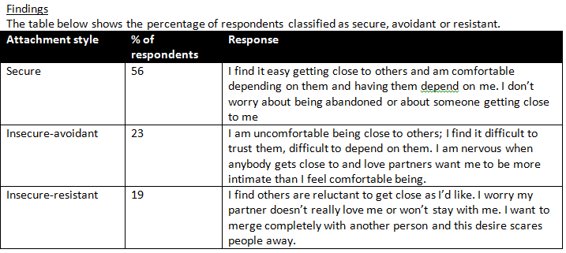
The Love Quiz

Slide 14
The Love Quiz

Slide 15
Love Quiz Link
http://www.web-research-design.net/cgi-bin/crq/crq.pl
Choose option B

Slide 18
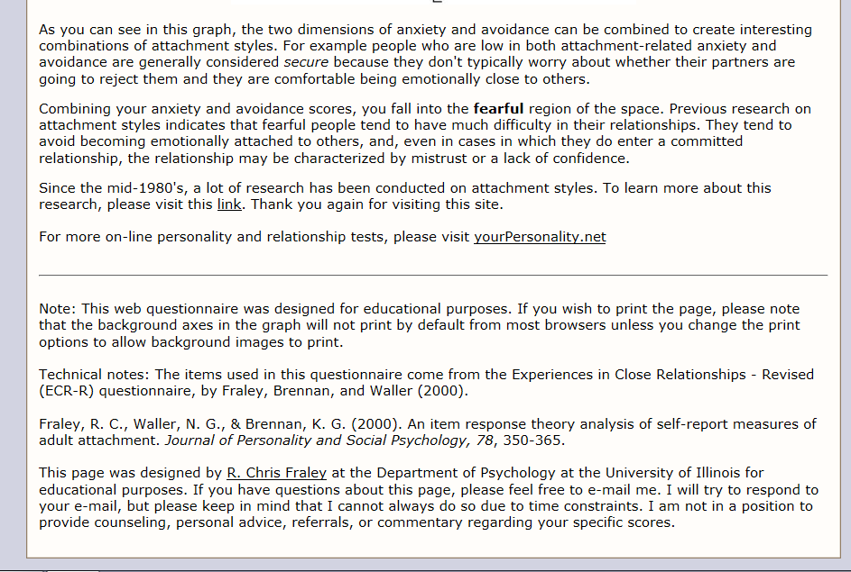

Slide 19
Love Quiz - conclusions
Securely attached respondents tended to have a positive internal working model (see table)
They also found a positive correlation between attachment type and love experiences; the more attached a person was the more positive they found their love experiences. Securely attached respondents described love experiences as happy, friendly, trusting and were able to accept and support their partner despite their faults.
Securely attached love relationships were more enduring- lasting on average 10 years compared to five for resistant and 6 avoidant and if married they tended not to divorce.
Both insecure types were vulnerable to loneliness with resistant being the most vulnerable
Avoidant types tended to reveal jealousy and fear of intimacy.

Slide 20
Evaluating the Love Quiz - PES
Research Method
Low correlations
Contradictory Findings
Social Desirability
Retrospective Data
Causation
Issues

Slide 21
Using your knowledge of research into the effects of early attachment on childhood and adult relationships, explain what is being shown in the graph below. (3 marks)

Slide 22
Answer
Bowlby stated in his theory of monotropy that the ‘internal working model’ provided a blueprint for future relationships
Children who are securely attached grow up to form more stable and secure friendships and romantic relationships
The graphical data supports this – those with the longest duration relationships had the highest scores for secure attachments – the shorter the relationship duration the more likely a lower score on security of attachment
This is supported by Hazan and Shaver (1987) Love Quiz study - securely attached love relationships were more enduring and securely attached respondents tended to have a positive internal working model

Slide 23
Attachment Revision!
Use the 50 questions to help you identify gaps in your knowledge
Prepare thoroughly for a mini-mock next week!

