Slide 1
ATTACHMENT – OBSERVATIONS THE STRANGE SITUATION
Attachment – Lesson 7 and 8

Slide 2
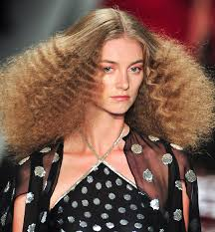
Bowlby’s Theory of Monotropy
Bowlby’s Theory is based around 6 key concepts:
C
I
I
M
P
S
‘Cr-I-I-M-P-S’
Recall the 6 key concepts to describe Bowlby’s Theory

Slide 3
Bowlby’s Theory of Monotropy
Bowlby’s Theory is based around 6 key concepts:
Critical Period
Innate Programming
Internal Working Model
Monotropy
Proximity
Social Releasers
‘Cr-I-I-M-P-S’

Slide 4
Bowlby’s Theory of Monotropy
This is Albert… What is this an example of?

Slide 5
Evaluation of Bowlby’s Theory
Research to support (Harlow, Lorenz, Hazan & Shaver)
Research to contradict (Schaffer & Emerson, Lamb)
Socially sensitive
Economic implications
Role of the father

Slide 6
The Strange Situation
On Big whiteboards write the stages of Ainsworth and Bell’s (1970) study in the correct order.
Don’t use numbers write out the actual stages.
Stage | People in room | Procedure

Slide 7
The Strange Situation
Aims
To produce a method for assessing the security of an infant’s attachment by placing the infant in a mildly stressful situation and observing the attachment behaviours that result.
Procedures
The strange situation took place in a laboratory. The original participants were American infants aged between 12 and 18 months and their caregiver (usually their mother). The third individual involved in the strange situation was a stranger. The same stranger was used all the time.
The procedure lasted for just over 20 minutes and the behaviour of the infants was closely observed to assess the infant’s levels of exploring, playing and distress behaviours at separation and reunion with the caregiver and when left with the stranger.

Slide 8
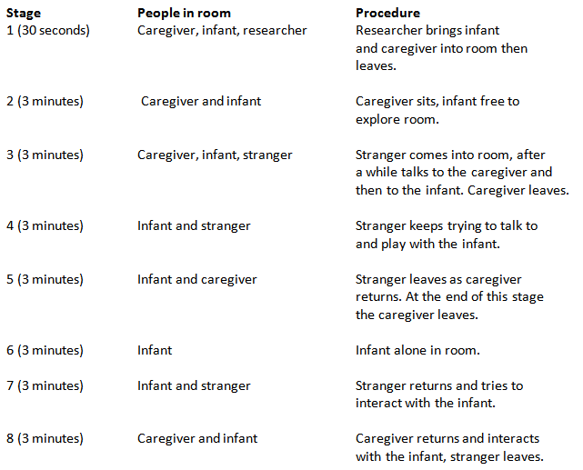
The Strange Situation

Slide 9
The Strange Situation
Scoring
Strange Situation classifications (i.e. attachment styles) are based primarily on 4 interaction behaviours directed toward the mother in the two reunion episodes (Ep. 5 & Ep. 8).
Proximity and contacting seeking
Contact maintaining
Avoidance of proximity and contact
Resistance to contact and comforting
The observer notes down the behaviour displayed during 15 second intervals and scores the behaviour for intensity on a scale of 1 to 7.
Other behaviours observed included:
Exploratory Behaviours e.g. moving around the room, playing with toys, looking around the room.
Search Behaviours e.g. following mother to the door, banging on the door, orienting to the door, looking at the door, going to mother’s empty chair, looking at mother’s empty chair.
Affect Displays negative, e.g. crying, smiling.

Slide 10
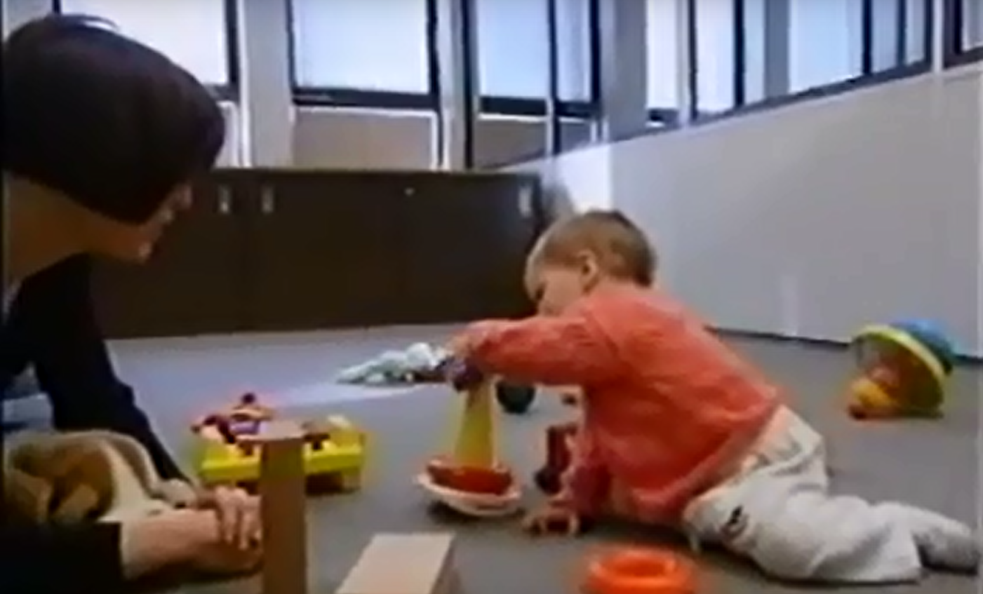
The Strange Situation
https://youtu.be/QTsewNrHUHU

Slide 11
The Strange Situation
Secure attachment- This is a strong and contented attachment of an infant to his/her caregiver, which develops as a result of sensitive responding by the caregiver to the infant’s needs. Securely attached infants are comfortable with social interaction and intimacy. Secure attachment is related to subsequent healthy cognitive and emotional development.
Insecure attachment- This is a form of attachment between infant and caregiver that develops as a result of a caregiver’s lack of sensitive responding to the infant’s needs. It may be associated with poor subsequent cognitive and emotional development.
There are two types of insecure attachment; avoidant and resistant (ambivalent).
Insecure-avoidant- A type of attachment that describes children who tend to avoid social interaction and intimacy with others.
Insecure-resistant- A type of attachment that describes those infants that both seek and reject intimacy and social interaction.

Slide 12
Draw the following table and Use words like -very high, high, low, strong, strongest, none, stays close, stays closest, none, accepts, ignores, rejects. Some you will use more than once.
 | Secure | Insecure-avoidant | Insecure-resistant
Proximity-seeking
Exploration
secure base behaviour
Stranger anxiety
Separation anxiety
Response to caregivers affection on reunion

Slide 13
The Strange Situation
 | Secure | Insecure-avoidant | Insecure-resistant
Proximity-seeking | Stays close | none | Stays closest
Exploration | High | High | Low
secure base behaviour | High | none | low
Stranger anxiety | High | Low | High
Separation anxiety | High | low | Very high
Response to caregivers affection on reunion | accepts | ignores | rejects

Slide 14
The Strange Situation

Slide 15
The Strange Situation
https://www.youtube.com/watch?v=AGRT6VjnTm8
https://www.youtube.com/watch?v=Rdrp-0GLzws
Notes:
1. Avoidant

Slide 16
Evaluating The Strange Situation
Complete the following evaluation points for Ainsworth’s study
1. There may have been an issue with the research method used in the study because…
2. The study has inter-observer reliability because…
3. The study has real world application because…
4. The study depends on the care-giver used…
5. The study is culturally bound because…

Slide 17
What type of attachment and why?
Read the examples and determine the type of attachment - giving reasons why you made that choice

Slide 18
Flip Video - Baby G
You were all observers in the baby G experiment.
What was Baby G’s attachment type?
How you decided this?
Did we all get the same result?
Work out what percentage we got for each type of attachment. Did we have observer-reliability?
Secure | Insecure-resistant | Insecure-avoidant

Slide 19
Why did we have such high inter-observer reliability?
Behaviour categories
Behavioural categories – when behaviour is broken down into components that are observable and measureable.
If behavioural categories are used, inter-observer reliability should be high providing the categories used are good.
Good behavioural categories are, clear, unambiguous, precise and are not an interpretation of behaviour but a description of behaviour. For instance smiling is a behaviour, being friendly is an interpretation of behaviour.

Slide 20
Categorising Behaviour
Some examples of behavioural categories were
-Harmonious and cooperative relationship
-Proximity
Why are these poor categories?
Now make them better, remember they must be clear and not open to interpretation, i.e. operationalise them.

Slide 21
Key question
How should behavioural categories be developed?
Initially the behaviour that is being observed should simply be watched
From here behavioural categories should be developed
Different observers should then discuss what the behavioural categories actually mean to ensure they are using them consistently and make any refinements necessary
Ideally the behavioural categories should be piloted to allow for further modification

Slide 22
Developing behavioural categories
You are observers asked to look at the quality of attachments between a mother and child using the strange situation.
You are going to watch a clip but you need to come up with 6 behavioural categories to observe.
Remember good behavioural categories are, clear, unambiguous, precise and are not an interpretation of behaviour but a description of behaviour.
For instance smiling is a behaviour, being friendly is an interpretation of behaviour.

Slide 23
Deciding on class categories
Using the observation schedule sheet, we must decide on agreed behavioural categories and then all write them on the sheet.
Possible for categories include: crying, stop crying, picks up toy, walks/moves to mother, walks/moves to stranger, looks at stranger, looks around room, looks to the door, moves to the door, touches mother...
Do we all agree on what we are looking for?

Slide 24
Now watch a clip

Slide 25
Event Sampling
Sometimes it is difficult to record continuous behaviour in an observation so we may use:
Event sampling-counting the number of times a particular behaviour occurs in a target individual or group.
This is what we just did! We observed the number of times certain behaviour categories occurred during the whole clip.

Slide 26
Time Sampling
Time sampling- recording behaviour within a pre-established time frame.
So watching the infant and only making note of their behaviour every 30 seconds for instance.
It may be that order of events is important in the observation so this helps here.

Slide 27
Time Sampling
You have a grid that time samples at 10 second intervals but just for stages 5-7
We will just be looking at crying (start clip 2min 20)
What did you find?
If you were event sampling, what would you find? Why is it different?
What were strengths, limitations of these two types of sampling?

Slide 29
Research Methods: Observations
Different types of observation
1. Naturalistic observation
2. Controlled observation
3. Covert observation
4. Overt observation
5. Participant observation
6. Non-participant observation

Slide 30
Which type of observation?
1. A researcher secretly joins a religious cult to see if people are being brainwashed.
2. A researcher watches primary school children through a two way mirror in a playroom to investigate behaviour, they know she is watching
3. A researcher observes the crowd at a football match on secret CCTV cameras.
4. A researcher observes student behaviour during lunch breaks by enrolling on a course and pretending to be a mature student. He sits on a table on his own in the lunch room and watches.
5. The head of psychology department observes an A-level class by watching the lesson at an agreed time, sitting at the back of the room.
Participant-covert-naturalistic
Controlled-overt-non participant
Non-participant -covert-naturalistic
participant-covert-naturalistic
Non-participant-overt-naturalistic

Slide 31
Evaluating Observation Methods
Come up with advantages and disadvantages of the types of observation.
Naturalistic vs Controlled
Overt vs Covert
Participant vs Non-participant
Hint- Think about things like
Ecologically valid? Demand characteristics? Cause and effect? Ethics? Hard to carry out? Extraneous variables? Valid data?

Slide 32
Naturalistic V Controlled
Naturalistic observations provide a realistic picture of behaviour and therefore have high a) _________________________ validity. Although this may be less so if participants are aware of being observed.
However, one of the issues is due to the lack of control there may be uncontrolled b) ______________ ________________ that may actually influence the behaviour observed. Also, naturalistic observations tend to be one off situations and makes c) ______________________ of the investigation challenging.
Controlled observations mean the researcher can focus on particular aspects of behaviour and also being controlled means extraneous variables are less of a problem and replication becomes easier.
Notes:
External or ecological
Extraneous variables
Replication

Slide 33
Overt V Covert observations
Overt observations have an ethical advantage to covert observations because participants are aware of what is going on and have given d) ______________________. However, the slight disadvantage is that having this awareness could mean participants behave differently and not so e) ________________.
Covert observations have good validity because the participants are unaware of the observation, the behaviour will be natural. There is an issue with the f) _____________ of these studies, as people may not wish their behaviour to be studied without their initial consent.
Notes:
Consent
Naturally
Ethics

Slide 34
Participant V non-participant observation
Participant observations can provide real insight into the participants being studied and this richness may not be gained in any other way. However, there is a danger the observer may identify too strongly with those they’re studying and as a result lose their
g) _____________________________.
Non – participant observers are more likely to remain objective because they aren’t part of the group being studied. But they may lose valuable insight into the participants because they are too h) _______________ from the people and behaviour.
Notes:
Objectivity
Removed or distant

Slide 35
What is a Pilot study?
Pilot studies are small scale versions of an investigation that are carried out before the real investigation is conducted.
The purpose of them is to check that the procedure, materials and any other aspect of the study works; if anything does not work, this allows the researchers to change relevant aspects of the investigation before the full study is carried out.

Slide 36
Dealing with ethical issues
In the study, researchers have to deal with ethical issues.
Name issues and state how they dealt with each of them, give specific examples from the clips.
DECEPTION -
RIGHT TO WITHDRAW -
INFORMED CONSENT -
PROTECTION OF PARTICIPANTS -
PRIVACY -

Slide 37
Culture and Attachment

Slide 38
Culture and attachment
Culture is the whole way of living your life – your religion, your language, your beliefs
A cross-cultural study is one that compares different cultures
How would you carry out a cross-cultural investigation into attachment styles?

Slide 39
Culture and attachment
How could you assess how attachment varies with culture?
Rather than one researcher carrying out studies in lots of different countries which would be extremely time-consuming and expensive-what could they do?
This is called a meta-analysis and the data collected is called secondary data.

Slide 40
Types of culture- copy and complete
Individualistic culture - a culture in which people tend to view themselves as individuals and to emphasize self-reliance and personal independence.
E.g. ___________
Collectivist culture - a culture in which the community or social groups needs take precedence over individual needs and in turn the group takes responsibility for the wellbeing of the individual. E.g. ___________

Slide 41
Answer the following: Use Page 18 of your booklet
1. How many studies were used for the meta-analysis?
2. How many different countries? How many children?
3. Children from eight countries were used in the study. Some of the countries were classified as Western and some non-Western. Highlight western in one colour and non-western in another.
4. What attachment style was most common in all nations?
5. For non-Western countries, what was the dominant insecure attachment style?
6. For Western countries, what was the dominant insecure attachment style?
7. Was variation in attachment style found within or between cultures?
8. Does child-rearing vary between cultures, why?

Slide 42
Looking at the data-find and label the following
Whilst looking at the study:
Which nation had the most studies?
State the largest nation having only 1 study.
Which nation had the highest percentage of secure attachment?
Which country has the highest percentage of insecure-avoidant attachment?
Which two countries had the highest percentage of insecure-resistant attachment?

Slide 43
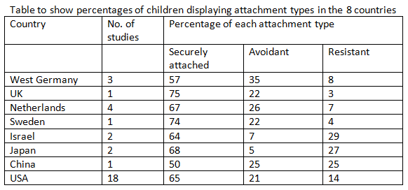
Cultural Variations

Slide 44
Show clip on attachment parenting. This is a parenting style increasing in the UK. Why may this affect the findings of the strange situation and it’s ability to use cross culturally?

Slide 45
Cultural research
Oumar (2001) studied the Dogon people of Mali using the strange situation and compared the findings to North American parents. They found no avoidant attachments compared to 23% in North American and 67% secure compared to 55% in North America.
Why may this be? Why does this matter?

Slide 46
Cultural Research
When the strange situation was carried out in Japan it tended not to work as infants showed such high levels of distress on separation it had to be finished early or mothers raced in to grab their infants.
Why may this be? Why does it matter?

Slide 47
Cultural Research
Simonella (2014) conducted the strange situation in Italy very recently to see if the attachment levels were similar to those recorded in past studies. 76, 12 month olds were used and they found much lower rates of secure attachment than in previous studies 50% secure (66% in original study) 36% insecure-avoidant (22% in original study).
Why may this be? Why does this matter?

Slide 48
Issues with cultural comparisons
Cultural bias
Culture does not mean country
Entirely standardised procedures?
Change over time? Simonella (2014)
Culture bound

Slide 49
Homework
Complete the Research Methods Activity

Slide 50
Research Methods Questions
1. What type of data are we using in these observations- qualitative or quantitative?
Quantitative
2. How would you best represent your findings graphically and why?
Bar chart because it is category data/nominal
3. So what are the benefits of using observational categories then?
Behavioural categories allow observers to tally observations into pre arranged groups
Categories give clear focus to the researcher
Enables proposal of hypothesis testing
Allows for more objective/scientific data recording
Greater reliability
Data is easy to quantify

Slide 51
Table one- The total number of observations of crying and playing with mother in children classified as secure and insecure avoidant
Research Methods Activity
 | Crying | Playing with mother
Secure | 30 | 42
Insecure avoidant | 5 | 4

Slide 52
A chart to show the total number of observations of crying and playing with mother in secure and insecure avoidant children.
Notes:
Bar chart t

Slide 53
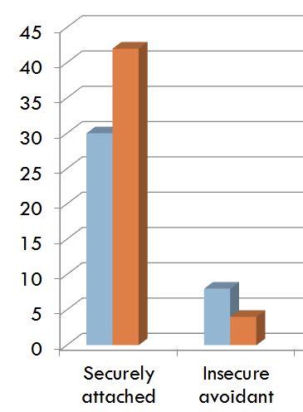
Bar Graph
A bar graph to show the total number of observations of crying and playing with mother in secure and insecure avoidant children.

Slide 54
Research Methods Activity
Marks for this question: AO2 = 3
• 1 mark for calculating the total number of observations of crying overall (30+5=35)
• 1 mark for representing the total number of observations of crying in the secure group as a fraction of total number of observations of crying overall (30/35)
• 1 mark for dividing both parts of the fraction by the lowest common denominator (30/5 = 6; 35/5 = 7) to produce the correct answer (6/7)

Slide 55
Research Methods Activity
Marks for this question: AO3 = 3
3 marks for clear explanation plus coherent elaboration
2 marks for explanation plus some elaboration
1 mark for vague / muddled explanation
Students may make a single, elaborated point or a number of points in less detail.

Slide 56
Research Methods Activity
Possible content
• The interviewer could have asked follow-up questions to gain greater insight into some of the points raised for instance finding out who the primary care-giver is the mother may not have been so incorrectly classified.
• The interview would produce more detail/depth of information than the participant would have been able to reveal in an observation
• Interview data would have provided a further measure of reliability/validity
• The interviewer may have gained rapport with the participant so they have felt comfortable revealing more personal/sensitive information face-to-face
Accept other valid points

