Slide 1
Behaviourist treatments for phobia
Systematic desensitisation & Flooding therapy

Slide 2
Starter Quiz on Behaviourist Treatments
Answer the questions in pairs on mini-whiteboards
Systematic desensitisation is based on the principles of which behaviourist theory?
What is involved in ‘counter conditioning’?
What is the principle of ‘reciprocal inhibition?
What are the three main processes used in systematic desensitisation?
In systematic desensitisation, when is the phobia considered to be cured?
How is flooding therapy different to systematic desensitisation?
What is the theory behind why flooding therapy works?
How long do flooding therapy sessions usually last?

Slide 3
Starter Quiz on Behaviourist Treatments: Answers
Systematic desensitisation is based on the principles of which behaviourist theory?
What is involved in ‘counter conditioning’?
What is the principle of ‘reciprocal inhibition?
What are the three main processes used in systematic desensitisation?
In systematic desensitisation, when is the phobia considered to be cured?
How is flooding therapy different to systematic desensitisation?
What is the theory behind why flooding therapy works?
How long do flooding therapy sessions usually last?
Classical conditioning
Replacing a fear response with a relaxation response
The fact that two incompatible emotional states cannot exist together (e.g. fear and relaxation)
Relaxation, hierarchy, gradual exposure
When the person can tolerate exposure to the top level of the hierarchy without feeling anxiety
SD involves gradual exposure, but flooding involves immediate exposure to the phobic stimulus
It is not possible to maintain a high level of anxiety for a prolonged period of time
One 2-3 hour session

Slide 4
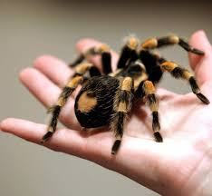
Create your own hierarchy
In your groups, you are going to be creating a hierarchy of anxiety provoking events for a phobia of your choice
Everyone must have a different phobia, so start by writing down three possible choices on your MWBs. You will be asked to pick one from the list
Now go up to BWBs and draw a 10 step hierarchy of anxiety provoking events for your phobia

Slide 5
Systematic desensitisation in action
Watch the clip and note down on MWBs where the processes of systematic desensitisation are demonstrated. You should be able to identify relaxation, the hierarchy, how gradual exposure was demonstrated

Slide 6
Exam practice
Answer the question individually without notes:
Outline the processes involved in systematic desensitisation (6 marks)
Now swap with the person sitting next to you and award marks according to the guidance on the next slide

Slide 7
Exam practice: Mark scheme
Systematic desensitisation is a behavioural therapy designed to gradually reduce phobic anxiety through the principles of classical conditioning (1 mark). It uses counter‐conditioning to help patients ‘unlearn’ their phobias, by eliciting another response: relaxation instead of fear (1 mark). A patient works with their therapist to create a fear hierarchy, ranking the phobic situation from least to most anxiety‐inducing (1 mark). The patient is also taught relaxation strategies, such as breathing techniques, to help them remain calm when exposed to their fear (1 mark). Finally, the patient works through their fear hierarchy, starting at the bottom, while trying to remain relaxed at each stage (1 mark). Systematic desensitisation works on the assumption that two emotional states cannot exist at the same time, a theory known as reciprocal inhibition, and eventually relaxation will replace the fear (1 mark).

Slide 8
Evaluation of systematic desensitisation
When evaluating a treatment, we need to consider how effective and appropriate the treatment is
What do you think these two terms mean in the context of treatments for psychological disorders?
Effective: Does it work?
Appropriate: Is it suitable for that person (e.g. are there side effects? how long does it take? Will the person be able to cope with the treatment?)

Slide 9
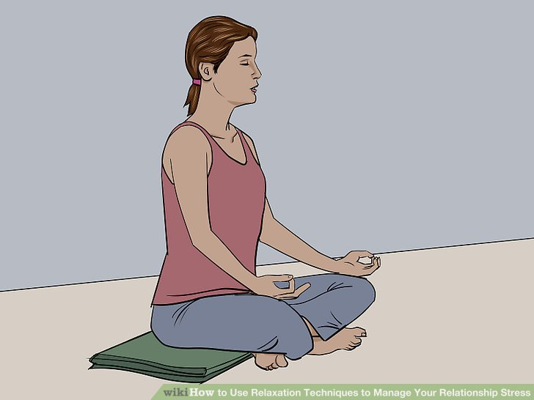
Evaluation of systematic desensitisation
Answer the following questions in your groups on MWBs
Gilroy et al (2003) followed up 42 patients who had been treated for spider phobia in three 45 minutes sessions of systematic desensitisation. A control group was treated by relaxation without exposure. At both 3 months and 33 months after the treatment the systematic desensitisation group were less fearful than the relaxation group
How does this finding support the effectiveness of systematic desensitisation? Why did they use a control group who had been treated with relaxation?

Slide 10
Evaluation of systematic desensitisation
Answer the following questions in your groups on MWBs
Do you think systematic desensitisation would work for all types of phobias? Are there any kinds of phobia that would be difficult to treat, or any circumstances that would make SD less appropriate?
More complex phobias, such as social phobia. CBT may be a more appropriate treatment for these. Also, if the person has more than one phobia SD will only treat one, whereas CBT will address both
Why may systematic desensitisation be considered to be more appropriate than flooding therapy?
Depending on the severity of the phobia, it may not be possible for someone to undergo flooding therapy. SD is more gentle and therefore may be more suitable for those whose phobia is very severe
Now, write a PEEL point using this information

Slide 11
Evaluation of systematic desensitisation
Read the case of Martin and, on mini-whiteboards, outline what problem it highlights for the use of systematic desensitisation
When Martin was a child he was subjected to physical abuse by his step-father. This usually happened at home when his mother was not in the house. The abuse usually took place in his step-father’s study, where his step-father went to listen to the radio, and write letters to his family. The room was always quite dark. Martin’s mother divorced her husband when Martin was nine, and Martin never saw him again. Martin has no conscious memory of the abuse. When Martin reached the age of 16 he developed a phobia of radios. He couldn’t be in a room with one and developed a fear of visiting places that he was unfamiliar with in case a radio was in the room. The effect was more severe if the radio was on. Martin received help for his phobia in the form of systematic desensitisation. After 8 sessions of SD, Martin’s phobia was cured. Recently Martin has begun to develop a fear of small spaces, especially if they are dark. He is finding hard to go to sleep with the light off.

Slide 12
Evaluation of systematic desensitisation
Now write up the following point for your notes, based on the discussions from the previous slide:
One of the issues with SD is that is only treats…
Some phobias may be a manifestation of ….
Therefore, treating the symptoms will not address the underlying cause and may lead to…
In these cases, SD may not be an…
Did you get: symptoms not causes, underlying psychological issues, symptom substitution, appropriate treatment

Slide 13
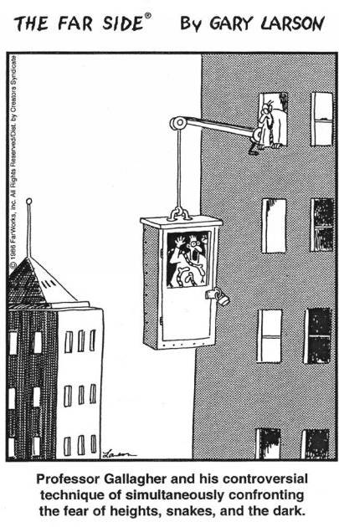
Evaluation of flooding therapy
Watch the clip on flooding therapy:
Answer the following questions in your groups on MWBs
Identify which of the evaluations that we have looked at for SD, would also be relevant for flooding therapy
Not appropriate for all types of phobia
Doesn’t address underlying causes
Ethical issues (less ethical than SD)
Kaplan and Tolin (2011) found that 65% of patients with a specific phobia who were given a single session of flooding showed no symptoms of specific phobia 4 years later
Write a statement linking the finding above to the effectiveness of the therapy

Slide 14
Snap plan
Write a snap plan for the following essay title:
Discuss behaviourist treatments for phobias (16 marks)

