Slide 1
Conformity to Social Roles
Zimbardo’s Stanford Prison Study

Slide 2
Starter: What social roles do you play?
Make a list of all the different social roles you play in a day, e.g. son/daughter, passenger on a bus, student, friend etc
Now write down next to each one how your behaviour changes in that particular role
Are you consciously aware of changing your behaviour in each situation?
Can social roles lead to undesirable behaviour? Give an example

Slide 3
Zimbardo’s Stanford Prison Study
Without any notes, write down as much as you can remember about Zimbardo’s Stanford Prison study. Write under the following headings:
Aims
Procedures
Findings
Conclusions

Slide 4
Zimbardo’s Stanford Prison Study
Now check against your preparation homework notes and in another colour write in anything you missed out, or anything you got wrong

Slide 5
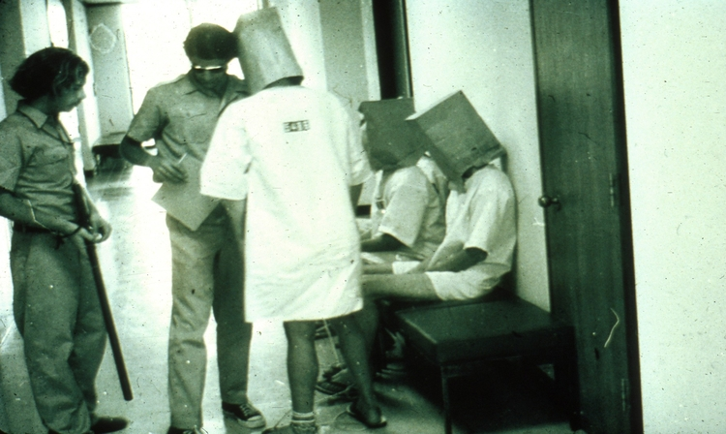
Now let’s try the Kahoot quiz

Slide 6
Evaluation of Zimbardo’s research
Answer the following questions on mini-whiteboards
Did all the guards behave in the same way during the experiment?
How can the answer to the question above be used as a criticism of the conclusions drawn from Zimbardo’s research?

Slide 7
Evaluation of Zimbardo’s research
Reicher and Haslam’s (2002) replicated Zimbardo’s study for the BBC. The findings were very different to Zimbardo’s. The guards were unwilling to impose authority over the prisoners, who rapidly took charge of the prison. Following the breakdown of authority in the prison, both groups attempted to establish a fair and equal social system. When this failed, a small group of prisoners took control and the study was called off.
On mini-whiteboards, answer the following questions:
What might account for these differences? Give at least two suggestions that link to types of external validity
Write a statement about the reliability of Zimbardo’s research, taking account of your answers to the other questions
Why may it be difficult to predict how someone might behave in a particular social role?

Slide 8
Evaluation of Zimbardo’s research
On mini-whiteboards:
Identify two ethical issues that were a problem in Zimbardo’s study and state exactly how they were an issue
N.B. bear in mind that the ethical guidelines were not in place when Zimbardo carried out this study. Therefore, when writing about the study, don’t make comments such as ‘Zimbardo broke the ethical guidelines’

Slide 9
Evaluation of Zimbardo’s research
Now, in your groups, write a PEEL point for each of the evaluations we’ve discussed:
Fails to explain individual differences
Lacks reliability
Ethical issues
Share the points out among the members of the group. After 5 minutes you will be asked to feed back on your points

Slide 10
Exam Practice
Answer the following questions individually without notes. You have 10 minutes to do so
1. Outline the procedures and findings of Zimbardo's research into conformity to social roles. (4 marks)
2. Many people have criticised Zimbardo’s prison study.
Identify and briefly discuss two reasons why people have criticised Zimbardo’s prison study. (6 marks)
Now swap over with someone in your group and give their answers a mark according to the mark scheme on the next slides

Slide 11
Outline the procedures and findings of Zimbardo's research into conformity to social roles. (4 marks)
Possible content:
• Procedure: details of the sample, the basic set-up, how participants were recruited, processes used to deindividuate/establish roles, etc. (1 mark for a brief point, an extra mark for elaboration, or another point)
• Findings: increased passivity of the 'prisoners' in the face of increased brutality of the 'guards'; study abandoned after 6 days; pathological reactions of the prisoners, etc. (1 mark for a brief statement on the findings, an extra mark for elaboration or another point)
Credit other relevant information.

Slide 12
Many people have criticised Zimbardo’s prison study. Identify and briefly discuss two reasons why people have criticised Zimbardo’s prison study. (6 marks)
Possible criticisms:
• Ethics – psychological harm – participants soon became distressed.
• Zimbardo himself took part in the action / was a participant observer.
Possible discussion points:
• Whether or not the distress should have been anticipated.
• Whether or not the consent gained was sufficiently informed.
• Zimbardo’s own behaviour affected the way in which events unfolded, thus the validity of the findings could be questioned.
• Use of examples from the study to support argument and elaborate on the criticisms given.
1 mark each for identifying two correct issues. Two further marks for elaboration.
For example:
Zimbardo’s study was unethical due to the distress caused to the participants (1 mark). Some participants showed signs of severe psychological distress, e.g. going on hunger strike, shouting and screaming (1 mark). This suggests that Zimbardo failed to protect his participants from harm, possibly because he had taken on the role of prison supervisor, rather than overseeing the procedure as a psychologist (1 mark)

