Slide 1
Exam style questions 2019

Slide 2
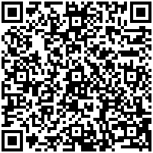
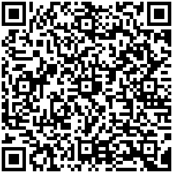
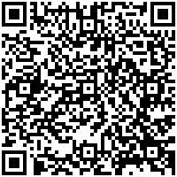
Paper 1: Attachment
Caregiver interactions, stages of attachment & Animal studies
Explanations & types of attachment
Maternal deprivation, institutionalisation & effects on later development

Slide 3
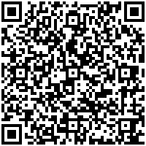
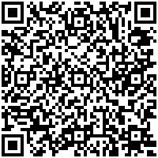
Paper 1: Memory
Nature of memory, models of memory & types of LTM
Forgetting
EWT and cognitive interview

Slide 4
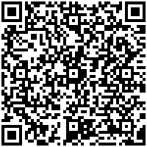
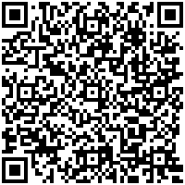
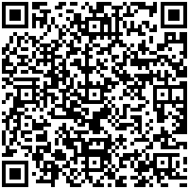
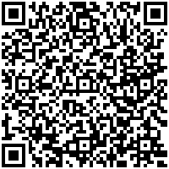
Paper 1: Psychopathology
Classifications of abnormality and characteristics of Psychological disorders
Explanations & Treatments for Phobia
Explanations & Treatments for depression
Explanations & Treatments for OCD

Slide 5
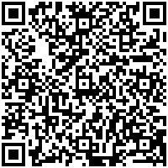
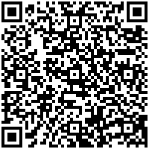
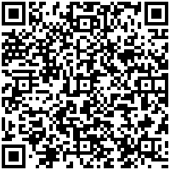
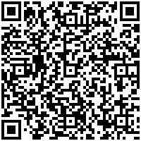
Paper 1: Social Influence
Conformity
Obedience
Resisting social pressures to obey & conform
Minority influence & social change

Slide 6
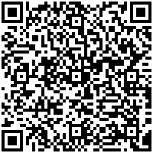
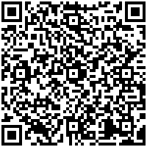
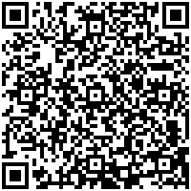
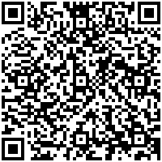
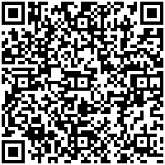
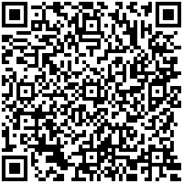
Paper 2: Approaches
Biological approach
Cognitive approach
Humanist approach
Learning approaches
Psychodynamic approach
Emergence of Psychology as a science
Comparison of approach

Slide 7
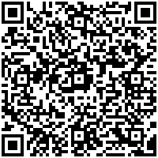
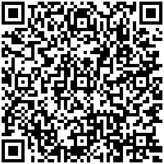
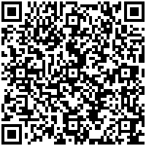
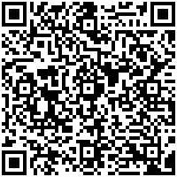
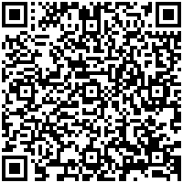
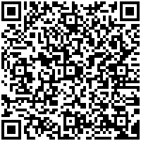
Paper 2: Biopsychology
Biological Rhythms
Endocrine system
Fight or flight
The nervous system
Studying the brain
The brain

Slide 8
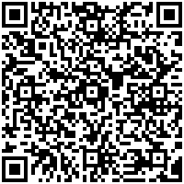
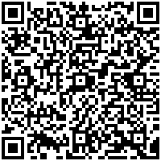
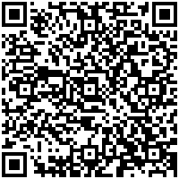
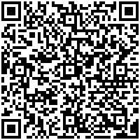
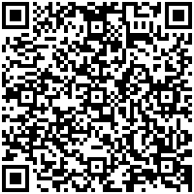
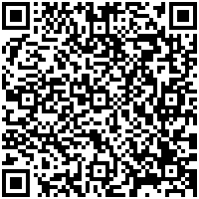
Paper 2: Research Methods
Experimental method
Observations
Correlations
Case studies
Content analysis
Self-report techniques
Descriptive stats 1
Descriptive stats 2
Inferential stats

Slide 9
Paper 3: Issues & Debates
Ethical issues
Free will & determinism
Gender bias
Ideographic vs nomothetic
Nature vs nurture
Reductionism vs holism

Slide 10
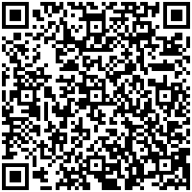
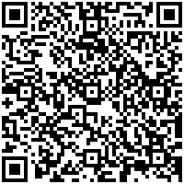
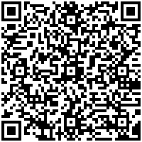
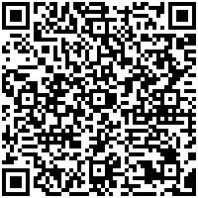
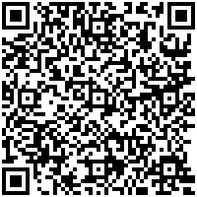
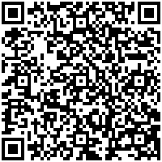
Paper 3: Gender
Sex & gender
The role of chromosomes & hormones
Cognitive explanations
Psychodynamic explanations
Atypical gender development
Social learning theory

Slide 11
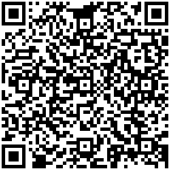
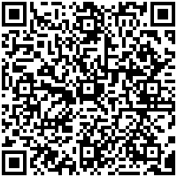
Paper 3: Schizophrenia
Diagnosis & classification
Explanations of schizophrenia
Treatments for schizophrenia

Slide 12
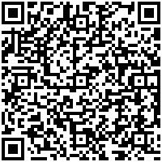
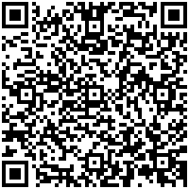
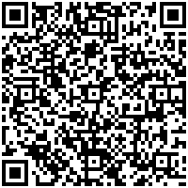
Paper 3: Forensic Psychology
Defining and measuring crime
Offender profiling
Biological explanations
Psychological explanations
Dealing with offending behaviour

Slide 13
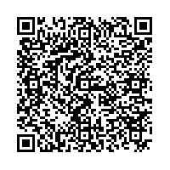
Links to all folders
https://drive.google.com/drive/folders/1Fs4sWLgbp-6Ct0vxCWNyQoFZkf2BV-79?usp=sharing

