Slide 1
Factors that affect conformity
Size of group, difficulty of task, unanimity

Slide 2
Starter Task
Look at the screen carefully. You will be shown a picture for a short period of time and you will be asked to say how many animals are in the picture
When the picture disappears off the screen, write your answer down on a piece of paper. Don’t share this information with anyone else at this stage
Are you ready?

Slide 3
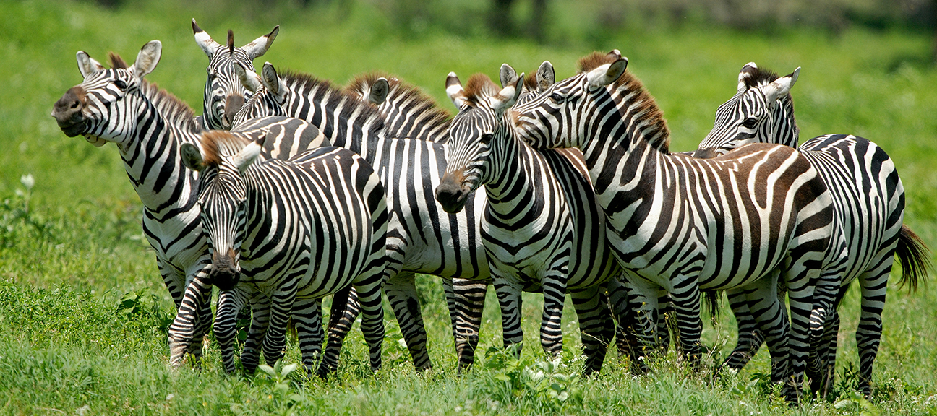
How many zebras are in this picture?

Slide 4
How many?
Write down your answer
Now discuss your answer with other members of your group
You can now decide to change your original estimate if you choose. If this is the case, write down the new answer
We are now going to repeat the whole task again, but with a different picture, so watch the screen carefully and count how many animals there are

Slide 5
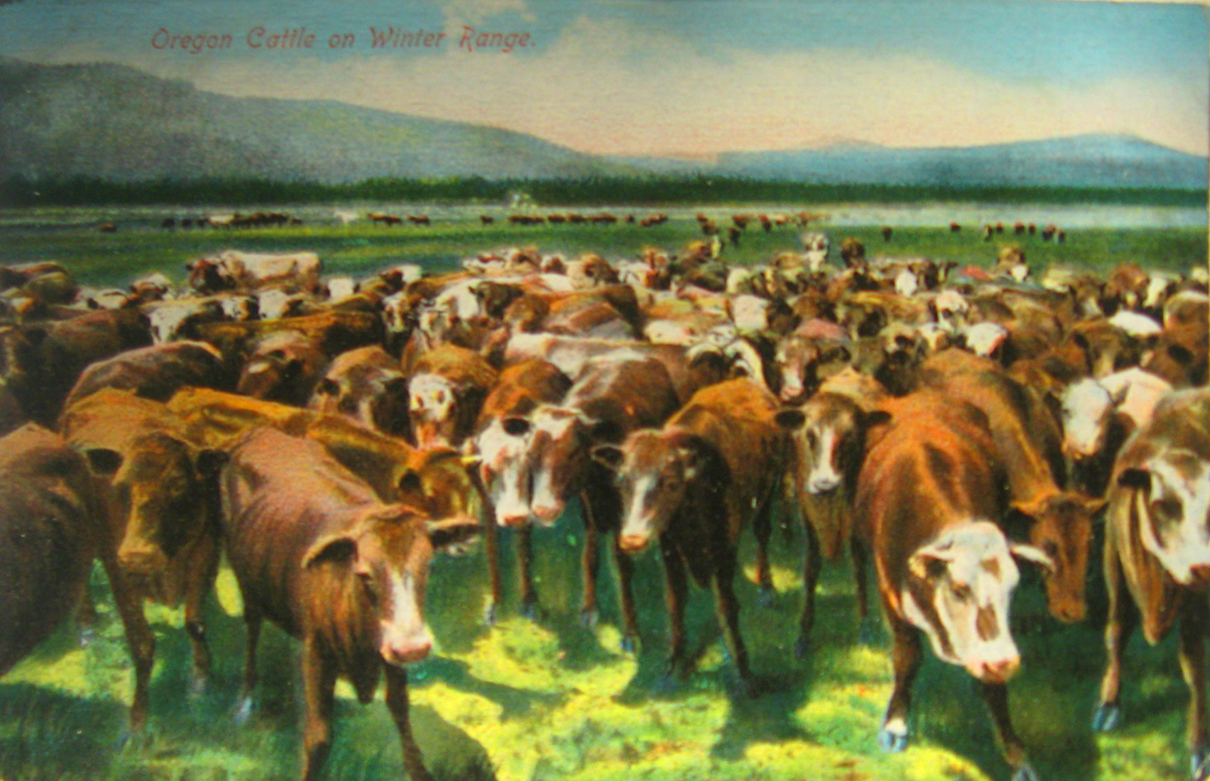
How many cows are in this picture?

Slide 6
How many?
Write down your answer
Now discuss your answer with other members of your group
You can now decide to change your original estimate if you choose. If this is the case, write down the new answer

Slide 7
What do your responses show?
Feedback these answers on mini whiteboards
Did you change your estimate after discussion with the group in the first trial – yes or no?
Did you change your estimate after discussion with the group in the second trial – yes or no?
From what you have read about in your preparation homework, why would people be more likely to change their opinion in the second trial?

Slide 8
ON MWBs, answer the following question
What three factors are thought to influence conformity rates?
Size of the group
Type of task
Unanimity

Slide 9
What do you remember from the preparation homework?
Let’s try a quizlet live to find out

Slide 10
What do you remember from the preparation homework?
Now go up to BWBs in your groups and write as much as you can remember about the research into all three factors
Group size
Unanimity
Difficulty of the task
Now check against your packs to see if you got the right information

Slide 11
Exam Practice
Answer the following question individually:
Outline research into one or more factors that have been found to affect conformity (4 marks)
Now swap papers and award a mark to the answer in front of you, using the guidance on the next slide

Slide 12
Mark Scheme
Asch manipulated the size of the majority to record the effect it had on the participant. Using his original procedure, he varied the number of confederates in the group. Participants were tested using either 1, 2, 3, 4, 8, 10 or 15 confederates
Conformity was only 3% when there was one confederate
Conformity was 13% when there were two confederates
When there were three confederates, conformity increased to 33% and didn’t increase much beyond this regardless of the number of confederates
In some conditions, a larger group of 15 confederates led to slightly less conformity, maybe because the participant was more likely to become suspicious when there was such a large group
When the participant had one (confederate) ally who gave the right answer before the participant answered, conformity dropped to 5.5%
Asch found that when the confederate dissenter gave a different answer from the majority, but that answer was still incorrect, this was equally effective in reducing conformity in the participant. Asch concluded from this that the important factor was that the participant had support for deviating from the group, not support for his answer
Asch found that when he made the length of the lines more similar, conformity increased. This supports the view that conformity is more likely when the task is difficult

Slide 13
Evaluation of the research
Read the following scenarios and suggest how they might be dealt with according to what you have learnt about the research in this area
Max is 6 years old. He is very badly behaved at school. In the classroom children sit in groups of 4. In Max’s group, there is another boy who also has difficult behaviour.
Suggest how Max’s teacher might deal with this situation and why the strategy you suggest might work

Slide 14
Evaluation of the research
Max is 6 years old. He is very badly behaved at school. In the classroom children sit in groups of 4. In Max’s group, there is another boy who also has difficult behaviour. Suggest how Max’s teacher might deal with this situation and why the strategy you suggest might work
Max could be put in a group with three other children who are well behaved
This may improve his behaviour because the fact that the majority is behaving unanimously means that Max is more likely to conform
The research suggests that the maximum conformity effect can be achieved with a majority of three, therefore, it is likely that Max’s behaviour will change

Slide 15
Evaluation of the research
Read the following scenarios and suggest how they might be dealt with according to what you have learnt about the research in this area
Greta is sitting on a jury that is trying a man for murder. They are at the deliberation stage. All of the other jurors think that the man on trial is guilty, but Greta doesn’t. The foreman asks all of the jurors to declare their views on whether the man is guilty.
Explain why it would be difficult for Greta to give her true opinion in this situation.
What might be done to make it easier for her to give her true opinion.

Slide 16
Evaluation of the research
Greta is sitting on a jury that is trying a man for murder. They are at the deliberation stage. All of the other jurors think that the man on trial is guilty, but Greta doesn’t. The foreman asks all of the jurors to declare their views on whether the man is guilty. Explain why it would be difficult for Greta to give her true opinion in this situation. What might be done to make it easier for her to give her true opinion.
It would be difficult for her to give her true opinion because she is going against a unanimous majority. Research suggests that it is much easier to dissent from the majority if you have even one supporter
It would be a lot easier for Greta to give her true opinion if she was able to write it down privately. This is useful to know in cases where people maybe put under intense pressure to conform

Slide 17
Evaluation of the research
Read the following scenarios and suggest how they might be dealt with according to what you have learnt about the research in this area
Trevor runs a stationery company with seven other people. They are all directors of the company. They also employ one other member of staff who is not a director. Currently the office is in the centre of town. Trevor and five of the board of directors support moving the company to a building on the outskirts of the town as it will cut down on running costs. Two of the directors are not in favour as it will be a lower profile for the company. They plan to have a meeting to persuade their member of staff, who is sceptical about the move, that it move would be beneficial. The two directors who are not in favour have made it clear that they will make their feelings clear at the meeting.
Are they likely to be successful in persuading their staff? Give a reason for your answer
How does this relate to the implications/applications of the research?

Slide 18
Evaluation of the research
Trevor runs a stationery company with seven other people. They are all directors of the company. They also employ one other member of staff who is not a director. Currently the office is in the centre of town. Trevor and five of the board of directors support moving the company to a building on the outskirts of the town as it will cut down on running costs. Two of the directors are not in favour as it will be a lower profile for the company. They plan to have a meeting to persuade their member of staff, who is sceptical about the move, that it move would be beneficial. The two directors who are not in favour have made it clear that they will make their feelings clear at the meeting.
Are they likely to be successful in persuading their member of staff? Give a reason for your answer. How does this relate to the implications/applications of the research?
They are unlikely to be successful as they are not presenting a unanimous majority, which will make it easier for their member of staff to maintain his own opinion
It shows the importance of presenting a unanimous majority, in a business setting, when trying to persuade workers to adopt certain practices

Slide 19
Evaluation of the research
Read the following scenarios and suggest how they might be dealt with according to what you have learnt about the research in this area
Carmen often resists pressure to conform to what her friends are doing. Yesterday they wanted to go to the cinema, but she didn’t so decided not to go. She has her own style of clothing which is different from her friends. However, the other day, she was with her friends and they were trying to work out how many gallons of water the pacific ocean would contain. Carmen personal view was much lower than her friends’, but she adjusted her view so that is was more in line with theirs.
Explain why Carmen conformed in this situation, linking what you have learned from the research into factors that affect conformity
What previous theory does it link to?
How could the research in this area be useful to those working in education?

Slide 20
Evaluation of the research
Carmen often resists pressure to conform to what her friends are doing. Yesterday they wanted to go to the cinema, but she didn’t so decided not to go. She has her own style of clothing which is different from her friends. However, the other day, she was with her friends and they were trying to work out how many gallons of water the pacific ocean would contain. Carmen personal view was much lower than her friends’, but she adjusted her view so that is was more in line with theirs. Explain why Carmen conformed in this situation, linking what you have learned from the research into factors that affect conformity. What previous theory does it link to? How could the research in this area be useful to those working in education?
It is likely that Carmen conformed because the task was difficult
This links to informational social influence. People tend to look to others for the right answer/way to behave, when they are not sure of the right answer
This is useful for educators to know, as it may be more effective to have students working in groups when working on a difficult task

Slide 21
Exam practice
How would you answer the following question?
Discuss factors that affect conformity (16 marks)
Think about:
What would you present as the AO1 content?
What would count as evaluation?

Slide 22
AO1:
Details of the research in each of the areas (unanimity, type of task, group size
AO3:
Applications of the research (using what we know about group size to encourage good behaviour e.g. in schools)
Applications of the research (using what we know about unanimity to prevent people from being pressured into conforming, e.g. in a jury situation
Implications of the research (explaining what has been found about greater level of conformity on difficult tasks in terms of informational social influence)

