Slide 1
What is obsessive-compulsive disorder (OCD) 3 marks
Answer 1: OCD has three components. The behavioural component is having compulsions which the sufferer tries to avoid. The emotional component is accompanying anxiety and distress. The cognitive component is the obsessive thoughts that give rise to obsessions.
Answer 2: OCD is an anxiety disorder where sufferers have obsessions and compulsions. Obsessions are recurring intrusive thoughts and compulsions are repetitive actions that the sufferer feels must complete in order to stop the obsessions.
Answer 3: An obsessive compulsive disorder is a recurring intrusive thought that produces anxiety. In order to reduce this and feel better many OCD sufferers feel compelled to do certain things. For example, they might wash their hands five times a day. This reduces their anxiety.

Slide 2
On big boards
Write up all the characteristics of OCD and put them together in terms of behavioural, emotional, Cognitive
Answer the question below

Slide 3
Notes:
Starter question

Slide 4
Biological explanations and treatments
Genetic and Neural explanations
Drug therapy

Slide 5
Explanations
GENETICS
The genetic explanation looks at if individuals inherit a genetic disposition to developing OCD.
An example of your first degree relatives would be your grandad or uncle.
A family study by Nestadt found concordance rates of 11.7% for first degree relatives compared to 2.7% in the control group.
A concordance rate is the probability that a pair of individuals will both have for e.g. OCD, given that one of the pair already has OCD.
The concordance rate found by Carey (1981) for MZ twins suffering obsessive symptoms was 100% compared to 0% for DZ.
OCD is polygentic and it is thought that there may be up to 230 genes involved in its cause.
TRUE OR FALSE – You have a few minutes to read the statements and, on your own, decide if they are true of false (write answers down on a MWB)

Slide 6
True of false
The genetic explanation looks at if individuals inherit a genetic disposition to developing OCD. True
An example of your first degree relatives would be your grandad or uncle. False
-mum, dad, brother, sister
A family study by Nestadt found concordance rates of 11.7% for first degree relatives compared to 2.7% in the control group. True
A concordance rate is the probability that a pair of individuals will both have for e.g. OCD, given that one of the pair already has OCD. True
The concordance rate found by Carey (1981) for MZ twins suffering obsessive symptoms was 100% compared to 0% for DZ. False
-MZ 87%, DZ 47%
OCD is polygentic and it is thought that there may be up to 230 genes involved in its cause. True

Slide 7
Now have a go at the evaluation activity. You need 3 highlighters.
Pg’s 33-34 in pack:
One colour-point
One colour-explain/evidence
One colour-so what?
Challenge-add some SS points (see below) to the relevant evaluation paragraphs for A and A* answers!
SS However we can’t say for certain that OCD is genetic because the concordance rates for MZ twins is not 100% so other factors must play a part. One of these factors could be….
SS This means that if we wanted to use the explanation to help work out who might be a risk……
SS This suggest that maybe we should look at the diathesis stress model…….

Slide 8
Neural explanations
This includes neurophysiological (areas of the brain) and bio-chemical causes. Lets look at the brain explanation first.
Match the cards
Then label the brain, using the cards
really stuck? Use your homework notes

Slide 9
Orbitofrontal cortex-
This is found in the prefrontal cortex just behind the eyes and is part of a brain circuit. Its main job is to turn sensory info into thoughts and actions.
Basal ganglia-
It is thought to be linked to the pre-frontal cortex and the caudate nucleus in located within it. Patients who suffer head injuries in this region often develop OCD-like symptoms, following their recovery.
Caudate nucleus-
Located in the basal ganglia- regulates the messages from the OFC to the thalamus, stopping the thalamus from getting excited if not necessary.
Thalamus-
This gets excited if it receives messages from the OFC via the caudate nucleus and then carries out action and sends info back to the OFC.

Slide 11
Brain of an OCD sufferer and non sufferer-what can you see?

Slide 12
So the Orbitofrontal cortex, caudate, nucleus and thalamus create a kind of circuit.
Turn over your brain diagram.
Fill in the gaps to create a flow diagram of how a “normal” and an OCD brain would work after walking past someone with a slight cold.
-I’ve totally got this from my flipped homework- fill in freestyle
-Still not totally sure but have a good idea-use the key terms in the box to help.
I found it really tricky- Use your packs and then ask me!
Finished before every body else? Write out the serotonin explanation in the challenge box on the sheet.

Slide 13
Orbitofrontal cortex sends a message of panic
Caudate nucleus
decides isn’t a problem
supresses signals from OFC
Circuit ended

Slide 14
Orbitofrontal cortex sends a message of panic
Caudate nucleus (is faulty)
Can’t supress signals from OFC so passes info on
Thalmus-receives message of panic and gets excited
carries out the action
Wash hands and face 5 times with disinfectant

Slide 15
Testing your knowledge
Outline one neural explanation of OCD (4 marks)
Use the structure below to scaffold your answer
-One sentence about PET scans and the area of the brain they found had higher activity for OCD patients.
-One sentence about what the OFC does
-Explain the circuit for a non OCD sufferer
-Explain the circuit for someone with OCD
-Make sure you mention how the loop keeps repeating which explains why compulsions are repetitive rituals.
Need a hand? Use your flow diagram but NO PACKS!

Slide 16
Biochemical explanation
What bio-chemical is linked to OCD?
Serotonin
Is it high or low levels that increase your risk of OCD?
Low
How is this linked to mood?
Normal passing on (transmission) of mood-relevant info does not take place so mood and mental processes are effected, i.e. OCD.

Slide 17
Evaluating explanations in Psychology
How do we evaluate explanations??
Use of supporting evidence
What else?

Slide 18
How do we evaluate explanations or theories of behaviour?
Evidence – supporting/contradicting
Evaluation of supporting evidence
What are the limitations of the explanation? E.g. Does it fail to explain any aspect of the behaviour?
Why is this a good explanation?
Practical/useful applications
Comparison of explanation with another
Relevant issues and debates
TASK:
1. Read the evaluation points for the neural explanations on pg 36 and decide which ones are examples of the points above.
2. Research additional evaluation points – one strength and one limitation of the neural explanations of OCD. (Hint: Look at the strengths and weaknesses of the biological approach in the Approaches pack)

Slide 19
Biological Treatments
From your flipped homework…..
What are SSRI’s? Can you name a type of SSRI?
How do they work?
Other treatments:
Tricyclics - have the same affect as SSRI’s but have much worst side effects so only used if the above do not work.
SNRI’s- newly developed anti depressant that increase serotonin and noradrenaline.
Drugs are often used alongside CBT or other treatments.

Slide 20
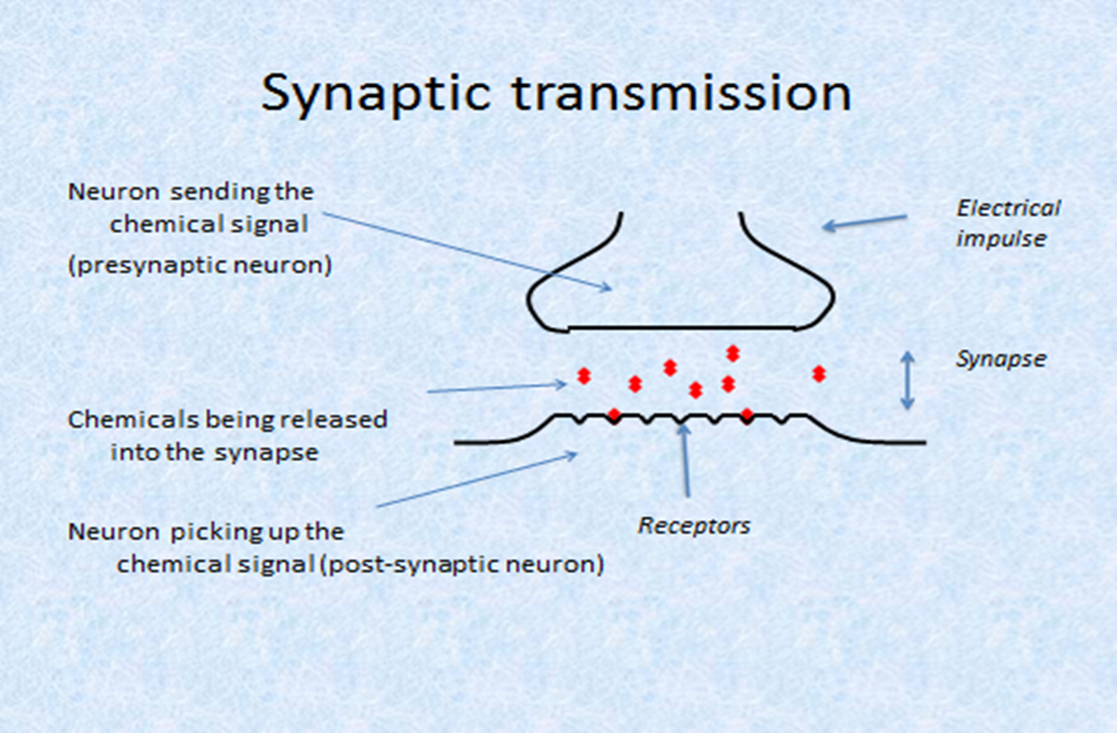
https://www.youtube.com/watch?v=WhowH0kb7n0

Slide 21
How drug therapies work
In pairs:
Use this picture to help you to write a more detailed explanation of how SSRI’s work

Slide 22
How do we evaluate treatments???
Appropriateness
Effectiveness

Slide 23
Evaluation - debate
You will be given 7 minutes to prepare an argument either for or against the use of drug therapy.
You will then be joined together in a group and will have a debate on the use of drug therapy!
Tips: make sure you know why your point is relevant, think about what the opposition might say – can you think of a counter-argument to that

Slide 24
On wallboards:
Evaluate the use of biological treatments for OCD (10 marks)
Based on the debate you had last lesson, answer the question above.
No notes/packs – work together!

Slide 25
Approach | Behavioural | Cognitive | Biological
Related disorder | Phobias | Depression | OCD
Characteristics (emotional, cognitive and behavioural) of the related phobia
General assumptions of the approach
How does this approach explain the related disorder?
How does this approach treat the related disorder?
Key points only! You have 10-15 mins!

