Slide 1
Romanian Orphans
The effects of institutionalisation

Slide 2
Starter Question
As a child, Sally's primary attachment figure was her mother however in the first five years of Sally’s life, her mother worked away from home for long periods, sometimes not coming back for months. Her father did his best to be a substitute for her mother. Sally is now five and about to start school.
Task:
What would Bowlby predict would happen when Sally starts at school and why? Come up with specific examples and link them to what you know about the theory of maternal deprivation

Slide 3
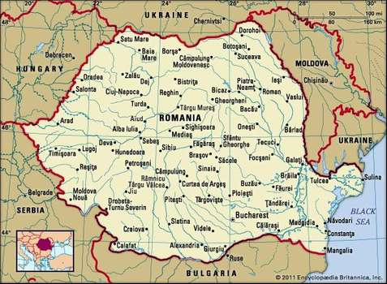
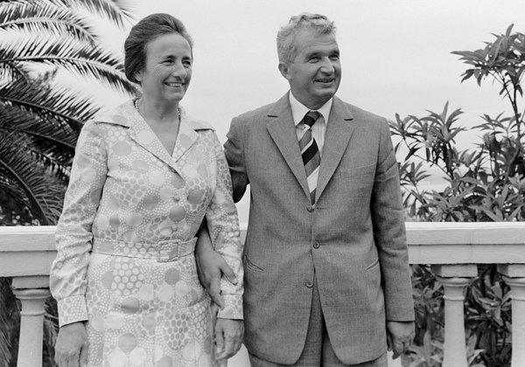
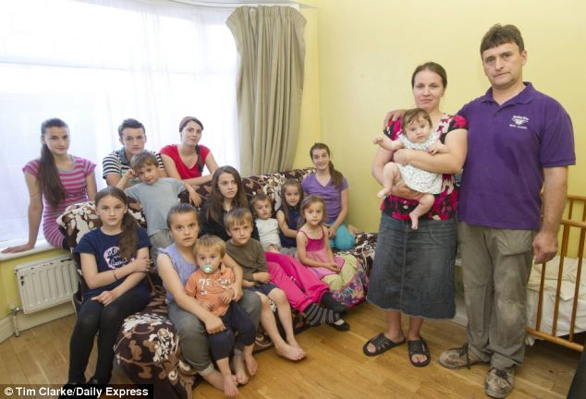
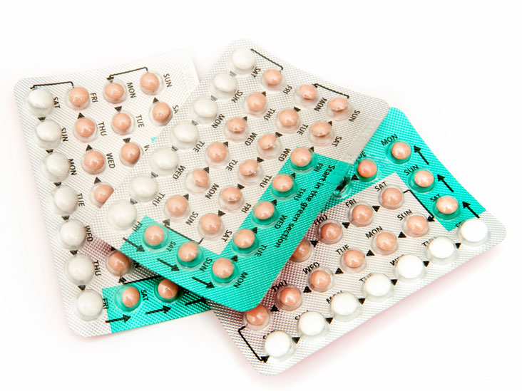
Romanian Orphans
In your groups, use the pictures to explain what happened in Romania that led to so many children becoming institutionalised

Slide 4
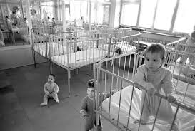
Romanian Orphans
The population of Romania increased from around 18 million in 1960 to nearly 23 million in 1992
This increase is because the dictator Ceaușescu, in an attempt to boost the country's population, made abortion illegal, to reverse the very low birth rate and fertility rate. Mothers of at least five children would be entitled to significant benefits, while mothers of at least ten children were declared heroine mothers by the Romanian state. This combined with a failing economy meant that families often couldn’t feed their large families
Therefore, rather than have the rest of the family starve. Many children in Romanian orphanages were not actually orphans

Slide 5
Romanian Orphans
What do you remember?
Answer the questions in your groups
What method of research was used in Rutter’s (1998) study?
How many Romanian children were studied?
Give two things that they were assessed for on arrival in the UK
At what age were they assessed again?
Who were the control group?
What was the average I.Q. score for the Romanian orphans on arrival in the U.K.?
What was the average I.Q. score of the orphans who were adopted after the age of 6 months?
51% of them were in the bottom 3% of the population on what measure?
At age 4, what proportion of the Romanian orphans had improved their I.Q. scores?
Which group showed the slowest rate of improvement?
What conclusions can be drawn from Rutter’s research?

Slide 6
Romanian Orphans
What method of research was used in Rutter’s (1998) study?
How many Romanian children were studied?
Give two things that they were assessed for on arrival in the UK
At what age were they assessed again?
Who were the control group?
What was the average I.Q. score for the Romanian orphans on arrival in the U.K.?
What was the average I.Q. score of the orphans who were adopted after the age of 6 months?
51% of them were in the bottom 3% of the population on what measure?
At age 4, what proportion of the Romanian orphans had improved their I.Q. scores?
Which group showed the slowest rate of improvement?
What conclusions can be drawn from Rutter’s research?
Natural experiment
111
Height, cognitive functioning, I.Q. physical ability
4 years
52 British adopted children
63
45
Weight
All of them
Those adopted after 6 months
Children can recover from even severe privation, although a minority did display some long-term negative effects. The early children are adopted, the quicker the recovery will be

Slide 7
Romanian Orphans
Kumsta (2010) identified 4 patterns associated with institutional deprivation (in a minority of children) that occurred by the age of 6 and were still present several years later:
Write the terms in the box down and then on the next slide, identify which child is displaying which of the symptoms and say why
Quasi-autism
Disinhibited attachment
Cognitive impairment
Inattention/over activity

Slide 8
Romanian Orphans
Simone is 6 and loves going out with her mum on the bus. She likes to go and talk to go and sit beside the other adults on the bus and have a chat with them. She saw a lady wearing a fake-fur coat and went to give her a cuddle
Jake doesn’t like school very much. He struggled as a young child and was always in the bottom 10% of the class in assessments. He improved by the time he got to secondary school, but only managed to get three GCSEs above a grade D
Carly likes to collect match boxes. She now has around 2,000. She sits in her room for hours laying them out on the floor and arranging them in different orders. She prefers this to being with other people as she finds it hard to get along with other children
David has tried lots of hobbies. He started to make model aeroplanes, but didn’t manage to complete any of the them. He got bored with it once it became difficult. His mum sent him to piano lessons, as he has always wanted to learn the piano, but didn’t practice and therefore found it difficult to progress. He asked his mum if he could stop going after a few months

Slide 9
Exam Practice
Anca is an orphan who was adopted by a British couple when she was 2 years old. Before being adopted, Anca lived in an institution with lots of other children in very poor conditions. Although under weight and short for her age she is settling in well but her new parents are understandably concerned about how Anca’s early experiences may affect her in years to come.
Use your knowledge of the effects of institutionalisation to advise Anca’s new parents about what to expect
You have 5 minutes to write your answer together.
You can bullet point your answer as long as you have the detail in the answer.

Slide 10
As she is a later adoptee, research suggest that any effects on Anca may be long term and more severe than if adopted before 6 months
Research shows that by 10 ½ Anca should not have any physical differences
Cognitive impairment/inattention- Anca may have a low IQ, problems with concentration – Anca may struggle more at school than other children/may not learn new behaviours, concepts as quickly
Anca is an orphan who was adopted by a British couple when she was 2 years old. Before being adopted, Anca lived in an institution with lots of other children in very poor conditions. Although under weight and short for her age is settling in well but her new parents are understandably concerned about how Anca’s early experiences may affect her in years to come.
Use your knowledge of the effects of institutionalisation to advise Anca’s new parents about what to expect. (6 marks)
lack of internal working model – Anca may have difficulty interacting with peers, forming close relationships, etc
disinhibited attachment – Anca may not know what counts as ‘appropriate’ behaviour towards strangers.
quasi-autism – Anca may have a problem understanding the meaning of social contexts, may display obsessional behaviour for example an excessive interest in a hobby or subject.

Slide 11
Evaluation of the Romanian orphans Research
Task: Answer questions in pairs on MWBs:
What are the implications of Rutter’s findings for adoption practices?
What are the implications of Rutter’s research for institutions caring for children?
What does this suggest about Rutter’s research?

Slide 12
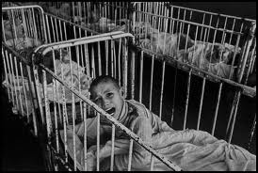
Evaluation of the Romanian orphans Research
In pairs on MWBs:
Why might it be difficult to draw any firm conclusions about the effects of institutionalisation from the studies of Romanian Orphans?
Think about the disadvantages of using this type of study

Slide 13
Evaluation of the Romanian orphans Research
Answer the following questions in pairs:
What does Rutter’s research suggest about Bowlby’s maternal deprivation hypothesis?
Why might Rutter’s research be considered more useful than Bowlby’s?

Slide 14
Evaluation of the Romanian orphans Research
Now complete the worksheet on the evaluation of the research into the Romanian orphans

Slide 15
Let’s see how well you can remember the facts & figures (AO1) for the Romanian orphan studies
https://quizlet.com/_59pchb

