Slide 1
Introductory Questions
What things can this baby do instinctively from birth?
Why do you think all babies can do these things from birth?
Human adults are hard wired to want to protect babies. What is it about babies, (think characteristics/behaviours) that makes this more likely? (Use the picture to help you)
All of these factors help to develop attachments between adult and child. Why is this so important in the short and long term ?

Slide 2
From your preparation homework..
On mini whiteboards, each person should write down one thing that they learned from the preparation homework (each person must have something different)
The research suggests that interactional synchrony is more important than reciprocity. Why do you think this is the case?

Slide 3
In pairs, you will be answering one of the following questions:
Define attachment, you must include the 3 behaviours displayed (3 marks)
Define reciprocity (2 marks)
Define interactional synchrony (2 marks)
4. How do reciprocity and interactional synchrony overlap and what is the difference between them? (2 marks)
5. How do we ensure the reliability of our observations of small children (3 marks)
3 minutes without notes

Slide 4
Pick on a pair: Define attachment
A two-way, enduring, emotional bond between two individuals, in which the following behaviours are displayed
Seeking proximity, especially at times of stress.
Distress on separation and pleasure when reunited
Secure base behaviour-so infants are happy to explore but regularly return to attachment figure.

Slide 5
In pairs on MWB:Is this baby attached? Use the 3 behaviours from the definition to answer the question.

Slide 6
Pick on a Pair: What is reciprocity?
‘reciprocity’ means ‘two way’, in other words, both partners are involved
Pick on a Pair: What is interactional synchrony?
It is reciprocal, but it is rhythmic and has a mutual focus and can include infant and caregiver mirroring each other’s behaviour

Slide 7
In order to really understand reciprocity and interactional synchrony you need to look at them together
Pick on a pair:
How do reciprocity and interactional synchrony overlap and what is the difference between them? (2 marks)
Overlap- any interaction that has interactional synchrony will always be reciprocal
Difference- Interactional synchrony tells us about the quality of an interaction whilst reciprocity just tells us it is 2 way. An argument is reciprocal!

Slide 8
Watch the following clips and decide whether they are examples of reciprocity or interactional synchrony
This is both. It is a two way interaction, so reciprocal and the dad is doing it in response to the babies laughs, therefore they are emotionally in sync
This is just reciprocity – it is two-way, but negative and aggressive and therefore will not lead to secure attachments

Slide 9
Most research into care-giver infant interactions uses observations…..
Pick on a pair:
How do we ensure the reliability of our observations of small children (3 marks)
More than one observer
Compare their observations
observers should produce the same record of observations and if there is 80% or above agreement that the data has high inter-observer reliability.

Slide 10
Let’s look at some research..
Meltzoff and Moore (1977) did an observational study on infants
Write down the questions below so that you can answer them while watching the following clip
How old were the babies?
What different things did the adult do?
How did the baby respond?
How old was the youngest baby ever studied?
Why does this suggest that interactional synchrony is innate?

Slide 11
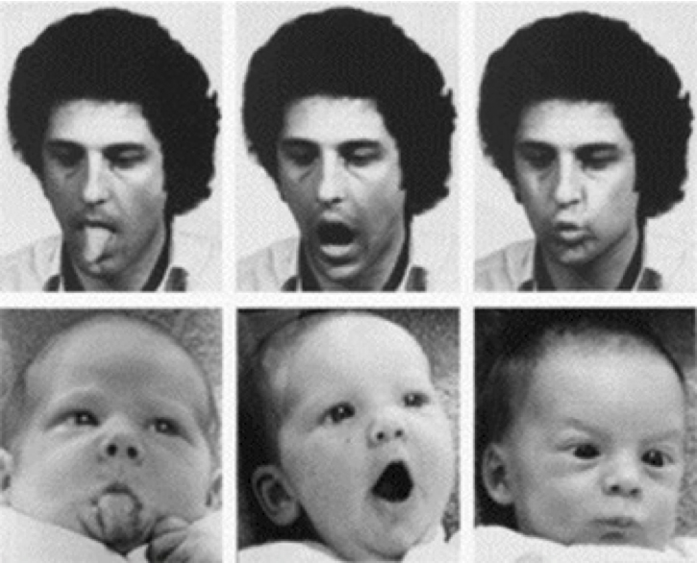
Why is Meltzoff and Moore (1977) a good piece of research? (Write some answers down on MWBs)
They used independent observers who had no knowledge of what the children had just seen to judge the babies behaviours
Each observer scored the tapes twice!
Inter-rater reliability was high-so what % agreement must there have been between observers?
Above 80% - in fact it was 92% or .92!
BUT babies do wave their arms about a lot and spit and stick out tongues so this could all be just a fluke! So potential validity issue
Very carefully controlled, filmed from many angles so very fine details so improves validity

Slide 12
Here is a second piece of research. On MWB, what do you think the findings were?
Belsky (1984) observed mother-infants interactions when the infant was 1,3 and 9 months old and then at 12 months assessed how attached they were to their mothers using the strange situation (see later sections)
For each of the mothers and infants below predict if they will be securely or insecurely attached?
Mothers and infants with low levels of reciprocal interaction
Mothers and infants with intermediate (medium) levels of reciprocal interaction
Mothers with very high levels of reciprocal interaction
Now hold up your boards

Slide 13
This what they found..
Those with a low levels of reciprocal interaction with mothers tended to be insecurely attached (insecure resistant).
Why?
mothers with high levels were over stimulating their babies so it’s about the sensitivity of the interaction and not just the amount of interaction (i.e. not just the reciprocity but the interactional synchrony)
Those with intermediate levels of reciprocal interaction were securely attached
Those with the highest levels of reciprocal interaction were surprisingly insecurely attached

Slide 14
So does the level of interactional synchrony predict attachment?
So it is interactional synchrony that is the key to attachment
YES! Other observational research (in your pack) found that..
interactional synchrony =secure attachments
Minimal involvement=insecure attachment

Slide 15
Linking to the exam
Write a plan for the following essay:
Discuss research into care-giver infant interactions. (16 marks)
Have a go at doing this on your own for 5 minutes. Think about what will go into the AO1 part and what will go into the AO3 part
Now let’s have a look at how we can structure this..

Slide 16
Outline: 6 marks
State that there are 2 main types of caregiver-infant interactions: reciprocity and interactional synchrony
Briefly define reciprocity and interactional synchrony
Outline 2 pieces of research that looks at these interactions (do you remember which two we looked at?)
Meltzoff (sticking tongues out) and Belsky
(secure/insecure attachments)

Slide 17
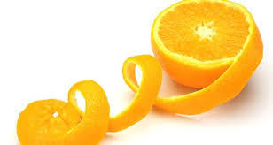
Now for evaluation: 10 marks
3 PEEL points for full marks
PEEL?
P-make your point
E-explain your point, or present findings of research to support your point (evidence)
E-either elaborate on that information OR give some counter evidence
L-now link all of this back to the essay title

Slide 18
Point one- You are going write a point about the methodology of the research studies in this area. See if you can complete the point, using the guidance below
P- Research into caregiver infant interactions tends to use controlled observations
E-This is a strength of the research because…
E-However, these studies are not without flaws, for example…. (clue: waving arms)
L- Now state how this issue with observing babies can impact on validity of the research but, overall, we can conclude that the research is strong

Slide 19
Point 2: Challenging evidence
P-There is evidence that challenges the importance of interactional synchrony in attachment
E-It was found that in a small group of Kenyan mothers, there was less physical contact and interaction with a specific caregiver (multiple-caregiver setting).
E-but they still had high proportions of secure attachments
Write a link back statement saying what the research suggests about the importance of interactional synchrony in attachment

Slide 20
Point 3: Practical applications
Watch the following clip (2.40-4.45)
How is reciprocity and interactional synchrony used through theraplay to improve attachment?
Anything which has practical applications increases the usefulness of the explanation or research

Slide 21
To summarise..
AO1
Define/explain reciprocity, interactional synchrony, 2 research studies in caregiver infant interactions
AO3
3 peel points:
1-use of observations in these studies
2-challenging evidence
3-practical applications

