Slide 1
Memory
Cognitive psychology
Unit 1

Slide 2
Your memory? A quick demonstration of the complexities of memory
How good is your memory? Can you remember a list of 8 words? Really try to recall all eight of these words. You’ll have 20 seconds to read them, then 20 seconds to write as many down as you can.
House
Cat
Plate
Box
Kite
Bell
Shoe
Coat
Now let’s check them
Lets try again, with different words… ready?

Slide 3
Your memory?
Autobiographical
Incompatibility
Electromagnetism
Denationalisation
Justifiability
Epistemological
Vegetarianism
Multiculturalism
Now let’s check them
Autobiographical
Incompatibility
Electromagnetism
Denationalisation
Justifiability
Epistemological
Vegetarianism
Multiculturalism
Compare your two scores? Which did you do better on? What about your classmates, did they do the same?

Slide 4
Try and list as many reasons why the second list was harder to recall than the first?
Length of words (letters/syllables)
Length of time to read words
Less common words?
You were more bored second time around?
Anything else?

Slide 5
Today
We will just deal with A01 Skills (that’s you ability to describe and outline)
1: The differences between STM and LTM and the nature of memory
2: The Multi-Store Model of Memory as proposed by Atkinson and Shiffrin (revision from induction lessons)
3: The Working Memory Model
4: Differences in LTM

Slide 6
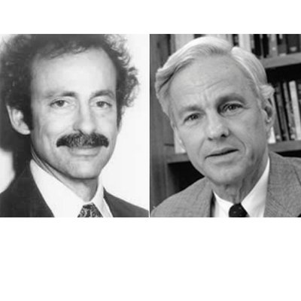
Things you already know about memory.
Each grab a different coloured pen, then on the BWB, write everything you know about memory from your homework. (2 minutes)
Now complete the sentences on the next slide
Atkinson and Shiffrin, who worked in partnership to develop the influential ‘Multi-Store Model of Memory’ in 1968

Slide 7
Outline differences between Short-term and Long-term memory (6 marks)
The capacity of STM is thought to be ______________________ whereas in LTM it is thought to be _____________________
The duration of STM is thought to be ______________________ whereas in LTM it is thought to be ____________________
The coding of information in STM is thought to be mainly _____________________ whereas in LTM it is thought to be _________________

Slide 8
Outline differences between Short-term and Long-term memory (6 marks)
The capacity of STM is thought to be 7 + or - 2 whereas in LTM it is thought to be unlimited
The duration of STM is thought to be between 15 to 30 seconds whereas in LTM it is thought to be up to a life time
The coding of information in STM is thought to be mainly acoustic whereas in LTM it is thought to be semantic
Common errors made by students:
1: they say that the duration of LTM is unlimited
2: they say that LTM is lasts forever
3: they say that the capacity of STM is 5-7 items
4: They say that the capacity for LTM is infinite (it is better to say ‘unlimited’)

Slide 9
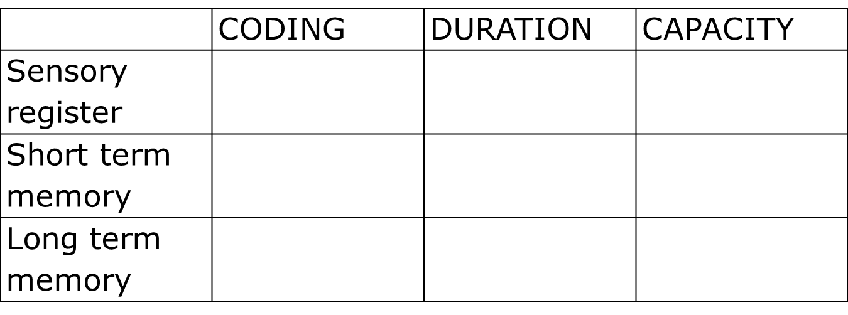
The Nature of Memory: Without looking at your homework notes, fill in this grid.
We will consider the evidence for these assertions in subsequent lessons, but if you finish any activities quickly, turn to pages 6-8 in your memory packs and start learning the research studies.

Slide 10
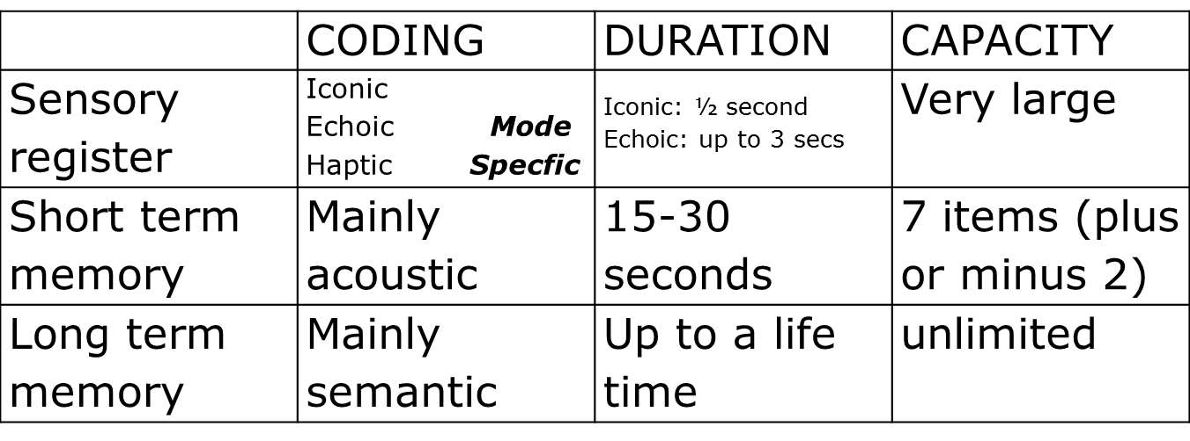
The Nature of Memory: Answers
We will consider the evidence for these assertions in subsequent lessons, but if you finish any activities quickly, turn to pages 6-8 in your memory packs and start learning the research studies.

Slide 11
Atkinson & Shiffrin’s multi-store model of memory
Atkinson and Shiffrin (1968) proposed the first formal model of memory
You task is to get a mini whiteboard and draw the multi-store model of memory in as much detail as you can
How much did you get right?

Slide 12
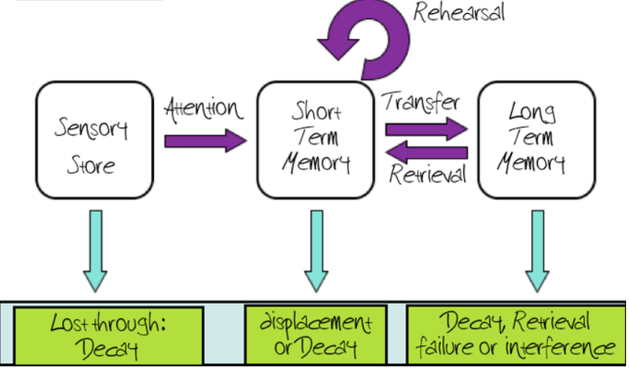
The Multi-store Model of memory: Atkinson and Shiffrin (1968)
Maintenance

Slide 13
Demonstrating aspects of the multi-store model of memory
Get yourselves into pairs and follow the instructions below:
First in the pair, Using the whole of the MSM, explain how you can answer this question
What is the name of the current Queen of the United Kingdom?
Second in the pair, explain this using the whole of the MSM
Why have you forgotten information that you previously had to remember for your GCSE exams?

Slide 14
Examples:
“When I was younger, I heard that the Queen was called Elizabeth, so that went into my echoic sensory memory, where I paid attention to it. Because I paid attention to it, It went into the STM and I repeated the information through maintenance rehearsal as it’s always in the media. This then passed into long-term memory for permanent storage. When I was asked the question, I retrieved the information from the LTM back into the STM and could answer ‘Elizabeth’.”
These examples show that information flows through it in a linear way (it has to pass through one stage, then the other).
Additionally, remember that STM and LTM are considered single, unitary stores. In other words they do not have any other components to them
“I had to read the information first for the exam, so the image of the words went into my iconic sensory memory for a few seconds, then I paid attention to it and as it went into my STM, During my revision, I kept repeating it until it was passed into my LTM. However, I can no longer recall it because I haven’t thought of the information since June, and it has decayed from my LTM.”

Slide 15
Exam practice
Individually on MWBs, answer this question. You have 6 minutes
Outline the multi-store model of memory (6 marks)
Now mark your own, using the guidance on the next slide

Slide 16
Mark scheme
The multi store model consists of three unitary stores; the sensory register, short term memory (STM), and long term memory (LTM). Information flows through these stores in a linear way (1mark).
Information from the environment, will pass into the sensory register. Material in the sensory register only lasts very briefly, less than 3 seconds, but if we pay attention to it, it will pass to the STM. (1 mark)
STM has a limited capacity, 7 +/- 2 item, and information in STM has a duration of up to 30 seconds and is coded acoustically. (1 mark)
If information is rehearsed it will be kept in STM, if not it will be lost. If we rehearse the information for long enough it will pass to LTM. (1 mark).
Encoding in the LTM is mainly semantic, and the capacity is unlimited with information lasting for up to a life time. ( 1 mark)
Although the information is stored in LTM when we want to recall it, it has to be transferred back to STM by a process called retrieval. (1 mark)

Slide 17
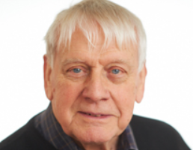
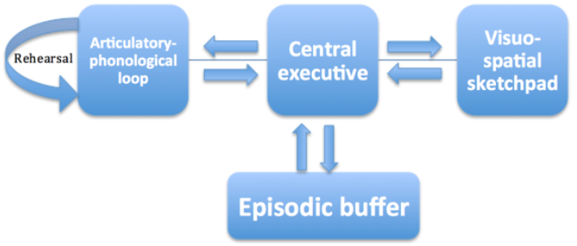
The working memory model
Alan Baddeley in the 1970s re-worked the idea of STM. He felt that the view of STM put forward in the multi-store model was too simplistic. He believed that STM was an active processer of information, rather than the passive store outlined in the MSM.
Therefore, he proposed the working model of memory to explain how short-term memory works

Slide 18
We can demonstrate aspects of Baddeley’s model by carrying out the following tasks in pairs:
on scrap paper or mini white board, one of you draw a picture of a house whilst telling your partner what you did last night….
Relatively easy, yes? you can do both tasks quite well
Now the other person, get your phone out, start texting a friend about something you’ve done this week (delete it before you send it of course) whilst telling your partner everything you have learned in this lesson (in detail)
Not so easy is it? So how does this support the working memory model and challenge multi-store model?

Slide 19
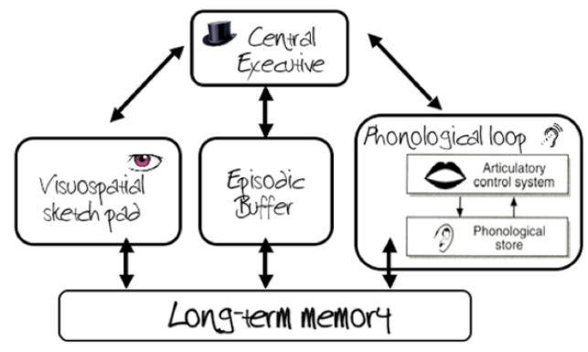
The Working Memory Model
The fact that some tasks we can do simultaneously, whilst others we struggle to do together suggests that STM is made up of separate components
This is in line with what Baddeley suggested about STM in the working memory model
It contradicts the multi-store model because the MSM sees STM as one unitary store

Slide 20
The Working Memory Model. Without using your homework notes…
Each person in the group will get a sheet of A4 paper
Without looking at your notes, allocate one of the components of WMM to each person/pair (if you are a group of 5, one of the components can be split into 2). They will write this title at the top of their paper
Now, using words and pictures, outline the component you have been given on the paper. Make sure you give sufficient detail of your component
Now correctly order the components on the table so that you have a physical model of the WMM
Go round each of the groups with a MWB and, individually, decide which table has the best model
Register your votes on the board

Slide 21
How well do you know the components of the WMM?
In pairs on mini whiteboards
Explain why you can/can’t do these things in terms of what you know about the working memory model..

Slide 22
a) Watching a film with moving pictures and sound, and perceiving them as one thing
This is the task of the episodic buffer. It binds information together so that it can be experienced as one event and not two separate events
b) Being able to repeat the word ‘the’ over and over again whilst drawing a picture of your house
We can do this because the phonological loop and the VSSP are completely separate, allowing this dual-task to be completed because of the different nature of the tasks
c) Being able to repeat sentences in your head for a few seconds
This is the articulatory control system which allows a replication of short sounds

Slide 23
d) Being able to repeat a short melody that someone sings to you
Phonological Loop. The sound recorded and replayed does not have to be spoken word
e) Not being able to recall seven long words (such as photosynthesis, exacerbation, serendipity etc.) but being able to recall seven short words (such as car, house, dog etc.)
This is because the articulatory control system has a limited duration and therefore capacity. The ‘loop’ only lasts for a few seconds, so not all the long words can fit on, whereas they can if they are short words
f) Participants not being able to follow a moving point of light on a screen whilst describing the angles of a hollow F
This is explained by the limited capacity of the VSSP which cannot cope with two visual tasks at the same time.

Slide 24
Exam practice
Individually attempt the following question:
Briefly describe the working memory model (4 marks)
Before you start, a few things to remember:
You must use the correct terms to describe the model
You won’t get much credit for just naming the components, you must describe them
What you write should be able to be understood by someone who has no knowledge of the model
For four marks, you won’t be able to describe everything about the model, so choose two components to concentrate on, although you can make reference to other parts of the model
Now have a go. You have 5 minutes
Now swap over with the person sitting next to you

Slide 25
Exam practice
Give the answer in front of you a mark out of four using the following guidance. Award one mark for each bullet point
The working model of memory consists of four components, the central executive, the phonological loop, the visuo-spatial sketchpad and the episodic buffer
The function of the central executive is to direct attention to particular tasks
The CE attends and monitors incoming information from the senses or LTM and this information is then sent to the other slave systems
The CE has very little capacity so it cannot attend to too many things at once, and it has no capacity for storing data

Slide 26
Exam practice
Give the answer in front of you a mark out of four using the following guidance. Award one mark for each bullet point
The phonological loop has a limited capacity and its function is to store speech-based sounds for brief periods
The PL has two components: the phonological store and the articulatory control process
The Phonological store allows acoustically coded items to be stored for brief periods
The articulatory control process allows sub vocal repetition of items in the phonological store

Slide 27
Exam practice
Give the answer in front of you a mark out of four using the following guidance. Award one mark for each bullet point
The Visuo Spatial Sketchpad processes and stores mental images in terms of what they look like and their place in the visual field
The Episodic Buffer allows both sound and visual information to be bound together and experienced as a single episode

Slide 28
Exam practice
You are now going to have a go at an application question individually
Bryan can hold conversations while he is driving with little difficulty. Bob finds it difficult to hold a conversation while he is trying to read.
With reference to features of the working memory model, explain the different experiences of Bryan and Bob (4 marks)
But before you start, a few things to remember:
Start by identifying the parts of the theory the information in the stem is referring to
Next, you should outline the details of the part of the theory that is referred to in the first part of the scenario before you try to apply it
Then, you apply that part of the theory by explaining exactly how it relates to Bryan’s experience
Now do exactly the same for the second part of the scenario (Bob)
You have 5 minutes, then swap over with the person sitting next to you

Slide 29
Exam practice
Use the following guidance to allocate marks to the answer in front of you
According to the working memory model, the phonological loop, which deals with acoustic information and the visuo spatial sketchpad which deals with visual spatial information work independently of each other(1mark)
This would explain why Bryan is able to hold a conversation while driving, as the conversation requires the use of the phonological loop whereas the driving requires the use of the visuo spatial sketchpad (1 mark)
According to the model each of the components has a limited capacity and therefore it is difficult to carry out two tasks that require the same component at the same time (1 mark)
This would explain why Bob finds it difficult to hold a conversation and read, as both of these tasks require the use of the phonological loop (1 mark)

Slide 30
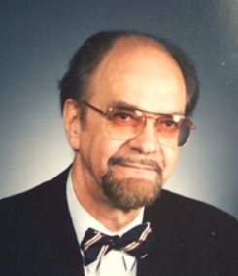
Types of LTM
Tulving suggested that a concept of a unitary LTM was too simple, and LTM was actually made up of three distinct parts. Episodic memory, Semantic memory and Procedural memory
On Mini whiteboards, define what is meant by ‘episodic’, ‘semantic’ and ‘procedural’
Evidence:
In 1989, Tulving injected 6 people with a (safe) radioactive substance that would allow blood flow to be tracked in the brain. He found that when they thought about personal childhood experiences, the back of the brain was active, and when they thought about historical facts, the front of the brain was active
This supports the view that LTM is not one unitary store

Slide 31
Types of LTM
On MWBs, draw a table and write the numbers of the statements under the correct headings – either ‘semantic’, ‘episodic’ or ‘procedural’ (font colour is not a clue)
1An autobiographical record of things that have happened
2 Structured record of facts, meanings, concepts and knowledge
3 Memories tend to be unconscious
4General factual knowledge, shared with others
5 Contains information about what, where and when an event happened (3ws)
6 Memory of skills and how to do things
7 Allows us to make predictions about what will happen to us in the future
8 Acquired through repetition and practice
9 Contain deeply embedded automatic sensory-motor behaviours
10 Contains an enormous and ever-growing amount of knowledge
11 Constructed rather than reproductive and are prone to errors and illusions
12 Examples include a memory about a holiday or a relationship split
13 Examples include the names of cities or historical dates
14 Examples include how to ride a bike or play guitar

Slide 32
Types of LTM
Episodic memory | Semantic memory | Procedural memory
1 An autobiographical record of things that have happened 4 General factual knowledge, shared with others 5 Contains information about what, where and when an event happened (3ws) 7 Allows us to make predictions about what will happen to us in the future 11 Constructed rather than reproductive and are prone to errors and illusions 12 Examples include a memory about a holiday or a relationship split | 2 Structured record of facts, meanings, concepts and knowledge 10 Contains an enormous and ever-growing amount of knowledge 13 Examples include the names of cities or historical dates | 3 Memories tend to be unconscious 6 Memory of skills and how to do things 8 Acquired through repetition and practice 9 Contain deeply embedded automatic sensory-motor behaviours 14 Examples include how to ride a bike or play guitar

