Slide 1
Schaffer’s stages
Lesson two

Slide 2
Starter: You have 3 mins to write something about each term
Reciprocity inter-observer Reliability
Attachment
80%
Interactional synchrony innate
Meltzoff and Moore
high levels of reciprocity=?

Slide 3
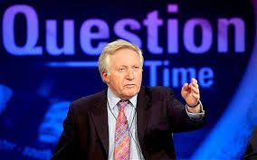
Prep question time: answer on MWBs
In what city did Schaffer carry out his study?
How many babies did he use?
He observed them every month for how long?
Then he visited them for the last time at what age?
By 10 months what % of children had a specific attachment?
By one year what % of children had multiple attachments?

Slide 4
Prep question time: answer on MWBs
In what city did Schaffer carry out his study?
How many babies did he use?
He observed them every month for how long?
Then he visited them for the last time at what age?
By 10 months what % of children had a specific attachment?
By one year what % of children had multiple attachments?
Glasgow
60
First year
18 months
80%
78%

Slide 5
On BWBs, draw the timeline and add in….
The following percentages at the right ages (50% attached, 80% attached, 30% and 78% multiple attachments)
Then add the names of Schaffer’s stages at the correct ages

Slide 6
It should look like this!
78%
multiple
80%
Attached
30% multiple
50% attached
6 month
1 year
Born
3 m
9 m
7 m
Pre-attach
Indiscriminate
attach
Discrim
attach
Multiple

Slide 7
So Schaffer didn’t just pluck his stages out of thin air or create them based on some subjective personal belief.
He carried out longitudinal research that clearly show the stages babies go through when attaching.
So the stages are based on actual psychological research
Why is it a good thing to use longitudinal research?
Who were the sample though? Is there anything about it that isn’t so good?

Slide 8
Now on MWBs, state which stage each of the following children is at and give a reason why
Jacintha showed no distress when her mother (her primary caregiver) left the room to go out for the evening. When her older brother elbowed her she cried but was comforted after a cuddle from the new baby sitter who had just started that evening.
Pre-attachment (0-3 months)

Slide 9
Now on MWBs, state which stage each of the following children is at and give a reason why
Ash went to nursery 4 days a week. When he saw his key worker at the nursery he was immediately pleased to see her and happy to be at nursery. When his mum picked him up from nursery he ran straight to he and was delighted to see her; the situation was the same when his dad picked him up. Once, though, his Auntie (who did not like children and rarely saw Ash) had to pick him up from nursery; Ash cried and clung to his key worker.
Multiple attachments (9 months – 1 year)

Slide 10
Now on MWBs, state which stage each of the following children is at and give a reason why
Albert cried the first time he saw his grandfather, who live abroad so had not visited him before. Furthermore, when his father (his primary caregiver) left the room Albert tried to follow him and tearfully banged on the shut door to try to get his father back.
Discriminate (7 – 9 months)

Slide 11
Now on MWBs, state which stage each of the following children is at and give a reason why
Jane seemed interested when shown the red balloon, her teddy or her older sister. She seemed quite excited when her dad came back home from work but she also seemed excited to see a blue balloon. When the blue balloon popped she became very upset; showing her the red balloon did not calm her down, but a cuddle from her dad did.
It is likely that she is near to the end of the indiscriminate attachment stage, so nearer to 6 months as she is starting to form an attachment to her Dad.

Slide 12
Stages of Attachment: Evaluation
Virtual Card Sort Activity
Open up the virtual card sort file. There are 6 cards
These cards make up the P & the EE of three evaluations. One card is the P for each point and one card contains the EE
Your task is to work out which cards are the three Ps and then, match the remaining cards (the EEs) to the correct P
When you have finished, check against the next slide to see if you got it in the right order but don’t look until you’ve had a go yourself!

Slide 13
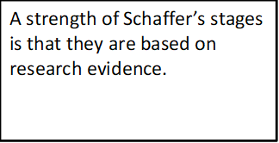
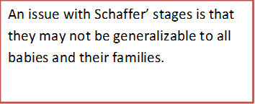
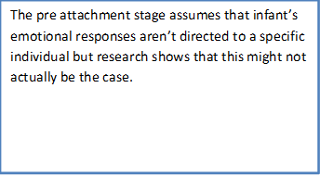
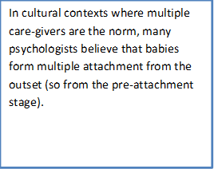
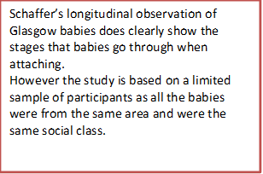
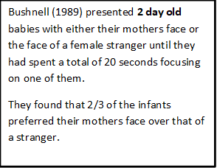
The cards should look like this…
Now see if you can write a link back statement for each of the evaluations

Slide 14
Evaluation of Schaffer’s stages
Did you get something like this:
This means that although the stages have some scientific validity, due to the limited sample, we need to be cautious about making generalisations to all babies
This means that Schaffer may not have been correct in presuming that babies must go through the stage of specific attachment before they are able to form multiple attachments, and further highlights the difficulty of generalising the results of culture-specific research
Suggesting that Schaffer may have under-estimated the ability of the new-born to demonstrate a preference for a particular individual. If this is the case, it calls into question the validity of the stages

Slide 15
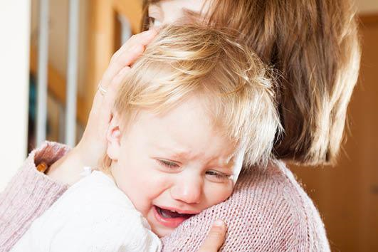
Lets kahoot!!

Slide 16
Snap Plan..
Ash went to nursery 4 days a week. When he saw his key worker at the nursery he was immediately pleased to see her and happy to be at nursery. When his mum picked him up from nursery he ran straight to he and was delighted to see her. Jacintha showed no distress when her mother (her primary caregiver) left the room to go out for the evening. When her older brother elbowed her she cried but was comforted after a cuddle from the new baby sitter who had just started that evening.
Discuss Schaffer’s stages of attachment. Make reference to Ash and Jacintha in your answer (16 marks)

