Slide 1
Psychological Investigations

Slide 2
Starter Questions
Answer in pairs on MWBs:
Put these sections of a psychological investigation report in the order they would appear in: discussion; abstract; results; method; references; introduction
What information is contained in the abstract and what is its purpose?
What are the four subsections of the method section?
Which section of the report is most important for replication to occur and why is this necessary?
What information is given in the introduction?
What is ‘discussed’ in the discussion? (you should have four different things)
Where in the report should the hypotheses be stated?
The results section can be split into three sections. What is contained in each?
What information is given in a book reference (you must state the right order)
What information is given in a journal reference (you must state the right order)

Slide 3
Starter Questions
Put these sections of a psychological investigation report in the order they would appear in: discussion; abstract; results; method; references; introduction
What information is contained in the abstract and what is its purpose?
What are the four subsections of the method section?
Which section of the report is most important for replication to occur and why is this necessary?
What information is given in the introduction?
What is ‘discussed’ in the discussion? (you should have four different things)
Where in the report should the hypotheses be stated?
The results section can be split into three sections. What is contained in each?
What information is given in a book reference (you must state the right order)
What information is given in a journal reference (you must state the right order)
abstract, introduction, method, results, discussion, references
It is a summary of what is contained in each section of the report (excluding references). Its purpose is to give a brief overview to the reader so that they can decide if it is worth reading the full report
Design, participants, materials, procedure
The method section. Method must be reported in precise detail otherwise exact replication is not possible. It is important so that the reliability of the research can be checked to ensure the conclusions are correct
Background research that relates to the investigation
A summary of the results and what they tell us, comparison to the background research presented in the introduction, limitations of the investigation and suggests for improvement, ideas for further research
At the end of the introduction
Summary of descriptive statistics, inferential statistics and conclusion from the test, graphs
Author’s name, date of publication, book title, place of publication, publisher
Author’s name, date of publication, title of article, journal title, volume, page numbers

Slide 4
Reference writing: Did you get it right?
Look at your answers to the reference writing questions on p.4 of the prep pack. Compare your answers to the references below and award your yourself a mark out of two for each one:
Bem, S L (1993) the lenses of gender: transforming the debate on sexual inequality. New Haven. Yale university press
2. Duck, S. (1992) Human relationships. London. Sage
Award yourself 2 marks, if it is all correct and in the right order. 1 mark if it is in the right order, but one thing has been missed out. 0 marks if it’s in the wrong order or more than one thing has been missed out. Note that the surname must be stated before the initials

Slide 5
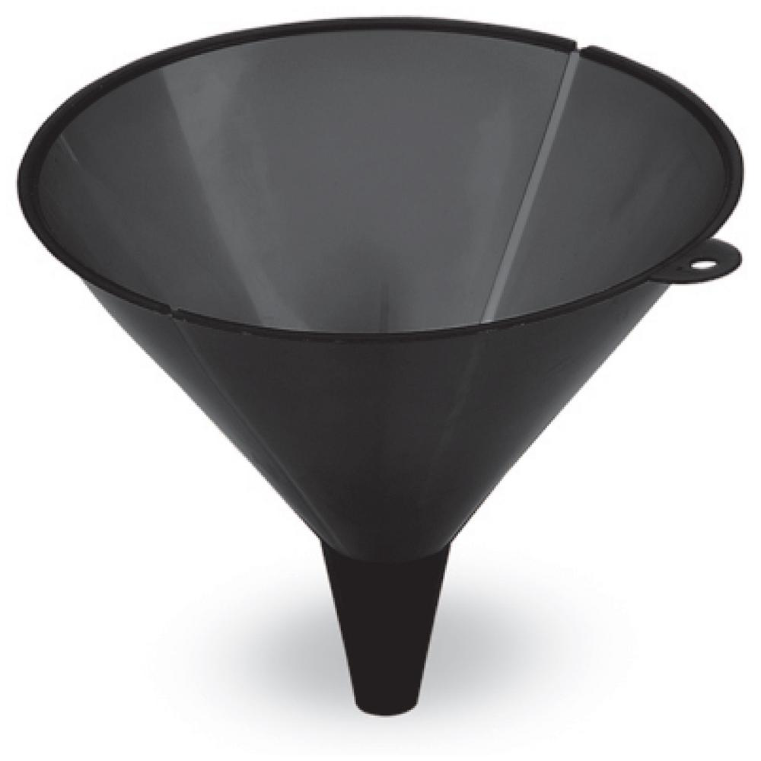
Writing an introduction
The introduction should be like a funnel and is also basically a literature review explaining why the study was conducted.
The funnel technique starts off with broad examples of research in the area narrowing down to the precise area of study
Finishing with your hypothesis.
The review you have given should allow you to decide if it is one tailed or two tailed.
When should we predict a one-tailed hypothesis?

Slide 6
Writing an introduction: Literature Review
We now need to find some past research that relates to the nature of our study:
We will be investigating whether people’s reaction times differ throughout the day. In a simple study, we will see whether people have faster reaction times after they wake up or before they go to bed
Don’t forget that in a real study, the search for background information would be carried out before the study is designed and the data collected!
Task:
Use the internet to find research that relates to our study
Remember: you should start with a piece of research that relates to the general topic, i.e. how people’s biorhythms affect their alertness
Then start to search for research that relates to the precise aims of the study, i.e. reaction times and time of day
Aim to include two or three pieces of research
Make notes on the research you find. Only include very brief details of the aims, procedure and findings

Slide 7
Writing an introduction: Putting it all together
Now turn to page 26 of the Research Methods Preparation pack and write the following in the introduction section:
Your background research, (brief details), starting with the general research and ending with the study that is most closely associated to our research study
State which direction the hypothesis will be – the justification for this will centre on what your background research suggests
State your hypothesis

Slide 8
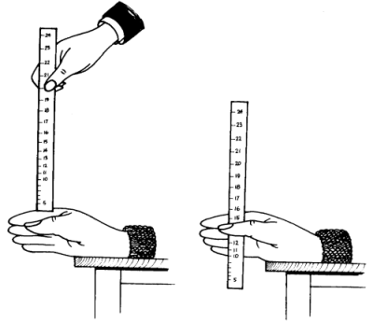
The Results
Come up to the board and write up your mean results for each condition
Morning: 30 minutes after waking | Evening: 30 minutes before sleeping
Now take a photo of the results and make sure that you keep it on your phones for later lessons

Slide 9
Results analysis: Descriptive Statistics
For now, we will only deal with descriptive statistics. You can work in pairs, but you will need to individually write the results into the space provided in your prep packs (p.27)
Draw out a table to record your descriptive statistics results. Make sure that you give the table a title
Work out the measures of central tendency for both sets of data and put them into the table
Work out the range and standard deviation (optional) for both sets of data and put them into the table
Draw and label an appropriate graph

