Slide 1
Evaluation of the Multi-store Model of Memory
AO3 skills

Slide 2
Evaluation of the Multi-Store Model
Do you remember how to evaluate a theory?
On mini-whiteboards, write down three ways we can evaluate a theory
We are going to start with supporting research

Slide 3
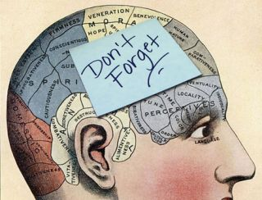
Class study
We are going to carry out a replication of a study that supports the Multi-Store Model of memory
You will be shown a list of 15 words, which will appear one by one on the screen
Your task is to memorise the words
Do not share information with anyone else and do not attempt to use a memory technique
After you’ve seen all of the words, write down as many as you can remember
You do not have to write them in the correct order
Are you ready?

Slide 4
Window

Slide 5
Tulip

Slide 6
Bread

Slide 7
Plate

Slide 8
Pencil

Slide 9
Chair

Slide 10
Doll

Slide 11
Boat

Slide 12
Glass

Slide 13
Deer

Slide 14
Grape

Slide 15
Spoon

Slide 16
Road

Slide 17
Girl

Slide 18
Rug

Slide 19
Now write down as many as you can remember

Slide 20
How many did you get right?
Window
Tulip
Bread
Plate
Pencil
Chair
Doll
Boat
Glass
Deer
Grape
Spoon
Road
Girl
Rug
Now check against the list and count up how many you got right
Write down next to each correct item, where it appeared in the list
Now choose a column from the grid on the board and come and put a tick in the boxes corresponding to the questions you correctly remembered
Now look at the grid. What have we found?
On MWBs: How does it support the multi-store model?

Slide 21
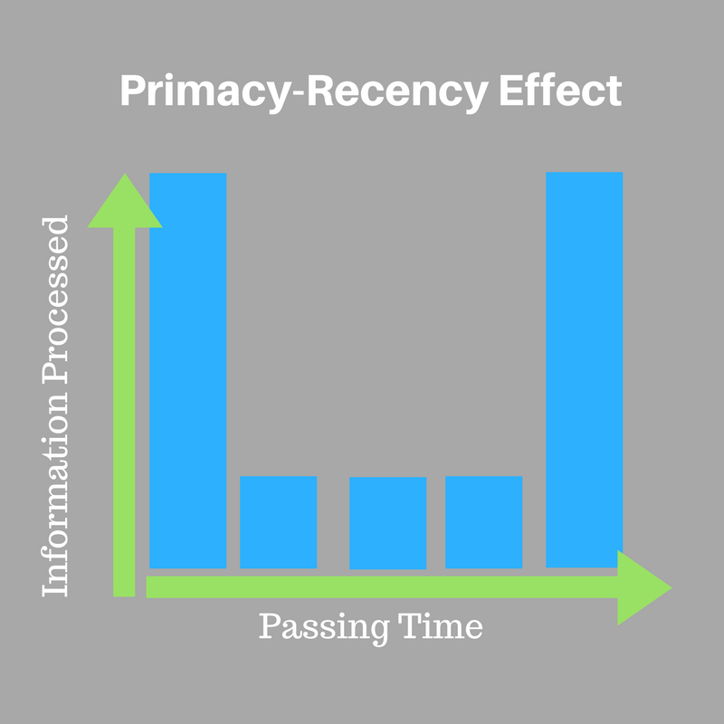
Evaluation of the Multi-Store Model: Supporting evidence
PEEL
P There is research supporting the multi-store model of memory
E Murdoch found that when participants were asked to recall a list of words, they remembered more of the words from the beginning and the end of the list, whereas the ones in the middle of the list were more likely to be forgotten. This is known as the primacy-recency effect
Now write the second ‘E’ and the ‘L’ of the PEEL statement
How can the findings be explained? How do they support the Multi-store model?

Slide 22
Evaluation of the Multi-Store Model: Supporting evidence
E This effect can be explained using the multi-store model. The words at the beginning of the list are rehearsed and therefore placed in LTM, so they are still able to be recalled. The words at the end of the list are remembered because they are still fresh in STM. The words in the middle of the list however, have not been rehearsed and have been displaced from the STM by the later items, and are therefore forgotten
L Therefore, these findings support the model as they suggest there is a distinct STM and LTM and that rehearsal is necessary for passing information from STM to LTM

Slide 23
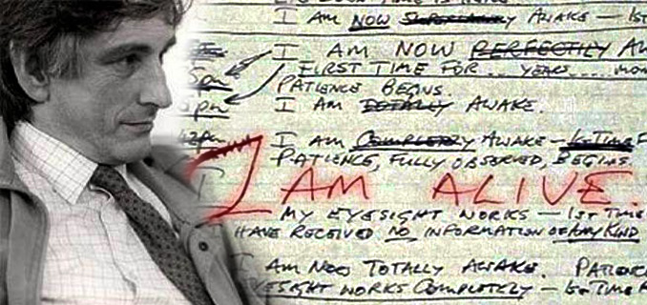
Evaluation of the Multi-Store Model: Supporting/challenging evidence
The case of Clive Wearing both supports and contradicts the model. Watch the clip and discuss in your groups why this is the case

Slide 24
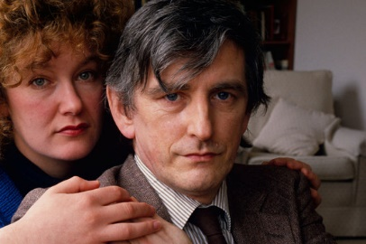
Evaluation of the Multi-Store Model: Supporting/challenging evidence
The case of Clive Wearing supports the Multi-Store Model because it suggests that STM and LTM are two separate stores. This is because Clive can remember some of his past (LTM), and he can also engage in conversation and remember information for a few seconds (STM), but he no longer appears able to transfer information from one store to the other
The case of Clive Wearing challenges the Multi-Store Model as it suggests LTM is not one unitary store. Clive’s memory for facts was very damaged, but he was still able to walk, talk, and play the piano
Now on MWBs, in pairs write a PEEL point for this research, focusing mainly on how it challenges the multi-store model

Slide 25
Evaluation of the Multi-Store Model: Supporting/challenging evidence
Did you get something like this?
P: Although the case of Clive Wearing partially supports the multi-store model of memory, as it supports the existence of a separate short term and long term store, it contradicts the suggestion that LTM is one unitary store.
E: Clive was unable to remember much information from his past, but he was still able to perform all the skills he was able to perform prior to his illness, e.g. walking, talking, playing the piano.
E: suggesting that LTM is probably made up of several components as suggested by Tulving in his tripartite theory, which recognises memory for facts and memory for procedures as being held in different parts of the memory system
L: This suggests that the view of LTM in the multi-store model is too simplistic, and therefore the model is not able to fully explain the complexities of memory

Slide 26
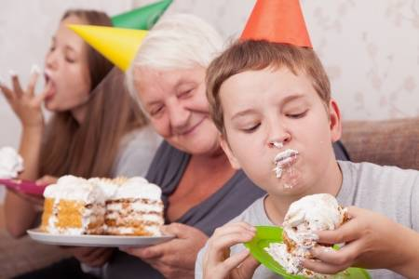
Evaluation of the Multi-Store Model: Fails to Explain
On a MWB, write down what you ate for dinner on your last birthday. Give as much detail as you can. Also write down the month that your birthday falls in
Now write down what you ate for dinner three weeks ago from yesterday
Why was it easier to remember what you ate for dinner on your birthday?
Did you rehearse the information?
How can this be used as a criticism of the Multi-Store Model?

Slide 27
Evaluation of the Multi-Store Model: Fails to Explain
Using our discussions from the last slide, and the research presented below, can you complete this PEEL evaluation point?
P:
E: Participants were asked questions about stimulus words at different processing ‘levels’. The words with questions that required a ‘shallow level’ of processing, for example, “is the word printed in capital letters” were less likely to be recalled than words with questions that required a ‘deep level’ of processing, for example, “Is the word a type of fruit.”
E:
L:

Slide 28
Evaluation of the Multi-Store Model: Fails to Explain
Did you get something like this?
P: The multi-store model fails to explain how some information appears to reach LTM without being rehearsed
E: In a study by Craik & Lockhart, when participants were asked questions about stimulus words at different processing ‘levels’, the words with questions that required a ‘shallow level’ of processing, for example, “is the word printed in capital letters” were less likely to be recalled than words with questions that required a ‘deep level’ of processing, for example, “Is the word a type of fruit.”
E: As the participants were not asked to learn the words, we can presume that no rehearsal took place. This suggests that processing information at a deep level, not rehearsal, is the key to remembering information in the long term
L: Contradicting the view put forward by the Multi-Store Model that rehearsal is how we transfer information to the long-term store

Slide 29
Snap Plan
Write a snap plan for the following essay:
Outline and evaluate the Multi-Store Model of memory (16 marks)
In one week’s time, you will write this essay in class and peer mark it using a model answer

Slide 30
Evaluation of the Working Memory Model & Types of LTM
AO3 skills

Slide 31
Starter Activity
On the worksheet are 6 pieces of research
In your groups of 3, split your mini WB in half
Label 1 side WMM and the other types of LTM
Decide which evidence could be used to evaluate the working memory model and which should be used for the types of LTM (write the number on the correct side of the board)
Under each one, justify your answer
Access the worksheet using the QR code

Slide 32
Starter Activity
Did you get it right?
Working Memory Model | Types of LTM
1 4 6 | 2 3 5

Slide 33
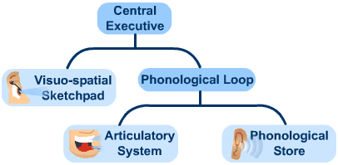
Evaluation of the Working Memory Model
On the following slides we will be discussing three evaluations of the WMM
Your task will be to construct a PEEL point for each evaluation after we have had the discussion
Do this individually, on paper, so that you have a proper revision resource to add to your notes
Some students will be asked to read their PEEL points out
Head up your paper with the title ‘Evaluate the Working Memory Model’
Outline and Evaluate the Working Model of Memory (16 marks)
You will be putting together the ‘evaluate’ part of the above essay

Slide 34
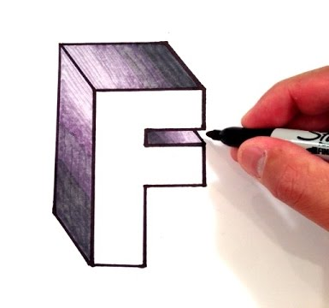
Evaluation of the Working Memory Model
Gathercole & Baddeley found that participants had more difficulty doing two visual tasks (simultaneously tracking a moving point of light and describing the letter F) than doing both a visual and verbal task at the same time
Answer the following questions in pairs on MWBs:
What type of evaluation point is this?
How can we explain these findings?
How do the findings link to the WMM? (e.g. do they support it, or challenge it)
Now write your first PEEL point

Slide 35
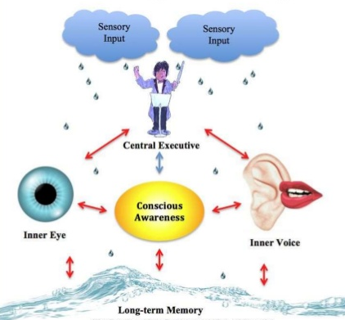
Evaluation of the Working Memory Model
What exactly does the central executive do?
Write down your answer to the question on mini-whiteboards
The WMM can be criticised because there is a lack of clarity over the central executive and the exact role it plays in the model
What evaluation point does this relate to?
Eslinger and Demasio (1985) reported on the case study of EVR who had a cerebral tumour removed. He performed well on tests of reasoning, which suggests that his central executive was intact; however, he had poor decision-making skills, which suggests that his central executive was not wholly intact
How does this link to an evaluation of the WMM?
“The central executive is the most important but the least understood component of working memory.” (Baddeley)
Now write your second PEEL point

Slide 36
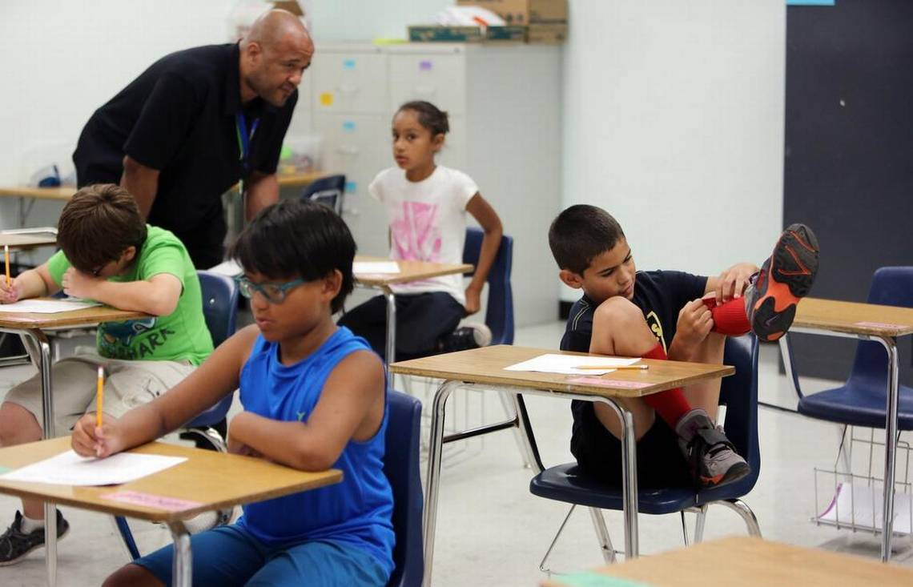
Evaluation of the Working Memory Model
Some types of cognitive dysfunction are thought to be linked to problems with working memory, for example, ADHD and dyslexia
Watch the following clip and then answer the questions
What type of evaluation point does this link to?
What does this mean about the WMM that does not necessarily apply to the MSM?

Slide 37
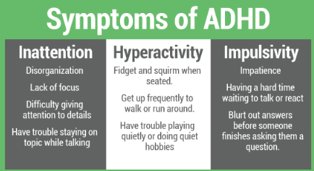
Evaluation of the Working Memory Model
There are educational programmes which help children increase their working memory skills, thus reducing their ADHD symptoms
Perhaps allows children with severe cases to remain in mainstream education, or any education
Increased awareness = better understanding and treatment by schools… e.g. use brief and simple instructions so they don’t forget what they are doing (limited capacity of phonological loop)
Perhaps reducing the reliance on drug treatments such as Ritalin or Aderall
Now write your third PEEL point. include a comparison with MSM

Slide 38
Evaluation of Types of Long-Term Memory
You will now be given a virtual card sort activity which you should attempt to complete in pairs. The statements make up three PEEL evaluation points that relate to the types of long-term memory theory. Your task, in your pair, is to:
Draw a table with three columns. Before you try to order the statements, see if you can separate them into three points and write the numbers of the statements that relate to the same Peel point in one column
Now try to order them correctly so that they make up a coherent PEEL point
Lastly, write a summary of each point in your notes
How did you do?

Slide 39
Evaluation of Types of Long-Term Memory: Supporting evidence
There is evidence to suggest that when a person uses episodic memory, they use a different region in the brain compared with when they use semantic memory. Tulving (1989) injected himself, his wife and 4 others with particles of radioactive gold that he could use to track brain blood flow in a scanner. He scanned each person’s brain whilst they thought about historical facts or childhood experiences. He found in 3/6 participants (including himself), that when they were thinking about historical facts blood flow increased at the back of his brain, whereas when he thought about childhood experiences blood flow increased at the front of his brain. The activation of the different areas of the brain when recalling facts or episodes suggests a biological basis to the different types of memory in LTM

Slide 40
Evaluation of Types of Long-Term Memory: Supporting evidence
In the case of Clive Wearing, as illness caused the near total destruction of his hippocampus. This left him with an inability to store new episodic or semantic information for any more than a few seconds. However, he was perfectly able to read, write, speak and play piano. Other researchers investigated learning in people with Huntingdon’s Disease (a progressive, degenerative disease of the brain). They found that HD patients had no problems learning new facts and knowledge, but had severe problems learning new motor skills. These findings give a strong indication that damage to specific areas of the brain leave the patients with deficits in one or more types of long term memory, whilst leaving other long-term memory stores intact, this offers support for the biological basis of separate long-term stores

Slide 41
Evaluation of Types of Long-Term Memory: Applications
Critics challenge the need of distinguishing between types of LTM. Cohen and Squire suggest that semantic and episodic memory should be understood as the same type of memory, called ‘declarative memory’, and research by Kan et al (2009) found that there was interdependence between episodic and semantic memory. Whether there are two or three types (or more) of LTM may be important when attempting to help people recover their cognitive functions after illnesses such as strokes. Being able to identify different aspects of LTM has led to psychologists targeting specific kinds of memory to make people’s lives better. Belleville et al (2006) demonstrated that episodic memories could be improved with training in older patients with mild cognitive impairment. This shows that the tripartite division of long-term memory has had tangible benefits for people with cognitive impairment, making it a useful theory).

Slide 42
Exam Practice
Answer the following question individually. You have 6 minutes
Annie can still skateboard even though she hasn’t skated for many years.
Germaine can still recall what happened on his first day at university even though it was ages ago. Billy remembers the names of the tools he needs to repair the broken tap.
Identify three types of long-term memory and explain how each type is shown in one of the examples above
(Total 6 marks)

Slide 43
Exam Practice: Mark scheme
1 mark: for each correct application in recognising (naming/identifying) each type of long-term memory by matching to the person in the stem
Plus
1 mark each for knowledge of a feature of the type of memory explained in the context of the behaviour in the stem:
• Annie’s case/remembering how to skateboard is an example of procedural memory (1) because she is remembering an action or muscle-based memory (1)
• Germaine’s case/remembering what happened is an example of episodic memory (or autobiographical memory) (1) because he recalls the events that took place at a specific point in time (1)
• Billy’s case/remembering the names of tools is an example of semantic memory (1) because he remembers factual/meaningful information (1).

