Slide 1
Idiographic vs Nomothetic Approach

Slide 2
Starter question
Answer the question individually:
Depression always runs in families but many depressed people have serious social problems or have experienced traumatic events in the past. However many people find ways to cope. What we need is the will to overcome our problems
With reference to the above, explain what is meant by determinism.
Refer to three types of determinism in your answer (6 marks)
Now swap with the person next to you and award a mark according to the mark scheme on the next slide

Slide 3
Starter Question: Mark Scheme
Ao1 mark 1-
Biological determinism suggests human behaviour is ruled by internal forces which are innate such as genes.
Ao2 mark 1-
“Depression often runs in families” suggests that depression is biologically determined through genetics
Ao1 mark 2-
Environmental determinism suggests behaviour is caused by external forces in the environment
Ao2 mark 2
“Depressed people have serious social problems” suggests an influence from external factors such as other people and social interaction
Ao1 mark 3-
Psychic Determinism suggests that behaviour is a result of unconscious conflicts repressed from childhood
Ao2 mark 3- the article suggests people with depression have experienced “traumatic events in the past” suggesting the cause is from a repressed conflict from childhood

Slide 4
The Nomothetic Approach: What do you remember?
Can you fill in the gaps?
Psychologists who take a nomothetic approach are concerned with establishing __________ _________ of behaviour based on the study of _________ ___________ of participants. Nomothetic approaches will use ___________ __________ through quantitative data collection. Research methods supporting a Nomothetic Approach include ____________, Correlations and Meta-Analysis.
Biological Psychologists take a nomothetic approach as they adopt ______________ methods to identify trends and generate causal laws. For example when explaining Psychological disorders such as OCD. They pinpoint __________ ___________ that tend to be responsible for disorders and use this law to inform ___________ such as drug therapies to treat all patients with. Also in Psychopathology classification systems such as the DSM and ICD are used to __________ ___________ ___________ and these are nomothetic classification tools.
Behaviourists such as Watson, Pavlov and Skinner conduct research using animals to draw general laws of learning such as in ____________ and ____________ _____________. Behaviourists generalise such laws to humans and animals and such laws can be used in ______________ such as the behavioural therapies for phobias including _____________ _____________ and _____________. ___________ Psychologists including Asch and Milgram also adopt a nomothetic approach to understanding Conformity and Obedience. They researched the role of _______________ factors in social behaviour and concluded that these factors influence levels of conformity and obedience in all individuals

Slide 5
The Nomothetic Approach: What do you remember?
Did you get it right?
Psychologists who take a nomothetic approach are concerned with establishing general laws of behaviour based on the study of large groups of participants. Nomothetic approaches will use statistical analysis through quantitative data collection. Research methods supporting a Nomothetic Approach include Experiments, Correlations and Meta-Analysis.
Biological Psychologists take a nomothetic approach as they adopt scientific methods to identify trends and generate causal laws. For example when explaining Psychological disorders such as OCD. They pinpoint biological factors that tend to be responsible for disorders and use this law to inform treatments such as drug therapies to treat all patients with. Also in Psychopathology classification systems such as the DSM and ICD are used to diagnose psychological illness and these are nomothetic classification tools.
Behaviourists such as Watson, Pavlov and Skinner conduct research using animals to draw general laws of learning such as in classical and operant conditioning. Behaviourists generalise such laws to humans and animals and such laws can be used in treatments such as the behavioural therapies for phobias including systematic desensitisation and flooding. Social Psychologists including Asch and Milgram also adopt a nomothetic approach to understanding Conformity and Obedience. They researched the role of situational factors in social behaviour and concluded that these factors influence levels of conformity and obedience in all individuals

Slide 6
The Idiographic Approach
In pairs, come up with three ways in which the idiographic approach is different to the nomothetic approach
Tends to use case studies, rather than experiments
Engages in detailed study of the individual
Tends to be more useful in falsifying old theories, rather than generating new ones
Attempts to understand the individual as an individual and makes no attempt to categorise them
Does not attempt to predict behaviour

Slide 7
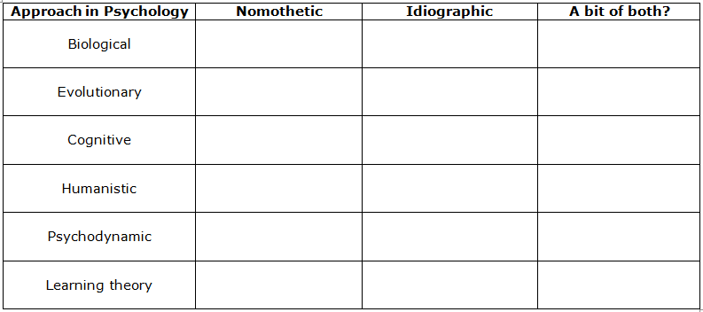
Application to the approaches
In pairs on MWBs, sketch out the table below and then place a tick in the boxes according where you think each approach falls on the debate

Slide 8
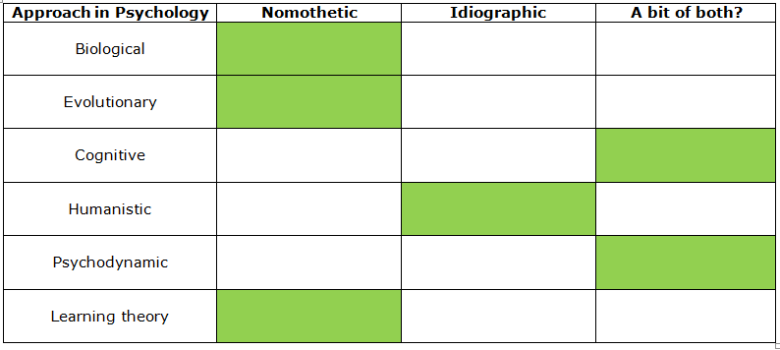
Application to the approaches
Did you get it right?
Now, in pairs, on MWBs, complete the following sentences:
1. The biological approach is nomothetic because…………….
for example………………………
2. Whereas the humanist approach is idiographic because………………….
for example…………………………
3. However, the psychodynamic approach is both idiographic and nomothetic because……………
for example………………………………………

Slide 9
Which type of approach is more useful?
Answer the following questions in your group on MWBs:
Nomothetic approaches tend to use what methods of research?
This produces what type of data?
What is an advantage of collecting this type of data (what does it enable us to do)?
Idiographic approaches tend to use which research method?
What type of data does this method produce?
Why may that be a disadvantage of the idiographic approach? (contrast with the advantages of the nomothetic approach)

Slide 10
Is the nomothetic approach really more useful than the idiographic approach?
Koluchova reported on identical twins whose mother died soon after their birth. When their father remarried, the stepmother locked them in a cellar for 5 and a half years, giving them regular beatings. The father was mainly absent from the home due to his job. Discovered at age 7, the twins were under-developed physically, lacked speech and did not understand the meaning of pictures. Doctors predicted permanent physical and mental damage. The boys were given physical therapy and put into a school for children with severe learning difficulties and were then adopted by two child- centred sisters.
At age 14 their intellectual, social, emotional and behavioural functioning was near normal. At adults they both married and had children and successful careers. Both enjoyed healthy adult relationships and are still close to one another
How has this case furthered our understanding of attachment?

Slide 11
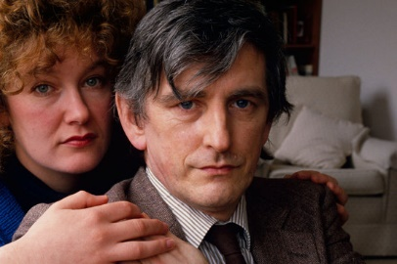
Is the nomothetic approach really more useful than the idiographic approach?
In the case study of Clive Wearing, an illness caused the near total destruction of his hippocampus this left him with an inability to store new episodic or semantic information for any more than a few seconds. His long term memory for facts and events was severely impaired, however, he was perfectly able to read, write, speak and play piano
How has this case furthered our understanding of memory?

Slide 12
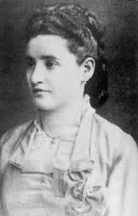
Is the nomothetic approach really more useful than the idiographic approach?
Freud developed his theory of repression and the unconscious mind through cases such as that of Anna O, a young woman who had developed a series of psychological and physical disturbances that Freud, and his colleague Breuer, were able to treat by uncovering the unconscious conflicts behind them. For example, Anna developed a fear of water and could not drink. This was cured when, under hypnosis, Anna revealed that a lady companion from childhood had let her dog drink from Anna’s glass. Once the memory had been uncovered and the discomfort dealt with, Anna was able to drink water again.
What developments has this led to in Psychology?
His theory led to the development of Psychoanalysis, a therapeutic technique that aims to uncover repressed memories, thoughts, or feelings, so that they can be dealt with, which Freud believed would cure the patient of the negative psychological and behavioural manifestations of the repressed information. Psychoanalysis is still a popular form of therapy today

Slide 13
Evaluation: Fill in the gaps
Now we have discussed some of the strengths and weaknesses of each type of approach, see if you can complete the evaluation statements on the following slides

Slide 14
How many did you get?
The Nomothetic approach is considered scientific because….
it adopts quantitative experimental methods and findings from such research have the ability to predict behaviour
whereas the qualitative methods used by the Idiographic approach are criticised because….
It is unscientific, subjective and unable to esablish general laws or predictions
This limits the usefulness of the idiographic approach particularly in its application and treatment of psychological disorders. However, supporters of the idiographic approach still argue that the approach is still useful because…
The depth and detail of the research will often lead to new research ideas or challenge previous theory and assumption from nomothetic research.

Slide 15
How many did you get?
As the Nomothetic approach adopts the laws of science it is useful in…
identifying trends; predicting and controlling behaviour which has useful applications
The Biological perspective adopts a Biological approach when explaining the cause of disorders such as OCD. This has led to the development of
drug therapies to treat chemical imbalance such as SSRI’s
Some Psychologists argue, however, that alternate treatments such as talking therapies and CBT are more suitable because…
they adopt a more person centred approach which is one of the strengths of an idiographic approach

Slide 16
How many did you get?
An idiographic study explores a behaviour or phenomenon with depth and detail that will often lead to…
new research ideas or a challenge to a previous theory and assumption from nomothetic research
What this suggests is that…
Both approaches are useful and, therefore, Psychology should adopt a mixed methods approach with idiographic and Nomothetic methods used to complement and challenge each other
This can be seen in approaches such as the Cognitive approach, which uses nomothetic approaches to draw general laws but also…
uses idiographic methods to explore topics, such as memory, with more depth

