Slide 1
Localisation of the Brain

Slide 2
Exam Practice: Answer individually without notes
You are a passenger in a car that has suddenly slammed on its breaks to avoid hitting a dog. Your breathing quickens, your mouth is dry and you have a feeling of ‘butterflies’ in your stomach. But after a few minutes these physical changes start to disappear. Using your knowledge of the body’s response to stress, explain why you are likely to have experienced:
A) the changes that occurred in the first 30 seconds (2 marks)
B) the changes that occurred after a few minutes (2 marks)
Now swap with the person sitting next to you and award a mark to their answer using the guidance on the following slide

Slide 3
Exam Practice: Mark Scheme
At the slamming of the brakes, the sympathetic division of the ANS goes into action. The pituitary gland releases ACTH which is detected by the adrenal medulla to release adrenaline (1 mark). This causes the changes associated with the fight or flight response, e.g. the quickened breathing and dry mouth. The butterfly feelings are due to blood being diverted away from the digestive system to the skeletal muscles (1 mark).
The changes after a few minutes are due to the parasympathetic branch of the ANS kicking in once the accident has been averted and the danger has passed (1 mark). This branch attempts to restore the system to homeostasis. Heart rate and breathing decrease, adrenaline secretion slows down and the butterfly feelings subside (1 mark).

Slide 4
Starter Questions
Answer in pairs on mini-whiteboards
What does the term ‘localisation of function’ mean?
Which area is involved in regulating movement?
Which area is responsible for speech production?
What is the function of Wernicke’s area?
In which lobe of the brain is the visual area?
What is being described in this statement: ‘It is 3mm thick and appears grey due to the location of cell bodies (grey matter)’
What might be the result of damage to the left occipital lobe?
What is Broca’s aphasia?

Slide 5
Starter Questions: Answers
What does the term ‘localisation of function’ mean?
Which area is involved in regulating movement?
Which area is responsible for speech production?
What is the function of Wernicke’s area?
In which lobe of the brain is the visual area?
What is being described in this statement: ‘It is 3mm thick and appears grey due to the location of cell bodies (grey matter)’
What might be the result of damage to the left occipital lobe?
What is Broca’s aphasia?
That specific functions are performed by specific parts of the brain
The motor area
Broca’s area
Speech comprehension
Occipital
The cerebral cortex
Blindness in the right eye
A condition where speech is slow and lacking in fluency

Slide 6
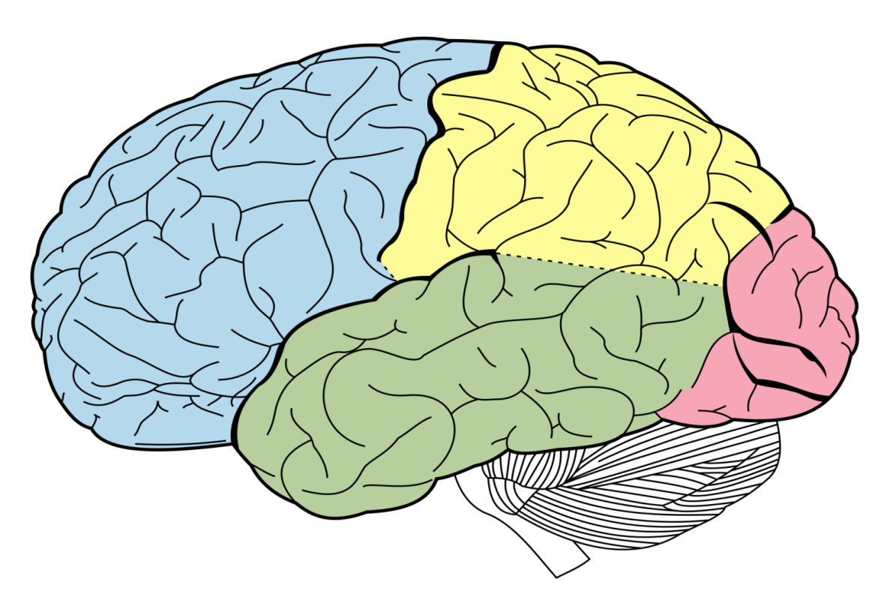
The structure and functions of the brain
Draw a rough sketch of the brain opposite, making sure you divide it up into areas
Then complete the tasks on the worksheet without looking at your notes (work in pairs)

Slide 7
The structure and functions of the brain
Motor area (movement)
Somatosensory area (perception of touch)
Auditory area (hearing)
Visual area
Broca’s area
‘speech production’
Wernicke’s area
‘language comprehension’

Slide 8
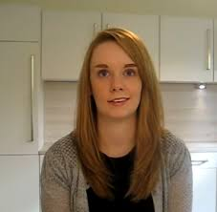
A demonstration of Broca’s Aphasia
Which hemisphere of the brain do you think was damaged by the stroke?
For most people, the language centres of the brain are located in the left hemisphere, so it is likely in Sarah’s case that stroke caused damage to the left hemisphere

Slide 9
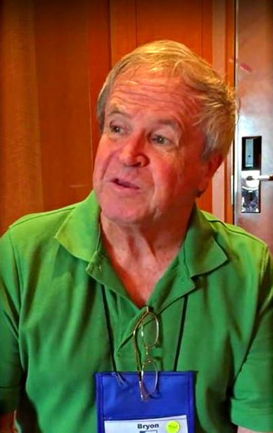
A demonstration of Wernicke’s Aphasia
Watch the case of Byron, who has Wernicke’s aphasia. In what way do his symptoms differ from Sara’s
He can speak far more fluently than Sarah, but what he says doesn’t make much sense, and he doesn’t understand what is being said to him
Why is this?
Because Wernicke’s area is associated with language comprehension

Slide 10
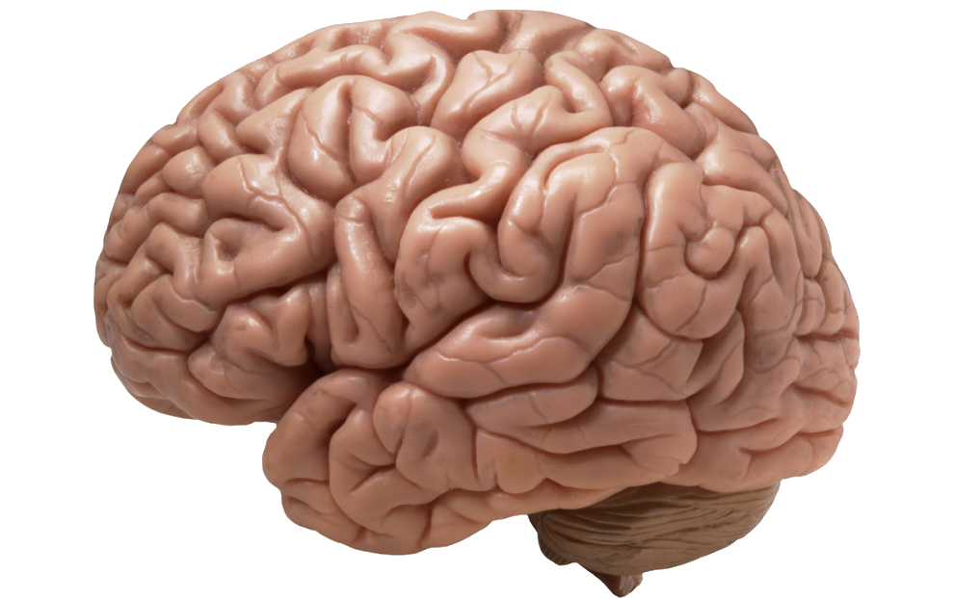
Localisation of the Brain
The theory of brain localisation can be challenged by an alternative view. What do you think that view might be?
Holism or multi-functionalism
The only way we can assess which theory is most likely to be true is to examine the evidence

Slide 11
Localisation of the Brain vs Holism: Research Evidence
For each of the studies below, decide whether they support localisation or holism and write a statement linking the finding back to how it supports that particular theory
1. Petersen et al (1988) used brain scans to demonstrate how Wenicke’s area was active during a listening task and Broca’s area was active during a reading task
2. The Case of Clive Wearing: An individual with brain damage as of a result of a viral infection, had damage to his semantic long term memory, however little damage to his procedural memory
3. Lashley removed between 10-50% of areas of the cortex in rats. The rats were learning a maze. No particular area was shown to be more important in terms of the rats’ ability to complete the maze.
4. Karl Wernicke worked at a hospital in Germany and found patients who had damage in an area close to the auditory cortex in the left temporal lobe had specific language impairments including the inability to comprehend language and a struggle to locate the word they need
5. Evidence shows that when the brain has become damaged through illness or accident and a particular function has been compromised or lost, the rest of the brain appears to be able to reorganise itself to recover the function. An example of this is in stroke victims many of whom seem to able to recover abilities that were seemingly lost as a result of illness (E.g. speech)

Slide 12
Exam Practice
Answer the following question individually, without notes:
A neurologist found that his patient, Walter, was experiencing a pattern of language difficulties that he has seen before. Walter was able to understand speech and could make the odd sound, but was unable to express any words coherently.
Using your knowledge of localisation of function, explain what areas of the brain might be affected. (4 marks)
Now mark your own answer according to the guidance on the next slide. Some of you will be asked to read your answer out to the class

Slide 13
Exam Practice: Mark Scheme
Broca’s area in the left frontal lobe is thought to be responsible for speech production. (1 mark) As Walter can only ‘make the odd sound’ and is unable to ‘express any words coherently’ this area may be affected and he may be suffering from damage to this region. (1 mark) The Wernicke’s area in the left temporal lobe is responsible for language comprehension. (1 mark) As Walter is ‘able to understand speech’ it would suggest that this area is working normally. (1 mark)

