Slide 1
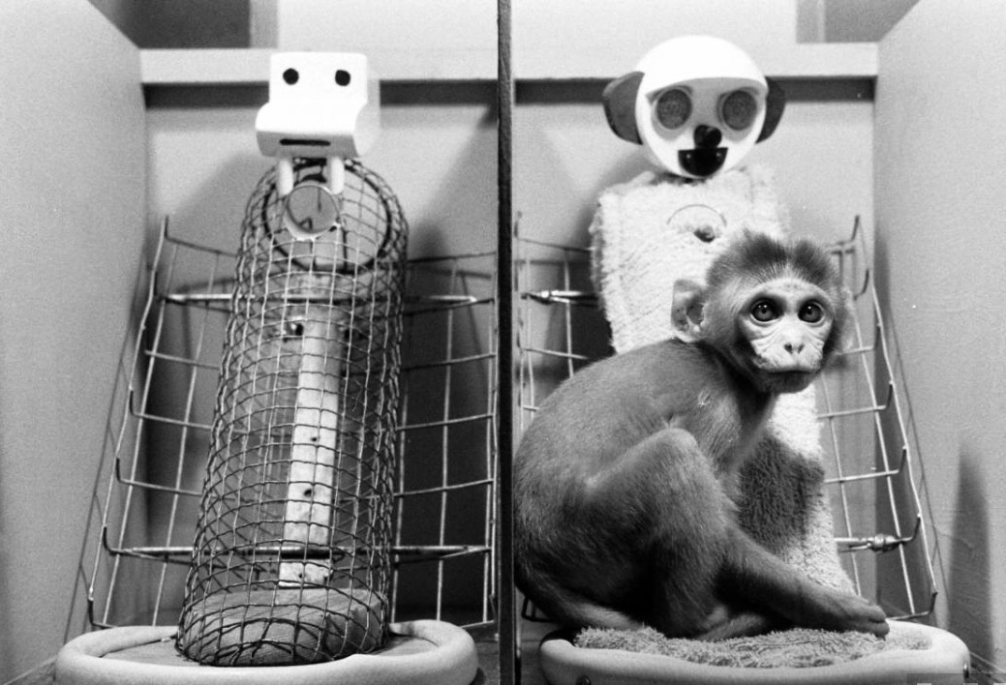
Starter: On BWB
In your groups, each person explain one criticism of animal studies of attachment (do it in pairs if you have more than three people in the group)

Slide 2
Explanations of attachment: AO1
Nature versus Nurture

Slide 3
If you believe that attachment is a result of nature then it may be…..
Nurture is then….
Note that the evolutionary explanation of attachment falls on the nature side of the debate and the Behavioural explanation falls on the nurture side of the debate
Do you understand what each of the terms in the boxes mean? See if you can explain them in your groups
Learnt
Conditioned
Environmental
Empiricist
Behavioural
Hardwired
Innate
Genetic
Pre-disposed
Biological
Heredity
Nativist
Evolutionary

Slide 4
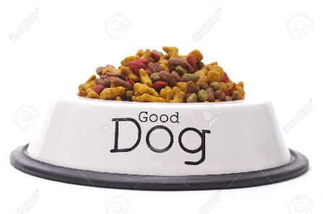
The Learning Theory of Attachment: Classical Conditioning
What do you think it going on in the scenario below?

Slide 5
The Learning Theory of Attachment: Classical conditioning
The following terms are associated with classical conditioning theory. What do they mean? Write down the definitions of each
Unconditioned stimulus
Conditioned stimulus
Neutral stimulus
Unconditioned response
Conditioned response
How do these terms relate to the Pavlov scenario? In pairs, see if you can draw it out on a mini whiteboard with the help of the pictures on the next slide

Slide 6
The Learning Theory of Attachment: Classicial conditioning
Add the terms associated with the classical conditioning theory

Slide 7
The Learning Theory of Attachment: Classicial conditioning
The classical conditioning explanation of attachment says that babies respond to all humans in the same way when they are born and have no preference for anybody.
It is through feeding (which gives the baby pleasure) that attachment is formed
Now can you draw the classical conditioning diagram for how a child becomes attached to their mother through classical conditioning?

Slide 8
Behaviourist theories of attachment: Operant conditioning
Operant conditioning is also part of the learning theory.
It says- “All humans possess primary motives or drives (sex, hunger, thirst) and any stimuli satisfying theses drives are primary reinforcers and are positively reinforcing.”
On MWB-
For a baby what is its primary drive?
So then what is its primary reinforcer?
How is this positively reinforcing?

Slide 9
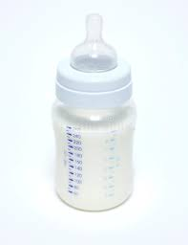
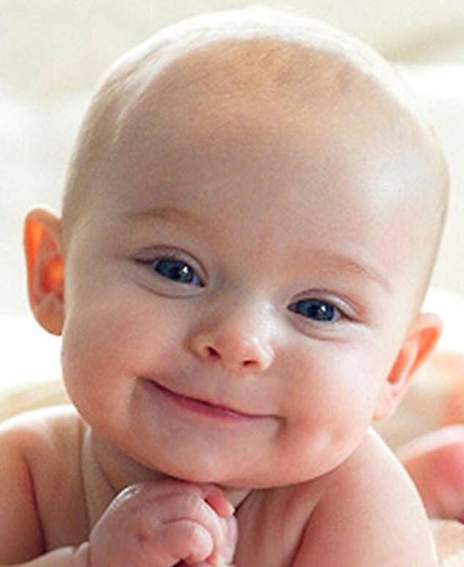
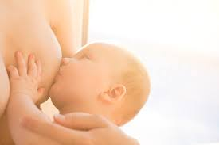
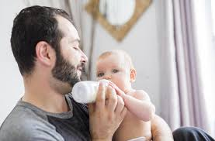
Primary drive is hunger
Baby’s primary drive is reduced and they feel pleasure so positively reinforcing
Therefore, the primary reinforcer is food
The secondary reinforcer is something that leads to the primary reinforcer. Who, or what, do you think that is?
The person who feeds the child

Slide 10
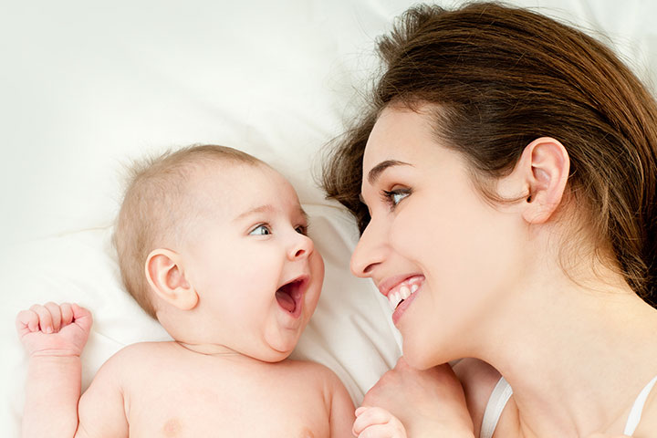
Behaviourist theories of attachment: Operant conditioning
Therefore, the baby behaves in ways that keeps the caregiver close, these are the behaviours that characterise the attachment

Slide 11
Exam practice
Now individually, see if you can answer the following question:
Outline the learning theory of attachment (6 marks)
Don’t forget to use the specialist terms in your outline!
Now read your answer out to your group and mark each other’s

Slide 12
Exam practice: mark scheme
According to learning theory, attachment is wholly learned in the environment as a result of the child’s experiences (1 mark)
The classical conditioning explanation suggests that milk is an unconditioned stimulus that elicits the unconditioned response of pleasure (1 mark)
The mother is a neutral stimulus and elicits no response before learning has taken place (1 mark)
However, after several pairings with the milk (UCS), she becomes the conditioned stimulus (CS) that automatically elicits a conditioned response (CR) of pleasure which forms the basis of the attachment (1 mark)
According to the operant conditioning explanation, food is a primary reinforcer because it directly satisfies the drive of hunger. Whereas the mother is a secondary reinforcer as she represents the means of achieving the primary reinforce of food (1 mark)
Therefore the baby behaves in ways that keep the mother close (e.g. crying, smiling) and these behaviours are what we understand as attachment (1 mark)

Slide 13
Bowlby’s Monotropic Theory
Is Bowlby’s theory on the nature or nurture side of the debate?
Bowlby believed that babies are biologically programmed from birth to attach in order to increase their chances of survival.
So attachment is innately programmed
Is this true or false?

Slide 14
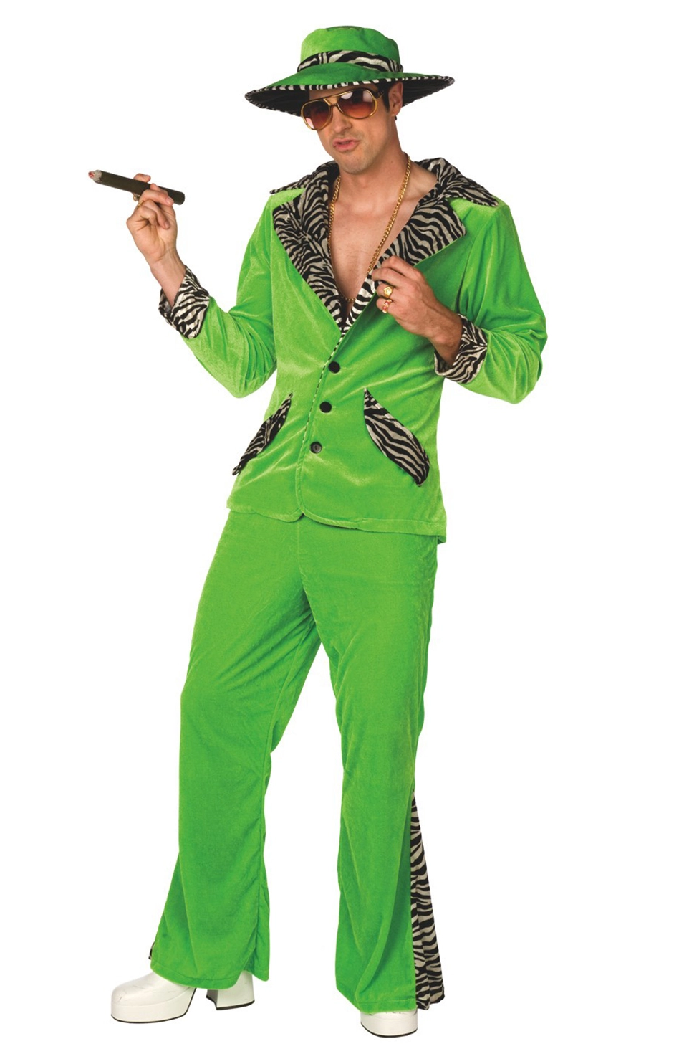
Bowlby’s Monotropic Theory
On MWBs, using what you learned in the preparation homework, list the 6 features of Bowlby’s theory
Use the mnemonic
to help you
Sic Pimp
On the next slides we are going to
look at these features of attachment
in more detail

Slide 15
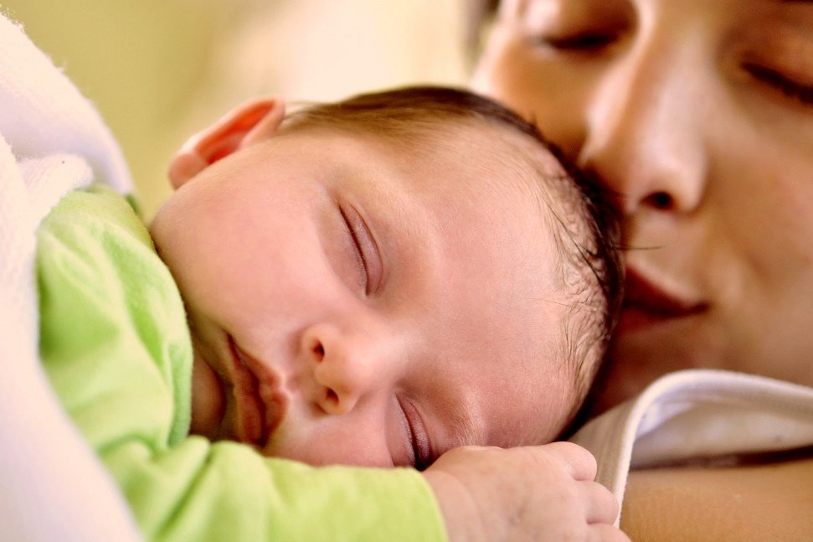
Bowlby’s Monotropic Theory: Proximity
Bowlby believed that babies are programmed to seek proximity to their caregiver. He also believed that proximity was more important to a baby than food. Why do you think that is?
Proximity protects the baby from immediate danger
In pairs, list some things that might pose a threat to a young child

Slide 16
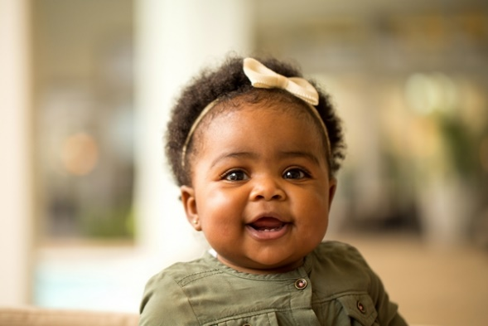
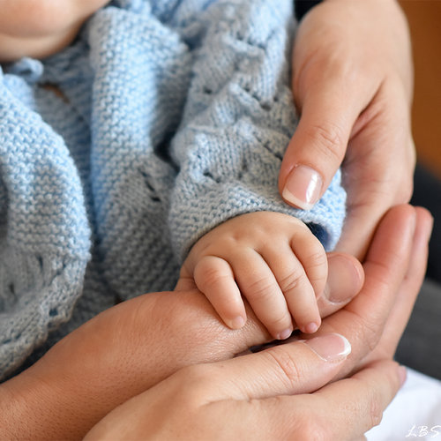
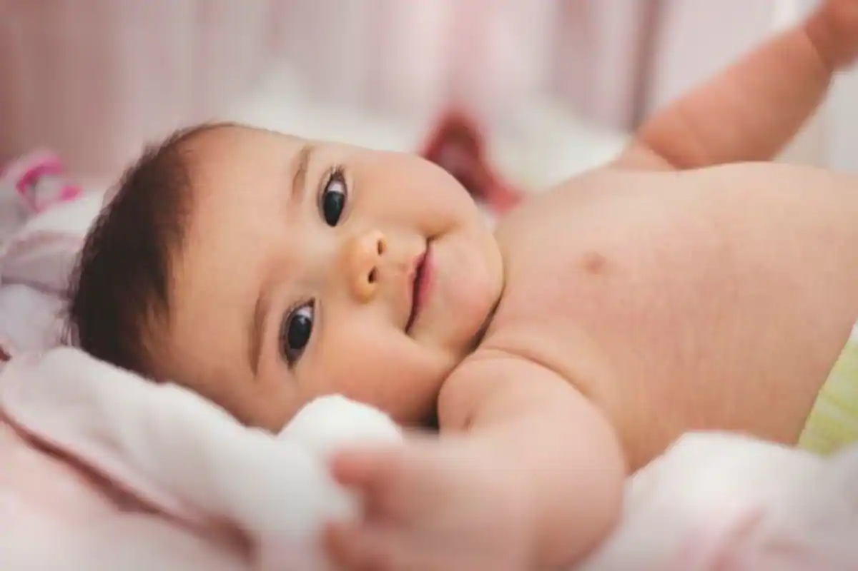
Bowlby’s Monotropic Theory: Social Releasers
Look at the following pictures and note down the emotional reaction you have to each
What features do these babies have that evoke a caring response?
Why do you think Bowlby suggests that these features have been ‘selected in’ through the process of evolution?

Slide 17
Bowlby’s Monotropic Theory: Social Releasers
Watch the video clip for a demonstration of social releasers

Slide 18
Bowlby’s Monotropic Theory: Social Releasers
Social releasers are innate mechanisms such as; smiling, cuteness, crying, clinging, baby faces, small hands.
Social releasers are important as they elicit caregiving from the parent
Social releasers help the development of the parent-infant attachment
If a baby is lovable then it will be protected by it’s parent or other adults around them, and thus is more likely to survive

Slide 19
Bowlby’s Monotropic Theory: Monotropy
On MWBs, what is meant by the term Monotropy?
Can this attachment be made with a male substitute?

Slide 20
Bowlby’s Monotropic Theory: The Internal Working Model
Christine is a middle aged woman who has always had trouble maintaining relationships. She needs constant reassurance from her partner that he loves her and tends to be very clingy and reluctant to let her partner meet friends without her being there. Consequently, her partners usually end up breaking off the relationship. When Christine was a baby, her father left the family home. Christine’s mother was very young and often did not respond to her baby’s needs very well. Christine was left crying and hungry for long periods of time. She did not attempt to engage Christine in play and did not show much interest in her baby’s development
Using what you know about the internal working model, explain Christine’s problems forming adult relationships

Slide 21
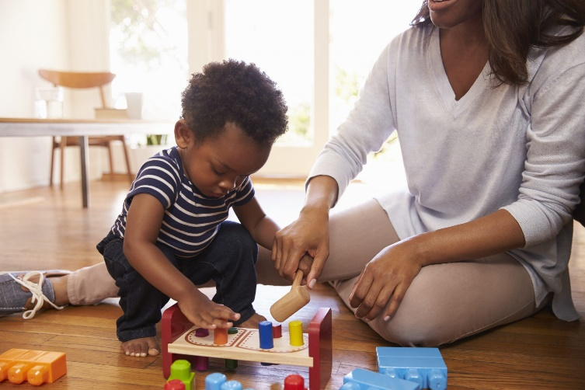
Bowlby’s Monotropic Theory: The Internal Working Model
According to Bowlby, the first relationship forms a template for all later relationships
If we have a happy and secure relationship with our mother or permanent mother substitute, then we are likely to have happy secure relationships and friendships in adulthood
But those who have an insecure relationship with their primary caregiver are likely to continue that pattern into adulthood

Slide 22
Bowlby’s Monotropic Theory: The Internal Working Model

Slide 23
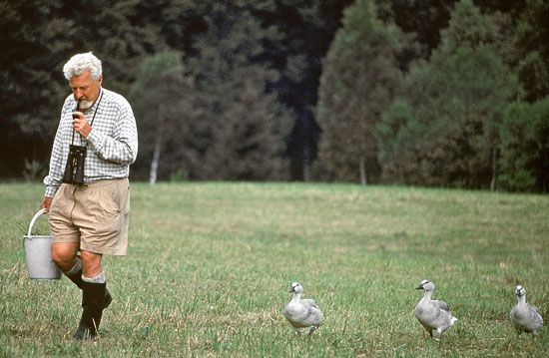
Bowlby’s Monotropic Theory: Critical Period
Where do you think the idea for a critical period of attachment came from?
Bowlby took this idea from the work of Lorenz, who suggested that if young geese did not imprint soon after hatching, they would loose the ability to do so
Bowlby believed that the same was true for humans. What did he suggest was the critical period for human attachment?
Bowlby believed that the critical period for attachment in humans ended at around 4 years, although he believed that the first two and a half years with the most important for forming an attachment

Slide 24
Bowlby’s Monotropic Theory: Can you remember what the 6 parts of the theory are?
Write them out, individually, on a MWB
Sic Pimp

