Slide 1
Evaluation of Theories of Attachment
Learning Theory & Bowlby’s Monotropic Theory

Slide 2
Starter Question
Answer the following question individually, without notes:
Outline Bowlby’s monotropic theory of attachment (6 marks)
Tips: you don’t have to write about every aspect of Bowlby’s theory. For a six mark question, you probably need to include three aspects of Bowlby’s theory and explain them clearly
Now swap over with someone on your table and award a mark according the guidance on the next slide

Slide 3
Mark Scheme
Award marks for the following:
Bowlby believed that the ability to form attachments is innate, in other words the child is born with it (1mark). He believed attachment has been selected in because it aids the survival of the infant (1 mark)
Bowlby believed there was a critical period for attachment (1 mark) and that if this monotropic attachment hadn’t occurred by the age of two then a child will have difficulty forming attachments later on in life (1 mark)
He believed that babies instinctively seek proximity to their principle carer for safety (1 marks) as it protects them from hazards, for example wild animals, cars, ponds, electricity etc and thus ensures their survival (1 mark)
Bowlby believed that the attachment the child forms with the mother or permanent mother substitute is different in quality to other relationships (1 mark), and is the most important attachment the child has, a concept he referred to as monotropy (1 mark)
The child’s first relationship forms a mental representation or a model for what relationships are like, this is known as the internal working model (1 mark). It can therefore have a powerful effect on the nature of a child’s future relationship and their ability to be a parent themselves. (1 mark)
Social releasers are important for the development of this parent-infant attachment as they elicit caregiving from the parent (1 mark). Social releasers are innate mechanisms so natural characteristics or behaviours, such as large eyes, soft skin, or crying (1 mark)

Slide 4
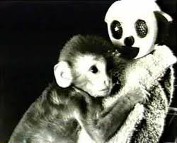
Evaluation of the Learning Theory of Attachment
Harlow’s study of attachment contradicts the learning theory of attachment. On MWBs, in pairs, state exactly why this is the case
Write the link back point for this piece of evidence. How exactly does it contradict the learning theory of attachment?

Slide 5
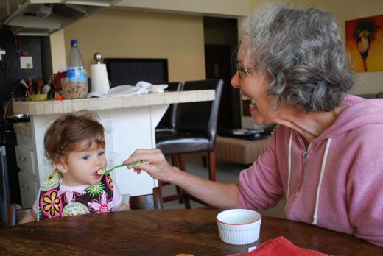
Evaluation of the Learning Theory of Attachment
Other research also contradicts the learning theory of attachment. Consider the following research finding related to Schaffer & Emerson’s Glasgow study:
Schaffer and Emerson found that in 39% of cases, the baby’s main attachment was not to the person who took care of its daily needs, but in most cases, it was to the mother
What does this finding mean, and how does it contradict the learning theory of attachment?

Slide 6
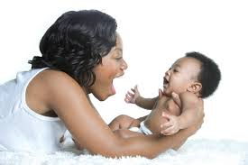
Evaluation of the Learning Theory of Attachment
One problem with the learning theory of attachment is that is could be considered too simplistic
What concept that we looked at early on in the topic was found to be an important factor in attachment formation?

Slide 7
Evaluation of the Learning Theory of Attachment
Can you write a PEEL point with the answer to the question on the last slide?
Start with: The learning theory of attachment could be considered too simplistic as it suggests that food is the factor that leads to attachment. However…

Slide 8
Evaluation of Bowlby’s Monotropic Theory of Attachment
Although Harlow’s monkey study contradicts the learning theory of attachment, it supports Bowlby’s theory
Can you think of three ways it supports it? (you will need to remember the precise finding of the study)

Slide 9
Evaluation of Bowlby’s Monotropic Theory of Attachment
We can use Schaffer and Emerson’s research to challenge Bowlby’s assumptions
Identify two findings from Schaffer & Emerson’s study that challenge Bowlby’s theory, and say which aspects of the theory they challenge

Slide 10
Evaluation of Bowlby’s Monotropic Theory of Attachment
Bowlby’s research can be considered socially sensitive
What does this mean?
Can you identify all the reasons why it is socially sensitive?
Can you link any of your points to economic implications?

Slide 11
Recap Quizlet

Slide 12
Can you apply what you have learned to an essay?
You are going to have a go at writing the following essay:
Two mothers at the toddler and parent group are chatting:
Jane: “I always felt sorry for my husband when Millie was a baby. He used to say his bond with Millie was not as strong as mine because I was breastfeeding.”
“I’m not sure”, replies Judy. “I think there’s something important about a mother’s love that makes it more special anyway, and so important for future development.”
Discuss the learning theory of attachment and Bowlby’s monotropic theory of attachment. Refer to the conversation above in your answer (16 marks)
Tips before you begin:
Start by identifying what bits of the theory are being referred to in the scenario. This is what you need to write about. You won’t have time to write about all of both theories, so select your information carefully
Can you remember the breakdown of marks for a 16 mark application essay?
Give the outline before you try to apply to the scenario
You should give one evaluation point for each theory, or give evaluation points that relate to both theories
You can have 5 minutes to discuss the essay in pairs, but then you will write it individually in 20 minutes

