Slide 1
Ainsworth’s Strange Situation Research

Slide 2
Questions on the strange situation study
Answer in pairs, on a sheet of paper. No notes
What type of research method was used in the study?
How old were the infants being observed?
What behaviours were being measured?
What were the three attachment types called?
What attachment type was Baby G displaying in the clip?

Slide 3
Questions on the strange situation study
Did you get it right?
What type of research method was used in the study?
How old were the infants being observed?
What behaviours were being measured?
What were the three attachment types called?
What attachment type was Baby G displaying in the clip?
Controlled observation
9-18 months
How the child reacted to the mother leaving, how they reacted to the mother returning, how they responded to the stranger
Secure, insecure avoidant, insecure resistant
Secure

Slide 4
The strange situation study
In your groups, without looking at your notes, jot down what happens in each stage of the strange situation procedure
Now check against the pack. Did you get it right?

Slide 5
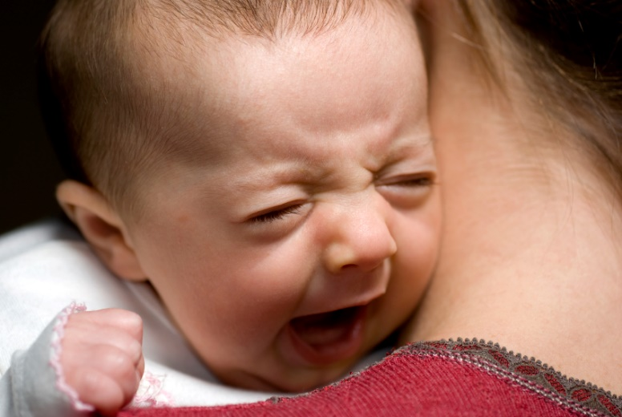
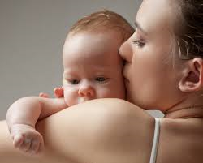
The strange situation study
Watch the clips and see if you can work out what the attachment type is (ignore the label on the video – one of them is definitely wrong) and justify your answer
Baby 1
Baby 2

Slide 6
The strange situation study
In groups, on MWBs, draw out the following table and complete it without looking at your notes:
Type of Attachment | Percentage of babies | Behaviour observed
Insecure avoidant
Secure
Insecure resistant

Slide 7
The strange situation study
Did you get it right?
Type of Attachment | Percentage of babies | Behaviour observed
Insecure avoidant | 22% | High willingness to explore. Low stranger anxiety, no distress on separation, doesn’t seek contact when mother returns
Secure | 66% | High willingness to explore, some distress on separation but easily comforted by the mother when she returns to the room. High stranger anxiety
Insecure resistant | 12% | Low willingness to explore. High stranger anxiety. High distress on separation from the mother. Seeks contact with mother when she returns, but also rejects her

Slide 8
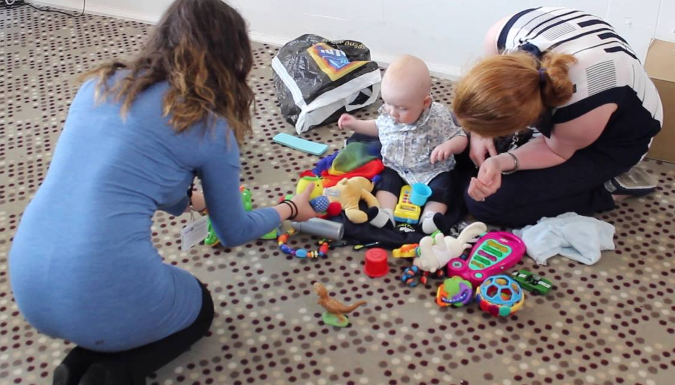
Evaluation of the strange situation
Read the following findings and, on MWBs, say what that finding suggests about the Strange Situation study. You will need to use your knowledge of research methods terminology to be able to do this
Different observers watching the same children tend to agree on what attachment type to classify infants as. Bick (2012) found the similarity between different observers classifications was as high as 94%
Vaughn and waters (1990) compared the behaviour of 1 year olds in the strange situation and at home and found that children who had been assessed as securely attached in Ainsworth’s procedure, also displayed secure attachment behaviour in the home
Now see if you can make a statement linking back to what this means for the research
Start you statement with:
“This means that we can be sure that…”

Slide 9
Evaluation of the strange situation
Answer the question on MWBs:
What did Ainsworth believe was responsible for a baby’s attachment type?
What then might lead to a child developing a secure attachment, and what might lead to a child developing an insecure attachment?
Now read the case study on the next slide and think about what it might suggest about a baby’s attachment type

Slide 10
Evaluation of the strange situation
“During the first six months of Noah’s life, I don’t think I slept for more than two hours at a time on any one night. Noah was constantly crying and whatever I did he didn’t seem to stop. He was assessed by a doctor, but there was no physical problem. It was difficult for me, as I felt as if whatever I did for him, it didn’t seem to have any effect. I was tired all the time and spent a lot of time crying. After a few months, my doctor suggested that I may be suffering from depression and started me on anti-depessants. My first child was really easy. She slept through the night from 8 weeks old, and was generally quite a calm baby. It was such a shock having Noah”
How do you think having a baby like Noah might affect a mother’s behaviour?

Slide 11
Evaluation of the strange situation
Kagan proposed the temperament hypothesis, which suggests that babies may be born with an innate temperament that possible influences the way the mother reacts to the baby.
Although there is limited evidence to support the temperament hypothesis, it does highlight a problem with Ainsworth’s conclusion
Why might we consider the research to be socially sensitive?
In pairs, on MWBs, write a statement suggesting why Ainsworth is unable to establish that the mother’s behaviour is responsible for the baby’s attachment type. In your statement attempt to use the following terms, but it must be specific to the study, not generic:
Cause effect control

Slide 12
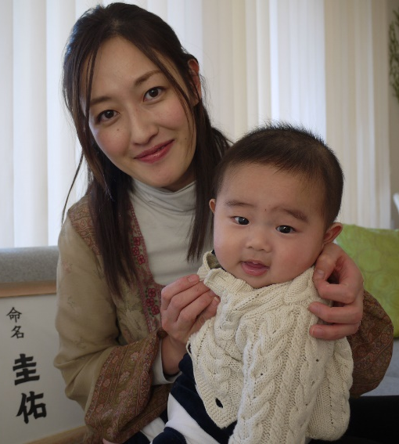
Evaluation of the strange situation
Japanese mothers are so rarely separated from their children that they show very high levels of separation anxiety and in observations Japanese mothers tended to race to their children and scoop them up at the reunion stage meaning the response was hard to observe
27% of Japanese babies were classified as insecure resistant, a much high proportion than in western cultures
Now see if you can write a PEEL point for this research
On MWBs, in pairs, from the information above, can you identify a problem with Ainsworth’s research?
What is the possible consequence of this bias? (use the second bullet point to help you come up with an answer)

Slide 13
Exam Practice
Answer the following question individually without notes:
A researcher used the Strange Situation to investigate the attachment types of two infants. Megan was classified as insecure-avoidant. Rosie was classified as insecure-resistant.
Explain how Megan’s behaviour would differ from Rosie’s behaviour in the Strange Situation. (4 marks)
Now mark you own answer according to the guidance on the next slide

Slide 14
Exam Practice: Mark Scheme
Answer the following question individually without notes:
A researcher used the Strange Situation to investigate the attachment types of two infants. Megan was classified as insecure-avoidant. Rosie was classified as insecure-resistant.
Explain how Megan’s behaviour would differ from Rosie’s behaviour in the Strange Situation. (4 marks)
Answer:
Separation behaviour – insecure avoidant (Megan) seem unconcerned when mother leaves, (1 mark) whereas insecure resistant (Rosie) show intense distress (1 mark). Reunion behaviour – insecure avoidant show little reaction when the mother comes back (1 mark), whereas insecure resistant may cling to their mother, but show ambivalent behaviour towards her (1 mark).

