Slide 1
Infradian Rhythms
The Menstrual cycle

Slide 2
Infradian Rhythms – the menstrual cycle
What do you know about the menstrual cycle? On MWB
What happens on day 1 of the menstrual cycle?
the first day of a woman’s period
How long does the ‘average’ cycle last for?
average cycle lasts for 28 days
The cycle varies in females, give an example of a short cycle (in days) and a long cycle
short cycle 21 days, long cycle 35 days
What are the two hormones that regulate the menstrual cycle?
Oestrogen & Progesterone

Slide 3
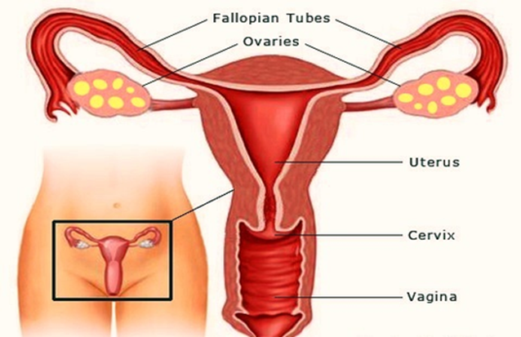
The menstrual cycle: Endogenous pacemakers (hormones)
The glands important for the menstrual cycle are the ovaries. As you know the hormones released are oestrogen & progesterone (endocrine system).
What are the missing words?
Preparing for ____________?
Promoting ____________?
After ovulation, progesterone levels increase, the lining of the womb (uterus) thicken with blood in readiness for embryo development - a baby!
Oestrogen has the main function of promoting __________?. It is at its highest around half-way through the cycle
Fertilisation
Ovulation

Slide 4
The menstrual calendar
In your groups, draw up a monthly calendar on your BWBs, like this:
Number the days 1 – 28
Can you list the hormonal events of the menstrual cycle and their consequences on your calendar?
Start with what happens on day 1
Check on the next slide to see if you got it right

Slide 5
The menstrual calendar
Did you get this?
The increase in oestrogen leads to ovulation around the14th day of the menstrual cycle. Following that, progesterone levels increase and this causes the womb lining to thicken in preparation for the fertilised embryo to embed. Levels of both hormones remain high until approximately day 26, when if no embryo has embedded in the womb, levels of both hormones drop sharply, which triggers the menstrual period, the shedding of the thickened womb lining
1st day of menstural period
An egg is released from one of the ovaries (ovulation)
Levels of oestrogen increase
Levels of progesterone increase while levels of oestrogen stay high
If the egg has not been fertilised, there is a sharp drop in levels of oestrogen & progesterone
Levels of progesterone increase while levels of oestrogen stay high

Slide 6
The Menstrual cycle: Exogenous zeitgebers
Answer the following questions on MWBs
What two external factors are thought to have an influence over the menstrual cycle?
Light & pheromones
How does light affect the menstrual cycle?
A lack of light shortens the cycle
How do pheromones affect women’s menstrual cycles?
Synchronising when living with other women

Slide 7
Research into the menstrual cycle
On MWBS: For each piece of research, say whether it relates to the effect of light, or pheromones. Write a statement for each one linking back to what it suggests about the menstrual cycle
McClintock and Stern (1998)
used a sample of 29 female university students, not taking birth control pills. Samples of sweat were gathered from 9 of the women at different stages of their menstrual cycle, via a cotton pad placed under their armpit. The pads were treated with alcohol and frozen (to eliminate any bacteria). This was the control group.
The odour from these pads were inhaled by the other 20 women (the experimental group) by being rubbed on their upper lip. On day 1, pads from the start of the cycle were applied to the 20 women, on day 2 they were given pads from the second day of the cycle, and so on.
when the experimental group inhaled secretions from women who were about to ovulate, their menstrual cycles became shorter. When they inhaled secretions from women who had just ovulated, their menstrual cycles became longer. The experimental groups’ menstrual cycles were affected by the secretions from the control group. On 68% of occasions the recipients of the sweat donation had experienced changes to their cycle which brought them closer to their ‘odour donor’.
Pheromones
It supports the view that other women’s pheromones have a synchronising effect on the menstrual cycle

Slide 8
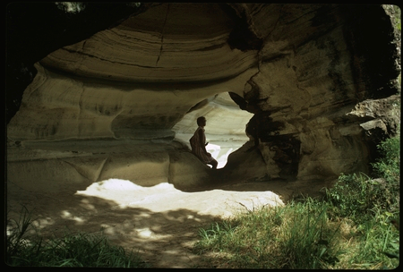
Research into the menstrual cycle
Reinberg (1967) conducted a study where one female participant spent three months in a cave with only a small lamp. Reinberg noted that her menstrual cycle shortened from the usual 28 days to 25.7 days
does it relates to the effect of light, or pheromones? Write a statement linking back to what the study says about the menstrual cycle
light
It suggests that a lack of light has the effect of shortening the menstrual cycle

Slide 9
Exam practice
Have a go at the following exam questions individually and without notes:
1. Explain what is meant by the terms infradian rhythm and ultradian rhythm (2 marks)
2. Give one example of an infradian rhythm and one example of an ultradian rhythm (2 marks)
3. Outline one research study that has investigated infradian rhythms (4 marks)

Slide 10
Possible answers – note down any changes needed to your answers
1. Explain what is meant by the terms infradian rhythm and ultradian rhythm (2 marks)
Infradian and Ultradian Rhythms are both biological Rhythms. Infradian Rhythm is a term that refers to cycles that longer than 24 hours to complete. (1 mark) Ultradian Rhythms is a term that refers to rhythms that take less than 24 hours to complete. (1 mark)

Slide 11
Possible answer – note down any changes needed to your answers
2. Give one example of an infradian rhythm and one example of an ultradian rhythm (2 marks)
One example of an infradian rhythm is the female menstrual cycle because it takes 28 days to complete (1 mark). An example of an ultradian rhythm is the cycle of sleep because it completes in less than 24 hours (1 mark)

Slide 12
And finally…
3. Outline one research study that has investigated infradian rhythms (4 marks)
One research study in infradian rhythms was by McClintock and Stern.
The Control group were 9 women of which pheromone samples were taken from them at various stages of their menstrual cycle. Cotton pads were placed under their armpit and worn for 8 hours (1 mark).
The experimental group of 20 women had the odour of the pads rubbed onto their upper lip. For example, on day 1, pads from the start of the cycle were applied, day 2, pads from the second day etc. (1 mark) They found the experimental groups cycle shortened if they inhaled secretions from women about to ovulate and vica versa. On 68% of occasions women from the experimental group had changes to their cycle (1 mark).
The study shows synchronisation and how pheromones, an exogenous zeitgeber, possibly affected their menstrual cycle (infradian rhythm) (1 mark).

