Slide 1
Essay Reflection- tips
Appropriate detail for AO1
Be Evidence based throughout
Remain formal in your writing
Do not include too much detail in the studies
Think about timing- too much on AO1?
Make sure evaluation is of the explanation and not just the research
Consider individual differences as an evaluation point- good or bad?
Consider application as an evaluation- good or bad?

Slide 2
Complete handout

Slide 3
Why do we remember or forget?

Slide 4
Memory Models
The Multi Store model
Working memory model
Levels of Processing

Slide 5
Draw on your whiteboards the multi-model of memory

Slide 6
Today
Features of Short term memory
(Coding, Capacity and Duration)
Next lesson
Features of Long term memory

Slide 7
Memory stores
Short Term memory
Long Term memory

Slide 8
On mini whiteboards draw and fill in grid below
 | (main) CODING | DURATION | CAPACITY
Sensory register
Short term memory
Long term memory

Slide 9
Should look something like this
 | (Main) CODING (form) | DURATION (how long) | CAPACITY (how much)
Sensory register | Iconic,echoic, other | Iconic-1/2 s Echoic-3 s | Very large
Short term memory | acoustic | 15-30 seconds | 7 items
Long term memory | semantic | A life time | unlimited

Slide 10
Now it’s your turn!
Your are psychologists investigating the nature of one of the short term memory stores. WITHOUT YOUR PACKS
Your task is to design an experiment to discover for example what the capacity of short term memory is (although you already know but pretend you don’t).
1.Coding of STM 2. Duration of STM 3.Capacity in STM
You must include -IV and DV, hypothesis, description of method and apparatus you would use, how would you prevent extraneous variables? How would you collect your data?

Slide 11
Social Influence assessment

Slide 12
Recap- Research
Coding- How
Duration- How long
Capacity how much

Slide 13
Coding
Our ideas

Slide 14
Coding
Baddeley (1966)
Four groups
A, B, C , D
I will read you a list
Write down as many as you remember

Slide 15
List A
Man
Cap
Can
Cab
Mad
Mat
Cat
Map

Slide 16
List B
Pit
Few
Cow
Pen
Sup
Bar
Day
Kit

Slide 17
List C
Large
Big
Huge
Broad
Tall
Fat
Wide
High

Slide 18
List D
Good
Huge
Hot
Safe
Thin
Deep
Strong
Foul

Slide 19
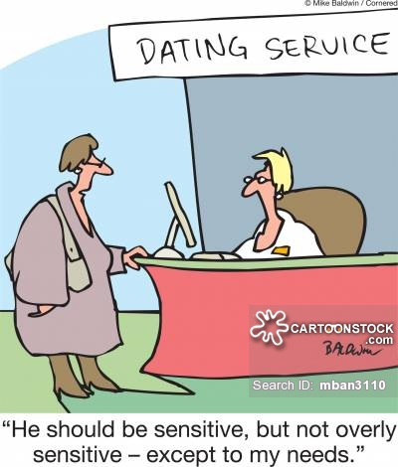
Encoding results:
The Mean
Most sensitive measure
More representative
☹ Can be distorted
 | memory
Acoustically similar
Acoustically dissimilar
Semantically similar
Semantically dissimilar

Slide 20
Findings in the original study
Participants tended to do worse with acoustically similar words
Participants in LTM did worse in semantically similar
Therefore
Short term memory is stored acoustically
Long term memory is stored semanticall

Slide 21
Encoding Evaluation
Artificial stimuli
Just words- who cares?

Slide 22
The Mean
Most sensitive measure
More representative
☹ Can be distorted

Slide 23
Duration of STM
Peterson and Peterson
Watch the Powerpoint
You will be presented with 3 letters
You will count backwards in threes from three numbers then recall (write down) the letters

Slide 24
Practice

Slide 25
SMP

Slide 26
395

Slide 27
Ready?

Slide 28
XTR

Slide 29
289

Slide 31
FBW

Slide 32
495

Slide 34
LCP

Slide 35
987

Slide 37
GZV

Slide 38
531

Slide 40
HSL

Slide 41
246

Slide 43
XFT

Slide 44
267

Slide 45
Results
How many did you get right?
XTR
FBW
LCP
GZU
HSL
XFT

Slide 46
Evaluation
Over emphasises the role of rehearsal
Could be displacement

Slide 47
Capacity in STM
Jacobs (1886) Digit Span- You will participate in this
And Miller (1956) Chunking

Slide 48
Digit span task
Watch the powerpoint
Write down the words immediately after each presentation of each list

Slide 49
Stimulus List for Digit Span Demonstration
8 1 3 0
2 5 3 6 8
3 7 9 2 5 6
0 7 1 8 4 5 3
1 2 7 5 3 6 3 4
1 0 8 3 2 3 7 5 4
4 6 9 7 3 4 6 1 2 7

Slide 50
Other research- Chunking
Which list would be easier to remember? Why?
Y E B N O I P D T A L G R C U
C A R D O G L I T P E N B U Y

Slide 51
STM capacity
Jacobs (1887) research on the capacity of STM
Jacobs conducted the first systematic laboratory study on the capacity of memory and found that the amount of information which can be remembered on one exposure is between five and nine items, depending on the information.
This is usually phrased as 7 + or – 2, so the capacity of STM is known as 7+ or – 2 items.
Participants were presented with a sequence of digits or letters and required to repeat them back in the same order. The pace was controlled at half second intervals using a metronome. The procedure was repeated a number of times and the longest list of sequences that was correct 50% of the time was the participants digital span.
Jacobs found that participants recalled more digits than letters. The average span for digits was 9.3, whereas it was 7.3 for letters. Jacobs also found that capacity increased steadily with age; in one sample of school girls he found that 8 yrds remembered an average of 6.6 digits whereas for 19 yrds it was 8.6 digits.

Slide 52
Evaluation
Lacking Validity
Control
Could have overestimated the role of capacity

Slide 53
Homework- Reading week
Reading week homework Homework pack 2 1. Complete Flashcards for Social Influence 2. Activity A in the homework pack 3. Read from packs (supplementary) and create notes/revision cards on the studies for
Sensory register- coding, duration and capacity short term memory- coding, duration and capacity Long term memory- coding, duration and capacity

