Slide 1
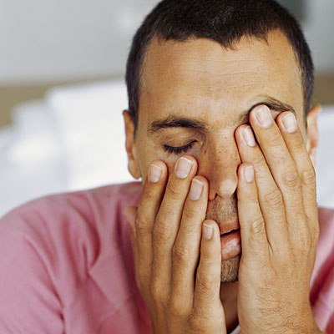
Narcolepsy
Sam, Daria, Ella, Jemma and Emily

Slide 2
Evidence for Narcolepsy
DEMENT – mice with low hypocretin.
Mice who couldn’t make hypocretin developed symptoms of narcolepsy.
Increased sleep attacks and cataplexy (strong emotion causes sudden collapse e.g laughter)
→ supports low hypocretin theory as it demonstrates the importance of neurotransmitters in sleep and causing sleep disorders.
→ BUT - Hard to generalise as mice aren’t humans and the research may not be applicable to humans.

Slide 3
Evidence for Narcolepsy
PICCHONI – Questionnaire on stressors and infections.
63 narcoleptics and 63 people in control group asked to complete questionnaire which assesed frequency and timing of stressors/infections.
Flu and stress were linked to an increased risk. Exposure to the infection before hitting puberty had a more increased risk of developing Narcolepsy.
Supports the idea that being exposed to risk factors increases the likelihood of developing narcolepsy – can be explained by the reducing of neurons producing hypocretin.
Does take into account the environment e.g sleep patterns and stress.

Slide 4
Evidence for Narcolepsy
Aldrich- Narcolepsy in dogs
A number of strains of dogs exhibit narcolepsy
Where following excitement they suddenly keel over and pass directly into REM sleep
→ Supports the role that exciting stimulants such as food or other dogs does lead to narcolepsy occuring

Slide 5
Evidence for Narcolepsy
MIGNOT – Twin Study
16 MZ pairs with at least one affected twin have been reported and five of these pairs were concordant for narcolepsy.
Narcolepsy is likely to have a genetic predisposition, the low rate of concordance in narcoleptic MZ twins indicates environment plays a role.

Slide 6
IDA
REDUCTIONISM – The theory behind narcolepsy is reductionist as it only explains the disorder in temrs of genetic variations on chromosomes and lower levels of hypocretin, it therefore excludes environmental factors such as stress and emotions acting as some kind of trigger.
Therefore is an oversimplified approach to the disorder. However, a positive aspect of this is it makes the disorder easier to study and research, giving us a smaller view of the issue by limiting it to just Biology, which may potentially lead to developing a cure, or at least providing stimulants that alleviates the symptoms, such as anti-depressants like SSRI’s and SNRI’s.

Slide 7
WIDEr EVAL
NATURE VS NURTURE - Approach is entirely Biology based and in our genes as, it excludes environment, argues narcolepsy is nature over nurture.

