Slide 1
Observations

Slide 2
Starter Questions
Answer in pairs on mini-whiteboards
List the 6 different types of observations
Naturalistic, controlled, participant, non-participant, covert, overt
Now write a definition of each type

Slide 3
Which type of observation?
For the following examples, state what type of observation is being used. Each can be described using three descriptors
1. A researcher secretly joins a religious cult to see if people are being brainwashed.
Participant-covert-naturalistic
2. A researcher watches primary school children through a two way mirror in a playroom to investigate behaviour. They know she is watching
Controlled-overt-non participant
3. A researcher observes the crowd at a football match on secret CCTV cameras.
Non-participant -covert-naturalistic
4. A researcher observes student behaviour during lunch breaks by enrolling on a course and pretending to be a mature student. He sits on a table on his own in the lunch room and watches.
participant-covert-naturalistic
5. The head of a psychology department observes an A-level class by watching the lesson at an agreed time, sitting at the back of the room.
Non-participant-overt-naturalistic

Slide 4
Which type of observation?
In the topics that we have covered so far, we have looked at two controlled observations
Do you remember what they are?
Milgram’s study of obedience
Ainsworth’s strange situation

Slide 5
Evaluating observations
In groups, on MWBs:
Identify two advantages of using an observational design?
Identify two weaknesses of using an observational design?

Slide 6
Evaluating observations
In pairs, on MWBs, draw out the following table:
 | Strengths | Weaknesses
Naturalistic
Controlled
Overt
Covert
Participant
Non-participant

Slide 7
Evaluating observations
Identify which box, or boxes, in your table the statements below belong in and write the number of that statement in the box. You can use each statement as many time as you like
High ecological validity
Extraneous variables can be controlled
Less likely participants will change their behaviour
It is more ethical as participants are able to give their consent
It could be considered unethical
Replication is more possible
Cannot establish cause and effect
Difficult to replicate
Participants may change their behaviour
Observer is more likely to remain objective
Likely to get a real insight into behaviour
Observer may lose the ability to be objective

Slide 8
Evaluating observations: Did you get it right?
 | Strengths | Weaknesses
Naturalistic | 1. High ecological validity | 7. Cannot establish cause and effect 8. Difficult to replicate
Controlled | 2. Extraneous variables can be controlled 6. Replication is more possible | 7. Cannot establish cause and effect
Overt | 4. It is more ethical as participants are able to give their consent | 7. Cannot establish cause and effect 9. Participants may change their behaviour
Covert | 3. Less likely participants will change their behaviour | 5. It could be considered unethical 7. Cannot establish cause and effect
Participant | 11. Likely to get a real insight into behaviour | 7. Cannot establish cause and effect 12. Observer may lose the ability to be objective
Non-participant | 10. Observer is more likely to remain objective | 7. Cannot establish cause and effect

Slide 9
Evaluating observations: Application
In pairs on MWBs, evaluate one of the following studies using what you learned from completing the table:
A researcher investigates what kind of study behaviour occurs in a college library. They install CCTV cameras in the library to video the students during study breaks and at lunchtime. Students are made aware that there are CCTV cameras in place. The researcher watches the TV screens and records their behaviour.
A researcher wants to observe the aggression levels of players during a rugby match. To investigate this, the researcher disguises himself as a rugby player and plays for one of the sides observing the aggressive interactions during the match.
A researcher sets up a children’s playroom and observes the children's play behaviour through a one-way mirror.

Slide 10
Designing an observation
You are going to design and carry out an observation, but before you start, you will need to have an understanding of how to do this properly
Rules of designing an observation
Always record your data in an observation schedule (this is a grid that contains the behavioural categories and space for recording how often they are observed
You must develop behavioural categories to observe. These should be clear, precise and objectively observable. E.g. ‘friendliness’ is not an appropriate behavioural category as it requires the interpretation of the observer to determine what would count as friendly behaviour, but ‘smiling’ or ‘nodding’ are fine because they can be objectively observed and agreed on

Slide 11
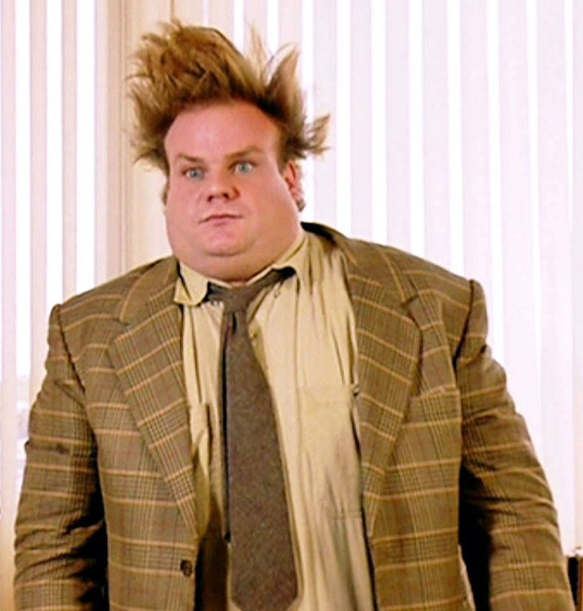
Designing an observation
Have a go at coming up with operationalised behavioural categories for the following concepts:
Aggression
Sociable
Stressed

Slide 12
Designing an observation: Behavioural categories
How is it done?
Initially the type of behaviour that is being observed should simply be watched
From here behavioural categories should be developed
Different observers should then discuss what the behavioural categories actually mean to ensure they are using them consistently and make any refinements necessary. (Training your observers)
Ideally, the behavioural categories should be piloted to allow for further modification before use

Slide 13
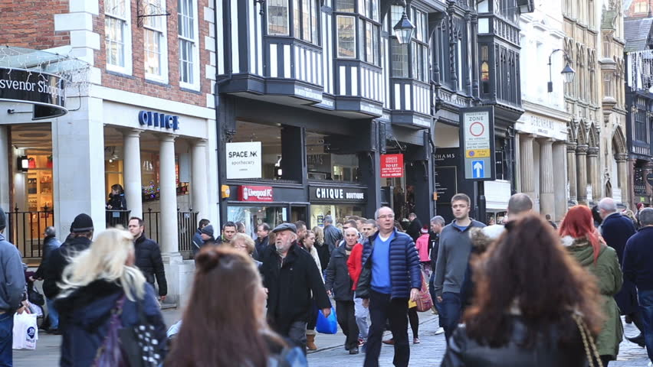
Observation: A practice
What problems did you have with the observation?
You are going to watch a clip of people in a busy shopping street. While you are watching think about, and jot down on a MWB or piece of paper, some categories that you might develop
These categories will be based on what you see
Do it individually to start with. You will be conferring after the clip has ended
How similar are your schedules?
We will now carry out the observation again, but this time using the observation schedule
Now, on your tables, agree on five or six behavioural categories you are going to use to observe
Discuss your categories to make sure everyone in the group knows how to use them properly

Slide 14
Event Sampling and Time Sampling
Using what you learned from your preparation homework define what is meant by:
Event sampling
Time sampling
Event sampling: counting the number of times a particular behaviour occurs in a target individual or group
You are observing an infant with one behavioural category of ‘crying’. The infant cries continuously for five minutes. How might the results of the observation differ if using event or time samping?
Time sampling: recording behaviour within a pre-established time frame. E.g., watching an infant and only making note of their behaviour every 30 seconds

Slide 15
Observation Exam Questions
In your observation groups, go up to a BWB and answer the question you’ve been allocated
Explain the difference between a naturalistic observation and a controlled observation. (4 marks)
Give one limitation and one strength of using non-participant observation as a method of collecting data. (2 marks + 2 marks)
Explain the difference between event sampling and time sampling. (3 marks)
Explain how behavioural categories are used in observational research. Use examples in your answer. (3 marks)
Now, in your groups, go round to each board and give the answer a mark (write your marks down on a MWB. You can use the pack for this

