Slide 1
Experiments: Recap

Slide 2
Starter Questions
Answer in pairs on paper
What are the four types of experiment?
What is an independent variable (IV)?
What is a dependent variable (DV)?
What does the term ‘control’ mean in Psychological experiments?
How is a natural experiment different from a quasi experiment?
What is a hypothesis?
Is the following a directional or non-directional hypothesis: there will be a difference in the number of errors made on a concentration task between participants who have consumed caffeine and participants who have not consumed caffeine
What does experimental design refer to?
Name the three types of experimental design
What is the difference between an extraneous variable and a confounding variable?

Slide 3
Starter Questions: Answers
What are the four types of experiment?
What is an independent variable (IV)?
What is a dependent variable (DV)?
What does the term ‘control’ mean in Psychological experiments?
How is a natural experiment different from a quasi experiment?
What is a hypothesis?
Is the following a directional or non-directional hypothesis: there will be a difference in the number of errors made on a concentration task between participants who have consumed caffeine and participants who have not consumed caffeine
What does experimental design refer to?
Name the three types of experimental design
What is the difference between an extraneous variable and a confounding variable?
Laboratory, field, quasi, natural
The variable being manipulated
The variable being measured
Keeping everything the same between conditions, apart from the IV
In a natural experiment there is no manipulation from the experimenter, in a quasi experiment, the IV occurs naturally, but it takes place in a laboratory setting where the researcher sets up the situation
A statement the researcher makes before the experiment begins, predicting its outcome
Non-directional
The way the participants are used in the study
Independent groups, repeated measures, matched pairs
An extraneous variable is something other than the IV that differs between conditions, whereas a confounding variable is an extraneous variable that has affected the outcome of the experiment

Slide 4
Writing a hypothesis
In pairs, write an operationalised hypothesis for the following studies
Study 1
A researcher wanted to test if drinking alcohol affected reaction times. Previous research suggests that people’s reaction times are negatively affected by alcohol. She randomly split her sample into two. One group drank a measure of strong alcohol, while the other group were given a drink that tasted like alcohol, but had no alcoholic content. Both groups then waited for half an hour before being asked to individually complete a card matching concentration game
Study 2
A researcher wanted to see if having an experience of being praised influences the likelihood of helping behaviour. There has been no previous research in this area. The researcher randomly split participants into one of two conditions. They were then asked to paint a picture of a landscape. One group of participants received praise for their landscape from the experimenter, whereas one group did not. They were then asked to sit in a room individually and wait for the next part of the procedure. A confederate then staged a loud falling over, just outside the door. The experimenter recorded whether or not the participant went to the assistance of the confederate

Slide 5
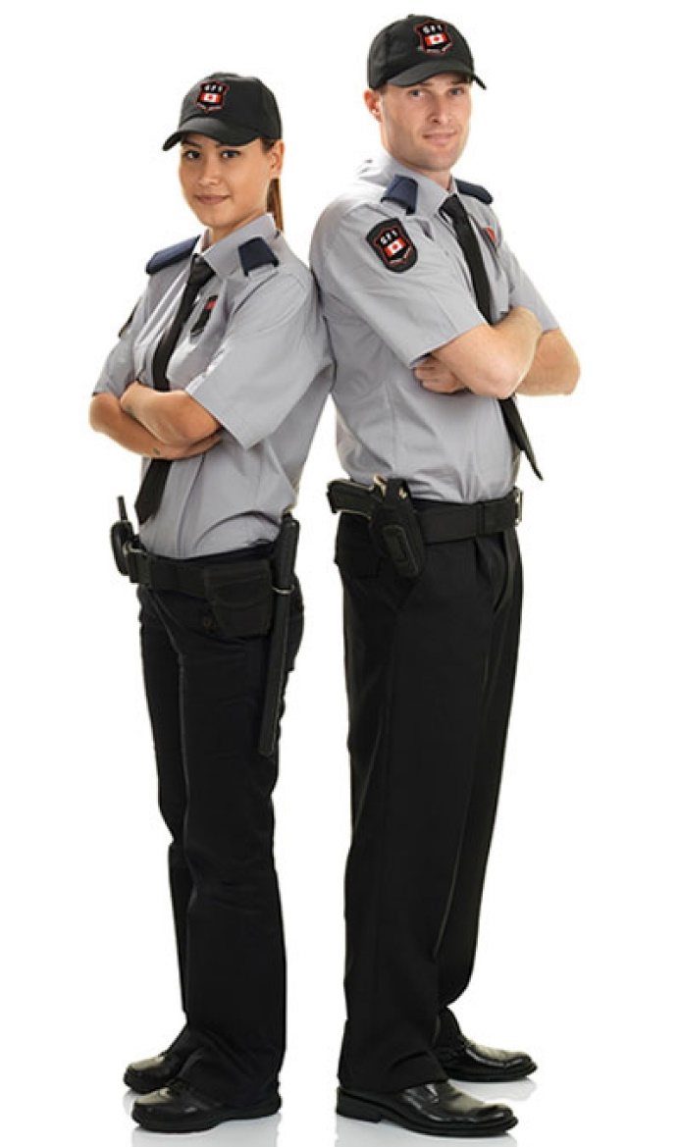
Identify the type of experiment
a) A researcher observes the aggressive behaviour of children who have either regularly attended day care or who have been raised at home.
NATURAL
b) A researcher asks 50 children to watch a video of an adult punching a teddy bear. He then asks 50 children to watch a video of an adult cuddling a teddy bear. The children are then shown into a room with a teddy bear and told they can play with it. Does the video they watched influence how they play with the teddy bear?
LAB
c) A researcher wanted to investigate whether males or females differed in their ability to remember a list of 50 words. He gave them 2 minutes to study the list of 50 words then asked them to recall them in any order.
QUASI
d) A researcher wanted to investigate whether people are more likely to obey an authority figure than another member of the public. A confederate dressed as a Security Guard approached people in a high street and told them to pick up litter. Another confederate dressed as a civilian did the same. The researchers then compared the amount of litter that was picked up by the members of the public.
FIELD

Slide 6
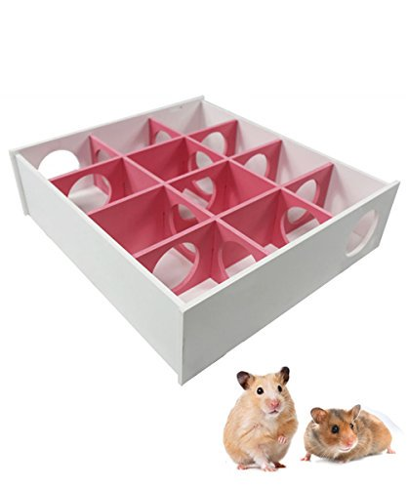
Experimental design
In pairs, on MWBs, What type of experimental design is being described in the following examples?
Boys and girls are compared on their IQ scores
Hamsters are tested to see if one genetic strain is better at finding food in a maze than another
Reaction time is tested before and after a reaction time training activity to see if test scores improve after training
Students are put in pairs based on their GCSE grades, and then one member of the pair is given a memory test in the morning and one in the afternoon
Three groups of participants are given different word lists to remember, in order to find out whether nouns, verbs or adjectives are easier to remember
IGD
IGD
RMD
MPD
IGD

Slide 7
Experimental design
On BWBs, draw out and complete the table:
 | Independent groups | Repeated measures | Matched pairs
Strengths
Weaknesses

Slide 8
Validity & Reliability
In pairs, draw out and complete the diagram on MWBs:
Internal validity
Definition?
External validity
Definition?
Name & definition?
Name & definition?
What does the term reliability refer to?
Name & definition?

Slide 9
Evaluation of Experiments
Draw out the following table on MWBs:
 | Strengths | Weaknesses
Laboratory Experiment
Field Experiment
Natural Experiment
Quasi Experiment

Slide 10
Evaluation of Experiments
Now write the number associated with each of the following evaluation points in the correct box or boxes in your table
High ecological (external) validity
Low level of control over extraneous variables
High replicability
High control over extraneous variables
Individual differences may affect the results
Low population validity
Less control over extraneous variables
Possible demand characteristics
Low replicability
Low ecological validity

Slide 11
Evaluation of Experiments: Did you get it right?
 | Strengths | Weaknesses
Laboratory Experiment | 3. High replicability 4. High control over extraneous variables | 8. Possible demand characteristics 10. Low ecological validity
Field Experiment | 1. High ecological (external) validity | 7. Less control over extraneous variables
Natural Experiment | 1. High ecological (external) validity | 2. Low level of control over extraneous variables 6. Low population validity 9. Low replicability
Quasi Experiment | 3. High replicability 4. High control over extraneous variables | 5. Individual differences may affect the results 8. Possible demand characteristics 10. Low ecological validity

