Slide 1
Resistance to Social Influence

Slide 2
Starter Activity
Using what you learned in the preparation work, compete the following matching activity. Which cards belong with which cards?
1. These individuals are more likely to believe that their actions can make a difference
2. Milgram found that when there were two disobedient confederates present in the procedure
3. This is because it helps the individual avoid ridicule
4. When one confederate dissented from the majority
5. Obedience rose to 92%
6. Having an ally helps people resist social pressures to conform or obey
7. Obedience dropped to 10%
8. This demonstrates the power of social support for non-conformity
9. When there were two obedient confederates
11. It means the consequences are shared with someone else
10. An internal locus of control helps people resist pressures to conform or obey
12. This demonstrates the power of social support for non-obedience
13. Conformity dropped to 5.5%

Slide 3
Starter Activity
Did you get it right?
10. An internal locus of control helps people resist pressures to conform or obey
2. Milgram found that when there were two disobedient confederates present in the procedure
9. When there were two obedient confederates
4. When one confederate dissented from the majority
5. Obedience rose to 92%
1. These individuals are more likely to believe that their actions can make a difference
7. Obedience dropped to 10%
13. Conformity dropped to 5.5%
12. This demonstrates the power of social support for non-obedience
8. This demonstrates the power of social support for non-conformity
6. Having an ally helps people resist social pressures to conform or obey
3. This is because it helps the individual avoid ridicule
11. It means the consequences are shared with someone else

Slide 4
Locus of control: Internal or external?
Some people don’t have to work hard to do well, they are just lucky in life
External

Slide 5
Locus of control: Internal or external?
I believe that fate brings people together
External

Slide 6
Locus of control: Internal or external?
If you work hard in life, you’re likely to get what you want
Internal

Slide 7
Locus of control: Internal or external?
I’m not good at learning languages. Some people have the gift and others don’t
External

Slide 8
Locus of control: Internal or external?
You make your own luck in life
Internal

Slide 9
Locus of control: Internal or external?
If I don’t like something in my life, I change it
Internal

Slide 10
Locus of control: Internal or external?
If it’s God’s will, then I will get the job I’m going for
External

Slide 11
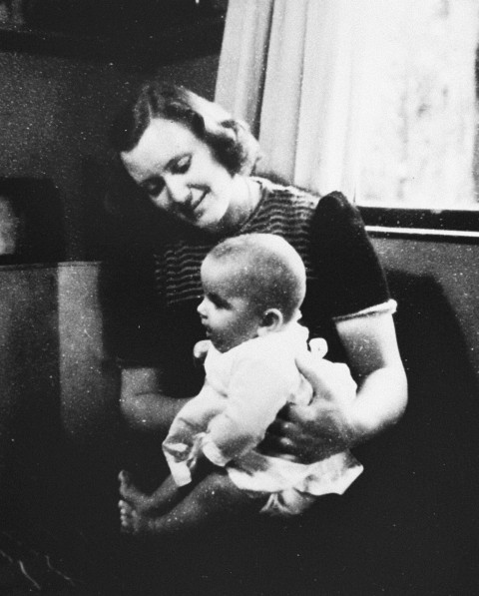
Applying the theory
You will see a clip about a women called Marion who resisted social influence. After watching it, see if you can explain her behaviour in terms of:
Locus of control
Social support
Use specific examples from you saw in the clip to illustrate your points

Slide 12
Exam Practice
Answer the following question individually:
Justin wanted to go to the cinema, but most of his friends wanted to go to a pub. Justin felt sure that if he insisted he was going to the cinema, some of his friends would follow. His friend Joe had already said that he wanted to go to the cinema too
Explain why some people are able to resist pressures to conform. Refer to the case of Justin in your answer (4 marks)

Slide 13
Exam Practice: Mark Scheme
One reason why someone might resist pressures to conform is if they have social support for non-conformity. This may be because it prevents them from feeling ridiculed by going against the crowd (1 mark). Justin had social support for non-conformity from his friend Joe, who also deviated from the majority and wanted to go to the cinema (1 mark). Another reason why someone might resist pressures to conform is that they have an internal locus of control. This means that they feel that are able to influence events in their lives and are therefore more likely to try to change a situation (1 mark). This is shown by Justin when he feels that by non-conforming he can influence his other friends to change their minds about going to the cinema (1 mark)

Slide 14
Evaluation of theories of resistance to social influence: Point 1
Fill in the gaps with the relevant information and percentages from the studies:
Research findings from studies of conformity and obedience support the view that social support increases the likelihood that a person will resist social influence. Milgram found that when there were two disobedient confederates present in the procedure, obedience in the real participant dropped dramatically to ____%. Conversely, when there were two obedient confederates, obedience rose to____%. This demonstrates the power of ________ ___________ (or lack of it) in obedient behaviour. Asch found that in his conformity procedure, when one of the confederates dissented from the majority and gave the right answer, conformity dropped to ____%. Interestingly, this percentage remained the same even when the confederate dissenter gave a ___________ answer from the majority, but that answer was still incorrect. Asch concluded from this that the important factor was that… (Finish the sentence)

Slide 15
Evaluation of theories of resistance to social influence
Did you get this:
Research findings from studies of conformity and obedience support the view that social support increases the likelihood that a person will resist social influence. Milgram found that when there were two disobedient confederates present in the procedure, obedience in the real participant dropped dramatically to 10%. Conversely, when there were two obedient confederates, obedience rose to 92.5%. This demonstrates the power of social support (or lack of it) in obedient behaviour. Asch found that in his conformity procedure, when one of the confederates dissented from the majority and gave the right answer, conformity dropped to 5.5%. Interestingly, this percentage remained the same even when the confederate dissenter gave a different answer from the majority, but that answer was still incorrect. Asch concluded from this that the important factor was that the participant had support for deviating from the group, not support for his answer, thus supporting the view that any deviation from the majority will act as social support for non-conformity

Slide 16
Evaluation of theories of resistance to social influence: Point 2
Choose the right words from the choices given:
There is also research to support/challenge the role of internal locus of control in resistance to social influence. Elms and Milgram (1974) investigated the background of some of the obedient/disobedient participants from Milgram’s first four obedience experiments. They found that obedient/disobedient participants had a high internal locus of control and scored higher on a scale that measured their sense of self worth/social responsibility. Furthermore, Oliner & Oliner (1988) interviewed two groups of non-Jewish people who had lived through the Holocaust in Nazi Germany. They compared 406 people who had rescued Jews with 126 who had not done so. Oliner & Oliner found that the rescuers/non rescuers were more likely to have scores demonstrating a high internal locus of control than the rescuers/non-rescuers, and also scored more highly on measures of social responsibility. Suggesting that having an internal/external locus of control is likely to lead to independent behaviour

Slide 17
Evaluation of theories of resistance to social influence: Point 2
Did you get this:
There is also research to support the role of internal locus of control in resistance to social influence. Elms and Milgram (1974) investigated the background of some of the disobedient participants from Milgram’s first four obedience experiments. They found that disobedient participants had a high internal locus of control and scored higher on a scale that measured their sense of social responsibility. Furthermore, Oliner & Oliner (1988) interviewed two groups of non-Jewish people who had lived through the Holocaust in Nazi Germany. They compared 406 people who had rescued Jews with 126 who had not done so. Oliner & Oliner found that the rescuers were more likely to have scores demonstrating a high internal locus of control than the non-rescuers, and also scored more highly on measures of social responsibility. Suggesting that having an internal locus of control is likely to lead to independent behaviour

Slide 18
Evaluation of theories of resistance to social influence: Point 3
Answer the following questions:
The research in this area is correlational. This means it is merely identifying a link between locus of control and independent behaviour without controlling for possible extraneous variables. What are we not able to do in correlational research?
Establish cause and effect
What else may co-occur with having an internal locus of control that could be the causal factor in independent behaviour?
E.g. Parental style could lead to an internal locus of control and high levels of independent behaviour
Williams and Warchal (1981) studied 30 university students who were given a range of conformity tasks based on Asch’s procedure. Each student was also assessed using Rotter’s locus of control scale. They found that those who conformed did not score differently on the locus of control scale but they were less assertive. What does this suggest?
It suggest that the research lacks reliability and that assertiveness may have more to do with independent behaviour than locus of control
Now see if you can write a PEEL evaluation using this information

