Slide 1
Self-Report Techniques
Questionnaire surveys & Interviews

Slide 2
Starter Questions
Answer in pairs on MWBs
What is a structured interview?
What is an unstructured interview?
What is a semi-structured interview?
Give one advantage of using an interview rather than a questionnaire
Give one advantage of using a questionnaire rather than an interview
Write an example of a closed question for a questionnaire on TV viewing habits
Write an example of an open question for a questionnaire on TV viewing habits
Give one advantage of using closed questions
Give one advantage of using open questions
Self-report techniques as a whole are useful because they give us a type of information that we are unable to access through any other method. What type of information is that?

Slide 3
Starter Questions
What is a structured interview?
What is an unstructured interview?
What is a semi-structured interview?
Give one advantage of using an interview rather than a questionnaire
Give one advantage of using a questionnaire rather than an interview
Write an example of a closed question for a questionnaire on TV viewing habits
Write an example of an open question for a questionnaire on TV viewing habits
Give one advantage of using closed questions
Give one advantage of using open questions
Self-report techniques as a whole are useful because they give us a type of information that we are unable to access through any other method. What type of information is that?
Made up of pre-determined questions that are delivered in a fixed order. The interview does not deviate from these questions
There are no set questions, only a general topic to be discussed. The interviewee is encouraged to expand on their answers
There is a list of pre-prepared questions, but interviewers can deviate from them for further questioning
Answers can be followed up on, rapport can be established
Much quicker and less costly to administer. Can achieve a wide range of data from a wide range of participants
Easy to statistically analyse. Only get relevant information
More accurate view of participants’ attitudes/behaviours, rich in detail
Attitudes, beliefs, emotion

Slide 4
Designing a questionnaire
In pairs, design a five item questionnaire aimed at testing levels of conformity
Three of your questions should be closed and two should be open
Now with get together with another pair and swap questionnaires. They complete yours and you complete theirs (write your responses on a separate sheet of paper)
Once you have completed each other’s questionnaires, answer the following questions about the questionnaire you answered on MWBs:
Do you think the questionnaire has internal validity? What does that mean?
Were there any questions that you didn’t understand, or were unclear how to answer? (give details)
Were any of the questions ‘leading’, (in other words, prompting you to give a particular answer)?
Were any of the questions double barrelled (in other words, the question included two separate questions)?
Now, use your answers to the questions to decide which pair had the better questionnaire. You must be able to say why

Slide 5
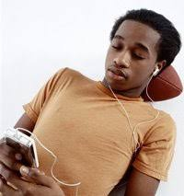
Designing a questionnaire: Music Survey
A researcher wants to investigate music preferences in sixth form students
We are going to test out the different types of questions that could be used to measure music preferences
After you have responded, we will be considering the pros and cons of using these different question types

Slide 6
Designing a questionnaire: Music Survey
You will be assigned a letter (A,B,C or D)
After the music has been played, answer the question you have been given
Now, in your groups, discuss the advantages and disadvantages of each question type. You will be asked to feedback on one of the question types
Music clip 1
Music clip 2
Music clip 3

Slide 7
Designing an interview
You are going to watch two examples of carrying out an interview. Your task is to identify the good and bad things about the way the interviews are carried out. Write your answers on MWBs
Interview 1
Interview 2

Slide 8
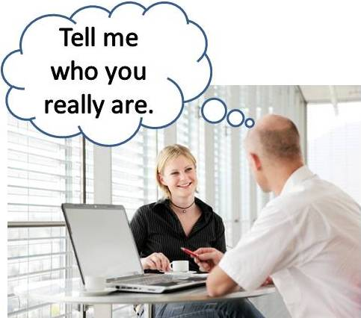
Designing an interview: Obedience
You are now going to work in pairs to design a structured interview on the topic of attitudes to independent learning, and how well or poorly students have made the transition from school to college. Number yourselves 1 or 2
Your aim is to find out what you can about how the student has coped with the transition to college, things they have found difficult, strategies they have used and their attitudes to when and how they complete their homework. You will need to produce a set of questions to be read out to your interviewee.
You will have 10 minutes to prepare the structured interview, but at the end of that time, one of you will deliver the structured interview and one of you will carry out an unstructured interview. You won’t know who is doing which until the end
Use the information on page 20 of the information pack to help you design and carry out a good interview
Now pair up with someone on the other side of the room and take turns to run your interview. If you are doing the structured interview, try to match with someone who is doing the unstructured interview and vice versa
On BWBs, based on your experiences, list the strengths and weaknesses of each interview type

Slide 9
Exam Practice: Designing a study
Answer the following question individually. You will have 12 minutes
Design a study that uses a questionnaire to investigate how A-level students revise
In your answer you will be awarded credit for providing appropriate details of:
Sampling
Materials including types of questions used with an example.
Controls used in the design of the questionnaire
Ethical considerations and how you would deal with them
You should justify your decisions
(12 marks)
Now swap with the person sitting next to you and award marks according to the guidance on the next slide

Slide 10
Exam Practice: Mark Scheme
Sampling:
1 mark for identifying suitable technique - Opportunity or Volunteer would be most suitable and say why
2nd mark for brief explanation of how to obtain sample e.g. ask students at college/put up a poster asking for people to come forward
3rd mark for elaborated explanation, e.g. Going to the local sixth form college, stand in the canteen and approach students asking them if they do A-levels and if they would consent to completing the questionnaire

Slide 11
Exam Practice: Mark Scheme
Materials:
1 mark for saying which types of questions they would use e.g. open/closed questions
2nd mark for giving example/s of the questions being used
3rd mark for justification in relation to study e.g. closed questions: easy to analyse and compare revision techniques across different A level students

Slide 12
Exam Practice: Mark Scheme
Controls:
1 mark for identifying at least one control e.g. making the questions clear, making sure they are not leading/biased, avoiding demand characteristics/social desirability, avoiding response bias
Further 2 marks for explaining how they would control for this and why this would need to be controlled, e.g. we would not ask questions like ‘do you use mind maps?’ as this is a leading question, instead we would ask them to indicate from a list of options which methods of revision they would use, which would make the answer more representative of their behaviour

Slide 13
Exam Practice: Mark Scheme
Ethics:
1 mark for identifying relevant ethical issues e.g. informed consent, right to withdraw, confidentiality
Further 2 marks for explaining how these ethical issues would need to be dealt with in this study e.g: We would make sure that confidentiality is maintained (1 mark). We would inform the participants that their name does not need to be written on their questionnaire (1 mark) and that no information that could lead to them being identified, such as the name of the college they attend, will be mentioned in the report (1 mark)

