Slide 1
Definitions of Abnormality
Statistical Infrequency & Deviation from Ideal Mental Health

Slide 2
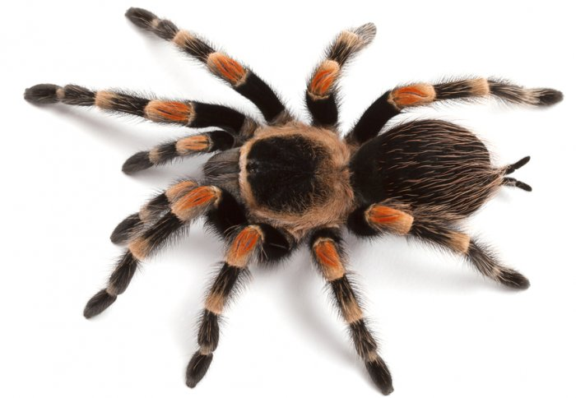
Statistical Infrequency
The Normal Distribution Curve
A lot of people are afraid of spiders
Come to the board and rate your level of fear for spiders on a scale of 1 - 10
(1= no fear, 5=moderate fear, 10=panic)

Slide 3
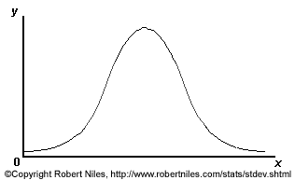
The Normal Distribution Curve: Task
Draw a statistical frequency graph to represent the data
Start by drawing a bar chart to represent the number of participants that gave each rating from 1-10
Then draw a curve following the distribution of the scores

Slide 4
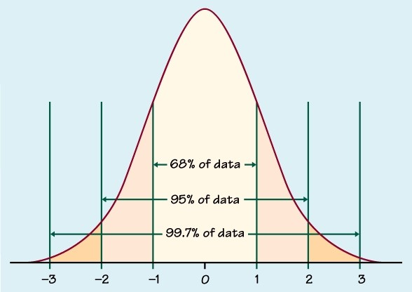
The Normal Distribution Curve
We would expect most people to give us a figure of 4, 5, 6 or 7-their ratings would cluster around the middle
There would be a few people at either end of the scale
The frequency distribution should look something like this graph- approximately a normal distribution
The abnormal ratings are those at either end, (2 SD away from the mean) because they are not the ‘norm’
A bit less/more than most people
A lot less/more than most people
Therefore this definition defines abnormality as any behaviour that is statistically rare.

Slide 5
Evaluation of the statistical infrequency definition
Answer the following questions on MWBs:
But is it that simple?
Can you think of a reason why the statistical infrequency definition might be skewed by social norms?
The deviation from social norms definition has been criticised because it is a subjective definition of abnormality, based on what behaviours society considers to be acceptable at that particular time. The statistical infrequency definition could be considered better because..?
In other words, some behaviours are driven ‘underground’ making them appear less frequent than they actually are
So the definition could have links to deviation from social norms!
Is it possible that the recorded frequency of a given behaviour will be distorted by whether or not it is considered to be socially acceptable?
It is more objective, because it uses statistical analysis, rather than subjective judgement!

Slide 6
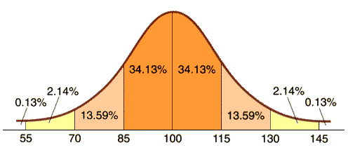
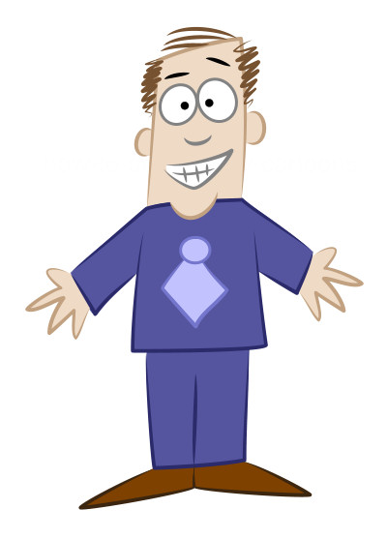
Evaluation of the statistical infrequency definition
Distribution of IQ scores
Samira has an IQ score of 70
Is Samira abnormal?
Is Keith abnormal?
What problem does this highlight for the definition?
Keith has an IQ score of 69

Slide 7
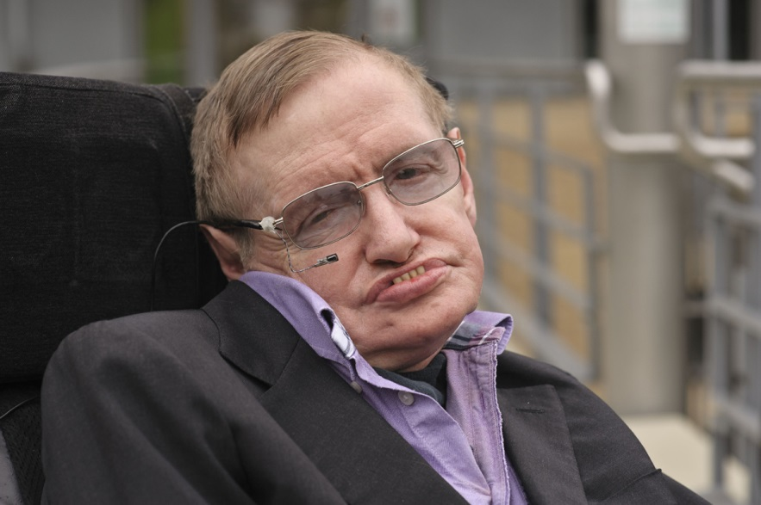
Evaluation of the statistical infrequency definition
Distribution of IQ scores
What problem does this highlight with the definition?
Stephen Hawking, thought to be one of the most intelligent people to have been alive in recent times, reportedly had an IQ score of 160

Slide 8
Evaluation of the statistical infrequency definition
In pairs, on MWBs, Write a PEEL evaluation for one of the points we’ve discussed

Slide 9
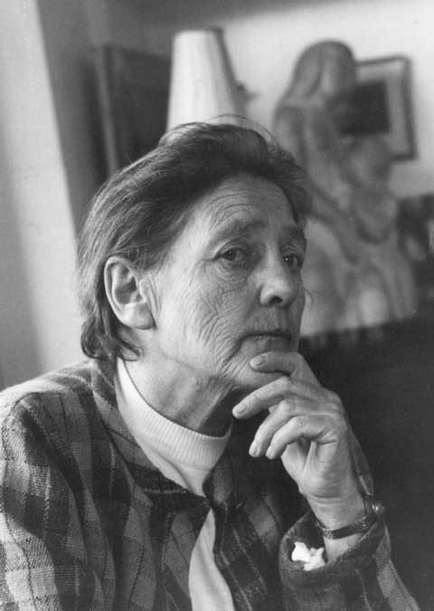
Deviation from Ideal Mental Health
Have a go at completing the worksheet using what you have learned from your homework
Positive attitude towards self
Resistance to stress
Accurate perception of reality
Independent (autonomy)
Self-Actualisation
Environmental Mastery

Slide 10
Evaluation of the Deviation from Ideal Mental Health Definition
In pairs, on MWBs, write an evaluation statement for the DIMH definition that includes the following words/terms:
Positive whole person range of criteria
Applications Treatment specific
individual mental health

Slide 11
Evaluation of the Deviation from Ideal Mental Health Definition
In pairs, on MWBs, write an evaluation statement for the DIMH definition that includes the following words/terms:
The DIMH definition can be considered more positive than other definitions, e.g. failure to function, as it concentrates on what the individual needs to be healthy, rather than what they lack. The focus on the whole person through a range of criteria has implications for treatment, as the therapist is able to focus on specific areas of mental health that the client needs to work on, meaning that the definition has real practical applications in the field of psychological therapy

Slide 12
Evaluation of the Deviation from Ideal Mental Health Definition
Look at the criteria for ideal mental health on your worksheet. Give each one a tick or a cross, depending on whether you feel you have achieved that criteria
Has anyone achieved all six criteria?
How can we link the answer to the last question to an evaluation of the DIMH definition? Write your answer on a MWB

Slide 13
Evaluation of the Deviation from Ideal Mental Health Definition
How can this diagram be used as a negative evaluation of the DIMH definition?
Cultures can be broadly classified in one of two ways. Look at the diagram below:
Western cultures
Non-western cultures
Individualist
Collectivist
Believe in striving towards own goals, being independent
Believe in interdependence, working for the good of the group

Slide 14
Exam Practice
You have 5 minutes to look over your notes on the definitions and their evaluations before having a go a writing an essay in pairs
Have a go at writing the following essay:
Kathy suffers from obsessive compulsive disorder. She is constantly preoccupied with not having turned off the cooker or the iron, and frequently has to return home to check, which means she has to leave her job. She also feels compelled to perform a ritual before she leaves the house. She has to go round to every light switch in the house and turn it on and then off ten times. This often makes her late. When she is out, she finds herself feeling very anxious because she believes she has forgotten to turn something off.
Discuss one or more definitions of abnormality. Make reference to Kathy in your answer (16 marks)
Now swap your answer with the other pair on your table

Slide 15
Exam Practice: mark scheme AO1
Did they get 6 marks worth of information on the definitions? They could have written a lot about one, or covered more than one in less detail. Use the guidance on the following slides to give their AO1 a mark
Credit can be given for outlining any of the definitions, but the ones that fit best with the scenario are failure to function and deviation from ideal mental health, so these are the ones that should have been concentrated on to get full credit for AO2

Slide 16
Exam Practice: mark scheme AO1
This definition defines behaviours that are abnormal as statistically rare (statistical infrequency)
A normal distribution curve can be drawn to show what proportions of people share the characteristics or behaviour in question. Most people will fall on or near the mean for these.
Any individuals that fall outside the ‘normal distribution’ usually about 5% of a population (2 standard deviation points away from the mean) are perceived as being abnormal.

Slide 17
Exam Practice: mark scheme AO1
Each society has social norms, which are rules for acceptable behaviour. Quite often these rules are unwritten for example, not being naked in public or not pushing to the front of a queue.
Abnormal behaviour is behaviour that goes against these social norms (deviation from social norms).
The definition draws a line between desirable and undesirable behaviours and labels individuals behaving undesirably as social deviants.
This is done for both the individual and for society as a whole. We are making a collective judgement as a society about what is right/correct behaviour.
For example, a person who is unable to discard useless or worn out possessions (hoarding) would be seen as abnormal as this behaviour is considered undesirable and deviates from social norms.

Slide 18
Exam Practice: mark scheme AO1
When someone’s behaviour suggests that they cannot cope with everyday demands e.g. getting up in the morning, getting washed and dressed, and going to work, then they run the risk of being labelled as abnormal by this definition- they are failing to function adequately.
Behaviour is considered abnormal when it causes distress leading to an inability to function properly.
It may also be characterised by an inability to experience a normal range of emotions or behaviours.
Rosenhan and Seligman (1989) put forward seven features of dysfunction and suggested that the more of these seven features of dysfunction an individual shows the more they are classed as abnormal.
Some of the features are.. (credit one mark for each correct explanation of a feature, or half a mark for naming a feature)

Slide 19
Exam Practice: mark scheme AO1
Compared with previous definitions that attempt to define what is abnormal, this definition attempts to define what is normal behaviour or an ideal state of mental health.
Thus abnormality is seen as a deviation away from these features (MUST HAVE THIS BIT!)
Positive attitude towards self: an individual should be in touch with their own identity and feelings. Have self-respect and a positive self-concept.
Resistance to stress: individuals should be able to resist the effects of stress by having effective coping strategies.
Accurate perception of reality: individuals should have an objective and realistic view of the world.
Independent (Autonomy): individuals should be independent and self-reliant and able to make personal decisions.
Self-actualization: individuals should be focused on the future and their own personal growth and development. ‘Becoming everything one is capable of becoming’.
Environmental mastery: being competent in all aspects of life and able to meet the demands of any situation. Having the flexibility to adapt to changing life circumstances.

Slide 20
Exam Practice: mark scheme AO2
Award up to four marks for application, using the following guide:
Kathy suffers from obsessive compulsive disorder. She is constantly preoccupied with not having turned off the cooker or the iron, and frequently has to return home to check, which means she has to leave her job. She also feels compelled to perform a ritual before she leaves the house. She has to go round to every light switch in the house and turn it on and then off ten times. This often makes her late. When she is out, she finds herself feeling very anxious because she believes she has forgotten to turn something off.
She is failing to function as her behaviour is disrupting her ability to work, as she has to keep returning home (2 marks)
She is failing to function because the need to complete the compulsions means that she feels a high level of stress when not able to do so, e.g. when she believes she’s forgotten to turn something off (2 marks)
She is deviating from ideal mental health because she does not have a realistic perception of the world, as she believes that is necessary to perform a ritual before leaving the house (2 marks)
She is deviating from ideal mental health, as the compulsions are preventing her from achieving self-actualisation as they are interfering with her ability to do her job (2 marks)
You can award some credit for the other definitions, but it is unlikely there would be enough evidence in the scenario to get full credit, e.g. ‘turning the lights on and off is statistically rare behaviour’

Slide 21
Exam Practice: mark scheme AO3
Now, check against the pack and award a mark out of 3 for each PEEL point (they should have given two points)
Make sure that the point they have given relates to the definitions they have provided
3= excellent
2= quite good
1= lacking in detail/muddled
0= no relevant information

