Slide 1
The Psychodynamic Approach

Slide 2
Starter Questions
Answer in pairs on MWBs
What is contained in the unconscious mind?
How does information get into the unconscious?
Freud believed that the human mind was like an iceberg. Why?
What does the term psychic determinism mean?
According to this approach, what do psychological problems result from?
Name and describe the three components of tripartite personality
Which part of the personality uses defence mechanisms?
Name and describe three defence mechanisms
What are the five psychosexual stages of development?
What does the term ‘fixation’ refer to?
Give two examples of how the psychosexual stages can influence later personality?
How does the child develop a superego?

Slide 3
Starter Questions: Answers
What is contained in the unconscious mind?
How does information get into the unconscious?
Freud believed that the human mind was like an iceberg. Why?
What does the term psychic determinism mean?
According to this approach, what do psychological problems result from?
Name and describe the three components of tripartite personality
Which part of the personality uses defence mechanisms?
Name and describe three defence mechanisms
What are the five psychosexual stages of development?
What does the term ‘fixation’ refer to?
Give two examples of how the psychosexual stages can influence later personality?
How does the child develop a superego?
Thoughts, feelings, memories etc, that would cause unpleasant, negative emotions
Through the process of repression (motivated forgetting)
Because the greater part of what is contained within it is buried below the surface (unconscious)
All behaviour is caused by repressed thoughts/feelings etc in the unconscious
Childhood experiences
Id (wholly concerned with the gratification of needs) ego (the rational part of the personality, mediates between id & superego), the superego (the moral side of personality)
The ego
Repression (pushing information into the unconscious to avoid unpleasant emotions) denial (refusing to acknowledge a reality) displacement (re-directing feelings or behaviour onto a more acceptable target)
Oral, anal, phallic, latency, genital
Failure to resolve the conflict in a particular stage. The individual becomes ‘stuck’ in that stage
Fixated in oral stage can lead to being optimistic, overly pessimistic, excessive oral activity. Fixation in anal stage can lead to hoarding, stingy behaviour, overly controlling
Through the resolution of the Oedipus/electra complex

Slide 4
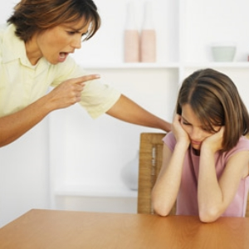
Defence Mechanisms: Repression, Denial, Displacement
Which defence mechanism is being used In the following examples? Give a reason for your answers
Andrew was sacked from work two weeks ago for gross misconduct. Since that time he has continued to get up and leave the house each morning and travel to the site of his old office. He enters the building and sits in reception until someone comes and asks him to leave
Pauline had a very troubled relationship with her parents. They were very strict and refused to compromise with her. They treated her very differently to her brother who was allowed a lot more freedom. Pauline has always been very patient and loving towards her parents. However, she is generally an aggressive person and frequently gets into quite heated arguments with strangers, often becoming verbally abusive
Tabitha doesn’t remember much about her early childhood. She was taken out of the family home by social workers when she was seven and placed with a foster family
Denial
Displacement
Repression

Slide 5
Defence Mechanisms: Exam Practice
Answer the following question in pairs. You have 5 minutes. After that time, some of you will be asked to read out your answer
Tim used to run a family business. About two years ago, the business got into financial difficulties. Tim’s bank demanded repayment of a loan. Tim lost the business and is very angry.
Two defence mechanisms are denial and displacement
Outline what is meant by denial and displacement and suggest how each could be involved in Tim coping with his situation (4 marks)
Now listen to the answers that are read out and give each one a mark out of 4. Be prepared to say why you are awarding that mark. But first, let’s have a look at the mark scheme..

Slide 6
Defence Mechanisms Exam Practice: Mark Scheme
[AO1 = 2 AO2 = 2]
1 mark each for outlining denial and displacement
Plus
1 mark each for application in the form of a brief relevant suggestion
Denial – refusing to acknowledge reality
Displacement – taking out your emotions on a substitute object
Possible applications:
Tim refuses to believe his business is gone and still spends all day in his office (denial)
Tim takes out his anger at the bank by arguing with his family (displacement)
Credit other relevant applications.
Now let’s hear yours

Slide 7
The structure of personality: Tripartite theory
complete the following task in pairs
Start by drawing a diagram on MWBs, similar to the one in the picture on the left. Label it with the following terms:
Ego, Id, Superego, Pleasure Principle, Morality Prinicple, Reality Principle
Now, using your preparation work, come up with a situation that is likely to cause conflict between the id and the superego
Write the conflict above the diagram and fill in the speech bubbles with the likely thoughts of the id and the superego, related to your scenario
Next to the scales, add how the ego is likely to mediate (keeping both the id and the superego happy). You might use one of the defence mechanisms for this

Slide 8
The Psychosexual Stages of Development
Now draw out and complete the following table in pairs on MWBs, without looking at your notes!
Stage | Age | Focus of libido | Major development/conflict
Oral
Anal
Phallic
Latency
Genital
Watch the clip for a reminder of the Psychosexual stages of development

Slide 9
The Psychosexual Stages of Development: Answers
Stage | Age | Focus of libido | Major development/conflict
Oral | 0-1 | Mouth, tongue, lips | Weaning off the breast or bottle
Anal | 1-3 | Anus | Potty training
Phallic | 3-6 | Genitals | Resolution of the Oedipus/Electra complex
Latency | 6-12 | None | Developing defence mechanisms
Genital | 12+ | Genitals | Sexual maturity, focus on relationships

Slide 10
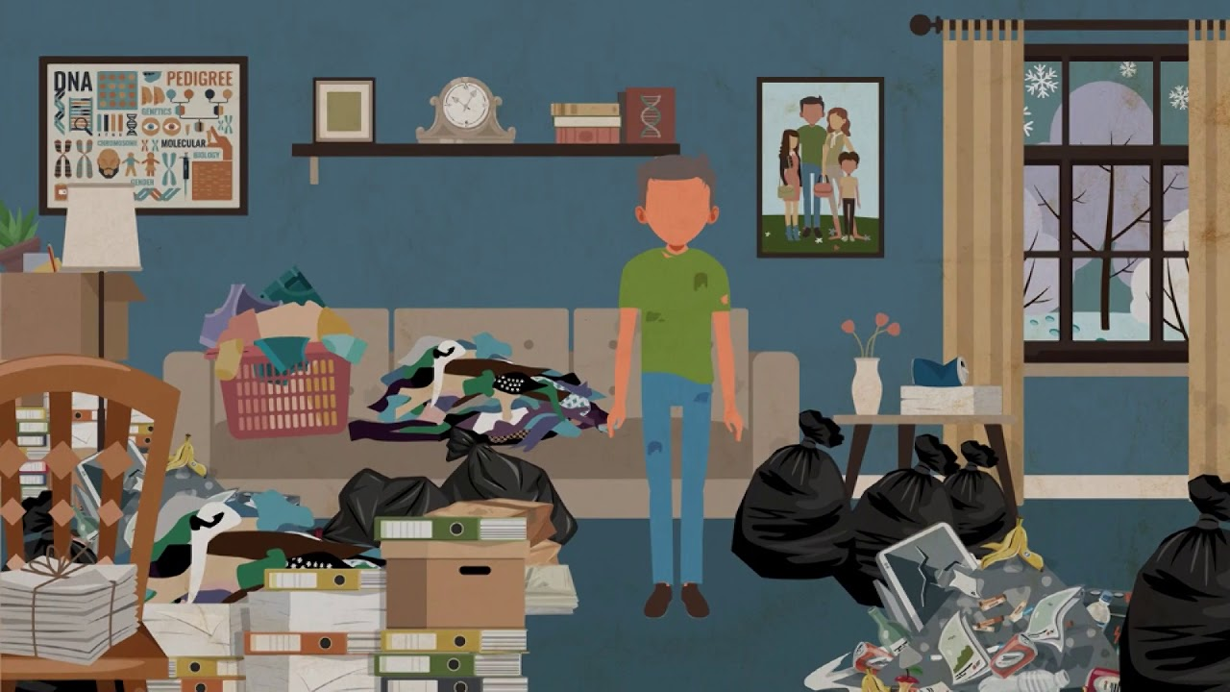
The Psychosexual Stages of Development: Case Studies
Access the case studies using the QR code and complete the following tasks in pairs:
For each person, state which stage of psychosexual development you think they have become fixated in. Give a reason for your answer
Using what you know about Psychodynamic theory, see if you can come up with an idea of what might have gone wrong in that stage based on the person’s characteristics. For example, if you think the person was fixated in the anal stage, do you think they were too strictly or too liberally potty trained?

Slide 11
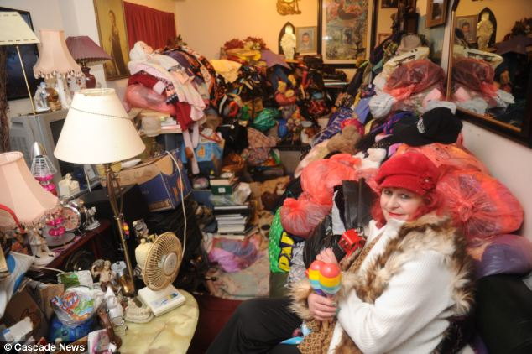
Case studies: Answers
Mary finds it difficult to throw anything away. Consequently, her house is filled with broken and disused items that she has collected throughout her life. This is disrupting her life as she does not have any space to sit down or sleep
Fixated in the anal stage. Hording would indicate an ‘anal retentive’ personality and would probably result from overly-strict potty training

Slide 12
Case studies: Answers
Sonia is 16. She is in a relationship with a 35-year-old man.
Fixated in the phallic stage
She has failed to resolve the Electra Complex

Slide 13
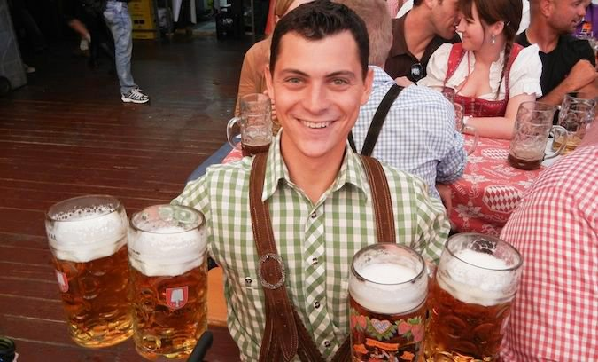
Case studies: Answers
Wayne is a really generous man. He loves buying presents for his friends and is always the first up at the bar to buy all the drinks, even though he doesn’t have a lot of money. By the end of the month, he is usually broke, and his spending often pushes him into overdraft.
Fixated in the anal stage
Being ‘overly-generous’ and giving away personal possessions is an indication of an ‘anal expulsive’ personality and is likely to result from potty training being too liberal

Slide 14
Case studies: Answers
Simon is a very respectful towards his father, but expresses a high level of hostility to others
Fixated in the phallic stage
His behaviour would suggest that he has not resolved his Oedipus complex and feels hostile towards his father, but displaces that hostility onto more acceptable targets

Slide 15
Case studies: Answers
Max is obsessed with the way he looks. He spends an hour each morning in the gym before work. He spends a lot of money at the tanning salon and at the hairdressers. He cannot walk past a mirror without checking his appearance. He believes that he is a very attractive man.
Fixated in the phallic stage
Failure to resolve the Oedipus complex can result in narcissism (self-love)

Slide 16
Case studies: Answers
Samina is a very optimistic person. She always looks on the bright side of every situation, even when this is somewhat unrealistic
Fixated in the oral stage
It is likely that Samina was over-indulged on the breast, which can lead to an overly optimistic and gullible personality

Slide 17
Case studies: Answers
Jody is the manager at a warehouse. He like to make sure that his staff are doing exactly what they have been told to do. Therefore, he makes sure that they log all the work that do in a day in a diary and he asks to see the diary at the end of the week. He also gets them to email them when they arrive at the warehouse in the morning so that he knows precisely what time they got in to work.
Fixated in the anal stage
A controlling personality is part of an ‘anally retentive’ personality and is likely to result from overly-strict potty training

Slide 18
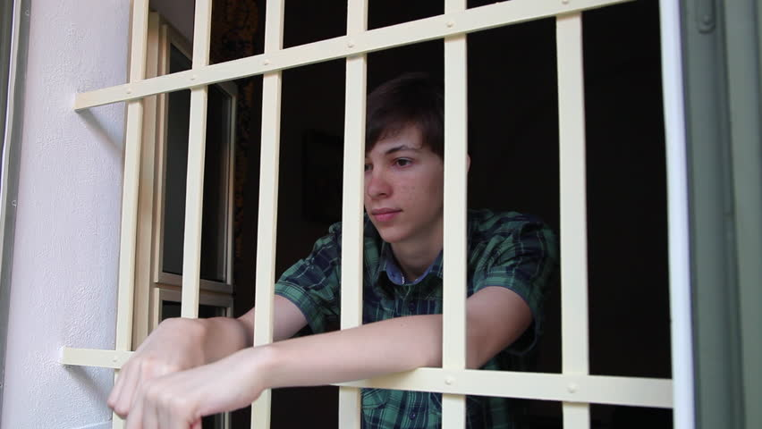
Case studies: Answers
Ali has been in trouble with the police since before he left school. He has been prosecuted for shoplifting, and burglary. He has also spent time in prison for GBH, after beating a security guard over the head with an iron bar in an attempt to steal the cash he was transporting
Fixated in the phallic stage
Lawless behaviour suggest weak morality, which might indicate that Ali has failed to identify with his father and internalise his values

Slide 19
Case studies: Answers
Sally is very sociable. She loves to meet up with friends to chat, have a meal and a few drinks. They often congregate in the smoking area together.
Fixated in the oral stage
Sally is engaging in excessive oral behaviours, which would suggest she was either under or over-indulged on the breast

Slide 20
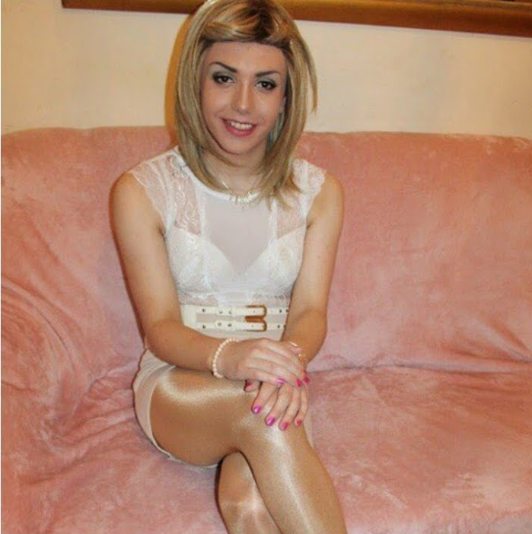
Case studies: Answers
John has always enjoyed dressing up in women’s clothing
Fixated in the phallic stage
Cross-gender dressing would indicate that he has not internalised the male gender role which would suggest he has not identified with his father

Slide 21
Case studies: Answers
Carly has lost a lot of her friends because she tends to be very sarcastic towards them and has a very negative mind set
Fixated in the oral stage
It is likely that Carly was under-indulged on the breast which has led to an overly-pessimistic and sarcastic personality

Slide 22
The Psychosexual Stage of Development: Exam Practice
Answer the following question individually without notes
Outline the psychosexual stages of development. Make reference to at least two of the stages in your answer (6 marks)
Now swap with the person sitting next to you and award marks to their answer using the model answer on the next slide as guidance

Slide 23
The Psychosexual Stage of Development: Mark Scheme
Freud believed Personality developed through a sequence of five stages, oral, anal, phallic, latency and genital. (1 mark)
During these stages, the focus of the libido (sexual energy) shifts from one part of the body to another (1 mark)
For example during the oral stage, the focus of the libido is in the mouth and pleasure is obtained through sucking and biting (1 mark),
whereas during the anal stage the focus of libido is the anus and pleasure is obtained through the expulsion of faeces (1 mark)
During each stage, conflicts arise which have to be resolved and failure to resolve these conflicts will result in the child becoming ‘fixated’ in that stage. (1 mark)
This will result in adult personality problems , for example, fixation in the anal stage of psychosexual development can result in miserliness and a preoccupation with order and control (1 mark)

Slide 24
Supporting Evidence: The Case of Little Hans
Use the pictures that you have been given to create a comic strip that outlines the case of Little Hans
Cut out the pictures and glue them onto your comic strip
Draw speech bubbles and add text to complete the detail
Don’t look up the details of the study unless you really have to
In pairs on MWBs, what are the strengths and weaknesses of using case study as a method of research?

Slide 25
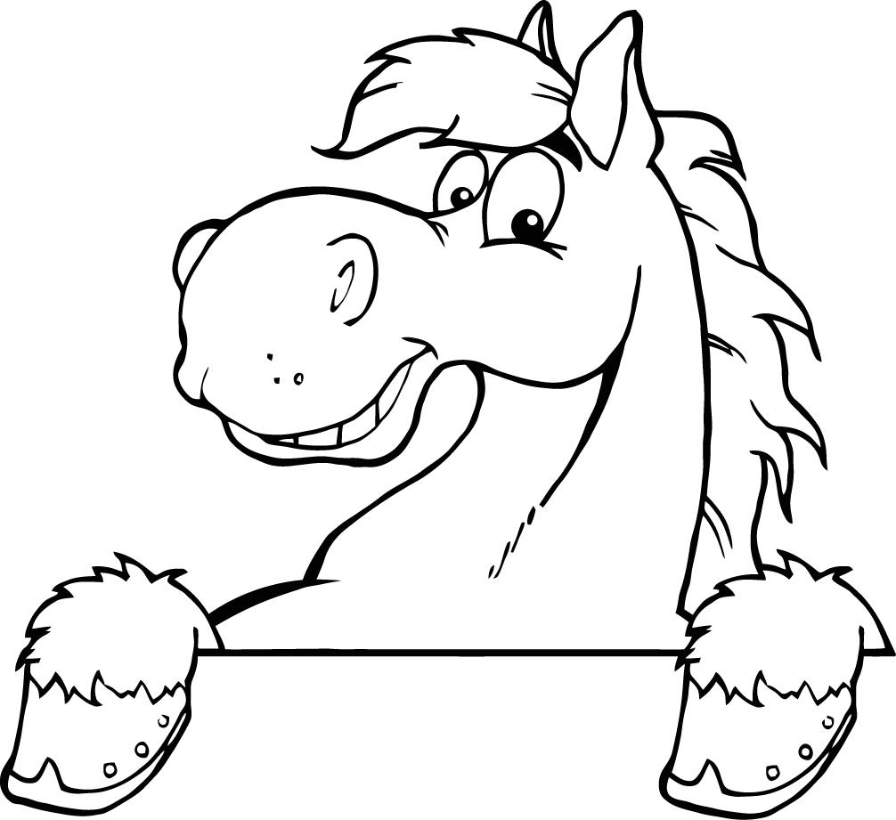
The Case of Little Hans: Limitations of the research
Answer the questions in pairs on MWBs:
Case studies can be affected by researcher bias. Give two reasons why this was likely in the case of Little Hans
Freud carried out the analysis himself, and so was motivated to support his own theory
Hans’s father was a supporter of Freud’s work and was feeding him information about Hans, so.. (same as before)

Slide 26
The Case of Little Hans: Limitations of the research
Answer the questions in pairs on MWBs:
It is not possible to establish a cause and effect relationship from a case study. Why is this? You must be specific to the Little Hans case
No, because Hans is only one child and his experience does not necessarily reflect the experiences of children as a whole
Also, we cannot isolate the castration anxiety as the only factor that may have contributed to Hans’ phobia

Slide 27
The Case of Little Hans: Limitations of the research
Answer the questions in pairs on MWBs:
How might the behaviourist approach interpret Hans’ phobia? Draw a diagram to demonstrate their likely alternative explanation
Big object falls down close to child
fear
Big object falls down close to child
+ sight of horse
fear
Sight of horse
fear

Slide 28
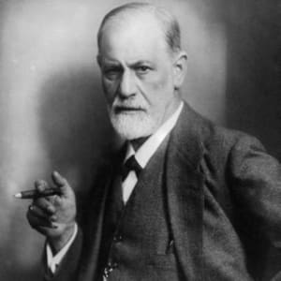
The Psychodynamic Approach: Evaluation
Consider the following questions in your groups:
What makes a theory or approach scientific? (Think back to what we discussed in the introductory lesson on Approaches)
Using your answer to the question above, why may the Psychodynamic approach be considered unscientific? Include the following aspects of the approach in your answer:
Unconscious; dream analysis; case studies;
Why does it matter if a theory is unscientific?

Slide 29
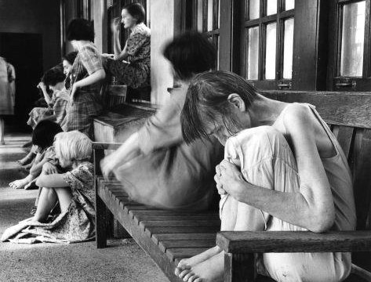
The Psychodynamic Approach: Evaluation
Consider the following questions in your groups:
So if the Psychodynamic approach is unscientific, why is it still included in the study of Psychology?
The answer is that the Psychodynamic approach contributed much to the development of modern Psychology. But what exactly?
Watch the clip and see if you can guess how it links to the importance of the Psychodynamic approach

Slide 30
The Psychodynamic Approach: Evaluation
Suggested that psychological disorders have a psychological cause, which led to the development of psychotherapy and a more sympathetic approach to mental illness
So what did Freud ever do for us?
Popularised the idea of the unconscious and how it shapes conscious behaviour, meaning the approach is able to explain the unexplainable
Raised our awareness of the importance of childhood experience on later development
This means that even though the approach is unscientific, it has led to important developments in Psychological understanding and has contributed to the development of modern psychotherapy

Slide 31
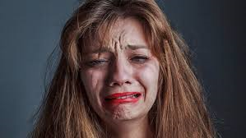
The Psychodynamic Approach: Evaluation
Consider the following questions in your groups:
The Psychodynamic approach could be considered gender biased.
Why?

Slide 32
Essay Practice: Snap Plan
In pairs (but everyone write it out for your notes), write a snap plan for the following essay title:
Describe the psychodynamic approach to explaining human behaviour. Discuss strengths and limitations of this approach.
(16 marks)

Slide 33
Snap Plan: Guidance
AO1
Marks for accurate description of features of psychodynamic approach: the role of the unconscious; psychosexual stages; the structure of personality; defence mechanisms; the role of conflict; the procedures used in psychoanalysis. Credit description of features provided by neo Freudians such as Erikson.
AO3
Marks for discussion of strengths and limitations of the psychodynamic approach. Likely strengths: focus on emotional development that occurs in early childhood and affects adult behaviours and personality; recognition of the lack of rationality in much behaviour and how stated intentions do not always match actual actions; development of a therapy for the treatment of anxiety disorders laying the foundation for psychotherapy in modern psychiatry. Likely limitations: not testable as concepts such as the unconscious are not easy to operationalise; not falsifiable as the theory is one in which the explanation uses post hoc reasoning, stating that adult disorder is a result of conflict in an early psychosexual stage but the theory often cannot predict how a particular conflict in childhood will affect adult behaviour; key concepts are not directly observable and have to be inferred from indirect procedures such as dream analysis; problems of generalisability due to lack of evidence in particular and reliance on individual case studies; general lack of scientific rigour because of interpretation of information and retrospective nature of psychoanalysis, limited evidence using the scientific method and reliance of case studies; general pessimism of the approach in which the individual always has to overcome repressed memories and overuse of defence mechanisms; emphasis on sexual instincts seems out of date in modern society, especially the imbalance in explanation for male and female development.

