Slide 1
Psychological Explanations of Offending Behaviour
Eysenck’s Criminal Personality Theory, Cognitive Explanations & Differential Association Theory

Slide 2
Starter Activity
In pairs on MWBs, can you define the following terms:
Extroversion
Introversion
Neuroticism
Psychoticism

Slide 3
Eysenck’s Criminal Personality Theory: Starter Questions
Answer in pairs on MWBs
True or false: Eysenck proposed that all personality types have a biological basis
What are the three personality dimensions measured on the EPQ?
Does criminal behaviour result from high or low levels of each of these dimensions?
According to Eysenck, why is criminal behaviour immature behaviour?
According to the theory, by what process are children taught to delay gratification and become more socially orientated?
According to Eysenck, what biological factor leads to extroversion?
How does the factor you identified in the last question lead to criminal behaviour?
According to Eysenck, what biological factor leads to neuroticism?
How does the factor you have identified in the last question lead to criminal behaviour?
If a person has a high E or N score, what are they less likely to respond to?
According to Eysenck, people who score highly on psychoticism, have high levels of what?
List three traits that someone with a high score on psychoticism is likely to display
How does your answer to the above question explain why people high on psychoticism are more likely to commit crime?

Slide 4
Eysenck’s Criminal Personality Theory: Answers
True or false: Eysenck proposed that all personality types have a biological basis
What are the three personality dimensions measured on the EPQ?
Does criminal behaviour result from high or low levels of each of these dimensions?
According to Eysenck, why is criminal behaviour immature behaviour?
According to the theory, by what process are children taught to delay gratification and become more socially orientated?
According to Eysenck, what biological factor leads to extroversion?
How does the factor you identified in the last question lead to criminal behaviour?
According to Eysenck, what biological factor leads to neuroticism?
How does the factor you have identified in the last question lead to criminal behaviour?
If a person has a high E or N score, what are they less likely to respond to?
According to Eysenck, people who score highly on psychoticism, have high levels of what?
List three traits that someone with a high score on psychoticism is likely to display
How does your answer to the above question explain why people high on psychoticism are more likely to commit crime?
True
Extroversion, neuroticism, psychoticism
High levels
Because it is selfish and concerned with immediate gratification, which a person is usually socialised out of
Conditioning – children learn to associate bad behaviour with the anxiety of punishment
Low levels of arousal in the brain
Because they are under-aroused, they seek excitement and engage in risk-taking behaviour
High levels of arousal in the ANS
They respond strongly to threat and experience high levels of emotion, which can lead to impulsive behaviour in an emotionally charged situation
Conditioning. They do not easily learn an association between anti-social behaviour and anxiety
Testosterone
Anti-social; aggressive; impulsive; uncaring
They lack caring for others, so less holding them back from committing a crime

Slide 5
Eysenck’s Criminal Personality Theory
Complete the worksheet in pairs
Katie
Cyril
Kevin

Slide 6
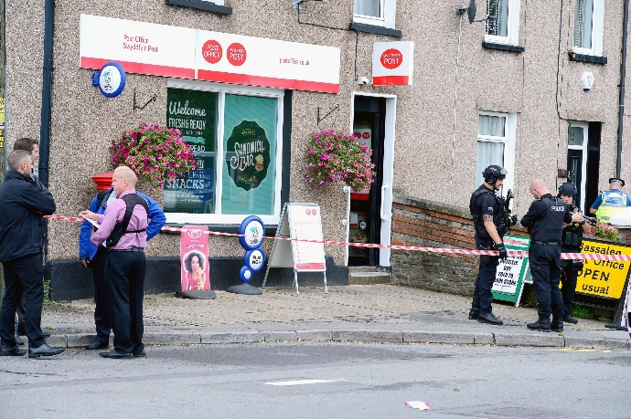
Eysenck’s Criminal Personality Theory
Look at the following case studies and explain each person’s behaviour knowing what you know about Eysenck’s Criminal Personality Theory
Case 1: Sandra has been in a relationship with Henry for four years. Last week, Henry announced that he was leaving Sandra for another woman. Sandra began to scream and shout at him and then when Henry tried to leave the house, Sandra picked up a kitchen knife and stabbed him. She is now being held in custody awaiting trial for GBH
Case 2: David has been having financial problems lately. He lost his job a few months ago and is struggling to pay the mortgage. His wife has told him that she cannot cope with the situation and if he doesn’t get another job soon she will leave him. David hatched a plan to rob his local post office. He managed to get hold of a shotgun, covered his face with a balaclava, and demanded the young female cashier hand over the money in the safe, otherwise he would shoot her.
Case 3: Wayne went to a party with his friends at the weekend. He took cocaine and ecstasy, as well as drinking quite heavily. The host’s father had a sports car, the keys of which were in the house. Wayne and his friends decided to take the car out Wayne drove around the town at 70mph. He knocked down a woman who was crossing the road and killed her

Slide 7
Eysenck’s Criminal Personality Theory: Exam practice
Answer the following question individually and without notes:
Last week, Henry announced that he was leaving Sandra for another woman. Sandra picked up a kitchen knife and stabbed him. After taking cocaine and ecstasy, Wayne took his friend’s father’s car without permission and drove round the town at 70mph, knocking someone down and killing them.
Using what you know about Eysenck’s Criminal Personality Theory explain the behaviour of Sandra and Wayne (6 marks)
Now swap your answer with someone on your table and give their answer a mark according to the guidance on the next slide

Slide 8
Eysenck’s Criminal Personality Theory: Mark Scheme
According to Eysenck, neuroticism results from high levels of arousal in the ANS and leads to a strong unpredictable reaction in an emotionally charged situation (1 mark). This can explain Sandra’s behaviour, as when faced with an upsetting situation, she reacted in an unpredictable and violent way by stabbing her partner (1 mark). High levels of extraversion result from low levels of arousal in the CNS and ANS (1 mark). This leads to the individual seeking stimulation and excitement, which often results in risk-taking behaviour which is linked to crime (1 mark). This can explain Wayne’s behaviour, as taking drugs and driving at high speed are risk-taking, criminal behaviours (1 mark) which have led to him killing someone, demonstrating how these risk taking behaviours are further linked to crime (1 mark)

Slide 9
Eysenck’s Criminal Personality Theory: Evaluation
In your groups, read the information and then answer the questions:
Eysenck (1977) compared 2070 male prisoners' scores on the EPQ with 2422 male controls. Groups were subdivided into age groups, ranging from 16 – 69 years. On measures of psychoticism, extroversion and neuroticism, across all age groups, prisoners recorded higher scores than the control group
What do the findings suggest about Eysenck’s theory?
Why may it not be possible to conclude from this research that personality type determines criminal behaviour?

Slide 10
Eysenck’s Criminal Personality Theory: Evaluation
Farrington et al (1982) reviewed several studies and reported that offenders tended to score high on P and N measures but not E. Hollin (1989) notes a similar pattern of findings with offenders generally showing higher P and N scores but not necessarily higher E scores
What might this suggest about Eysenck’s Criminal Personality theory?
Generally, there seems to be reliability with the research into P & N, but there is a lack of reliability in the research as it relates to the relationship between extroversion and offending behaviour
One possibility is that E scales actually measure two things, sociability and impulsiveness and that criminality is associated with the latter but not the former
What might this suggest about Eysenck’s construct of Extroversion and its link to offending behaviour?
It lacks validity, as not all forms of extraversion predispose someone to criminal behaviour

Slide 11
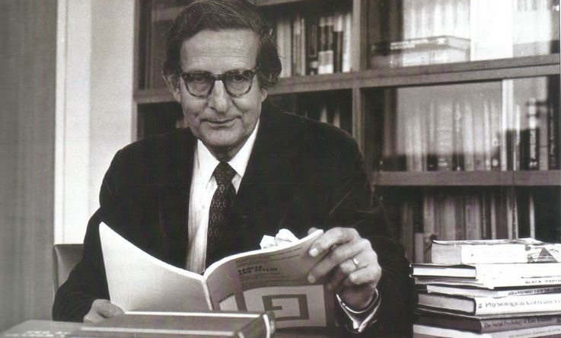
Eysenck’s Criminal Personality Theory: Evaluation
Where does Eysenck’s theory stand on the nature-nurture debate?
On MWBs, draw out the continuum and write an ‘E’ where you believe Eysenck’s theory falls on it. Be prepared to justify your answer
Nature
Nurture
Why?
How can this be used as a strength of the theory? Answer on MWBs. Use a comparison with another theory in your answer
He’s actually somewhere in the middle

Slide 12
Cognitive Explanations of Offending Behaviour: Level of Moral Reasoning Theory
The dilemma
Read the case of Heinz and decide, totally individually, whether Heinz was right or wrong to steal the drug. You must have a reason for your answer
Now look at the table on the next slide and decide what level of morality your answer puts you into. It doesn’t matter if you said he was wrong or right, it is your reasoning that is important

Slide 13
Cognitive Explanations of Offending Behaviour: Level of Moral Reasoning Theory
What stage does your answer to the Heinz dilemma put you into?
Kohlberg suggested that criminals had not developed beyond a pre-conventional level of morality. Why? How would this explain offending behaviour?
Do you agree? Discuss in pairs why you choose not to commit crimes.

Slide 14
Cognitive Explanations of Offending Behaviour: Level of Moral Reasoning Theory
Feedback on preparation homework question
For your preparation homework you answered the following question:
‘According to Kohlberg, which level of moral reasoning is more likely to lead to offending behaviour? Explain the reason for your answer and refer to evidence. (4 marks)’
Have this out in front of you

Slide 15
Cognitive Explanations of Offending Behaviour: Level of Moral Reasoning Theory
‘According to Kohlberg, which level of moral reasoning is more likely to lead to offending behaviour? Explain the reason for your answer and refer to evidence. (4 marks)’
Swap your answer with someone else on your table and peer assess based on the following criteria:
Have they…
Referred to the pre-conventional level of moral reasoning?
Explained why this level is more likely to lead to offending behaviour?
Used evidence, e.g. Kohlberg et al (1973), using his moral dilemma technique, found that a group of violent youths were significantly lower in their moral development than non-violent youths, even after controlling for social background?
Annotate their answer with any of the above points that are missing, then allocate a mark to their answer using the model on the next slide as a guide

Slide 16
Cognitive Explanations of Offending Behaviour: Level of Moral Reasoning Theory
‘According to Kohlberg, which level of moral reasoning is more likely to lead to offending behaviour? Explain the reason for your answer and refer to evidence. (4 marks)’
Example Answer:
The pre-conventional level of moral reasoning is more likely to lead to offending behaviour. The reason for this is that the pre-conventional level is associated with less mature, more childish reasoning and is characterised by the need to avoid punishment and gain rewards. Kohlberg suggested individuals who reason at this level may commit a crime if they can ‘get away with it’ or receive personal gains e.g. money. Studies have shown support this for example, Kohlberg found a group of violent youths were significantly lower in their moral development than non-violent youths
No more than 3 marks if they have not included evidence

Slide 17
Level of Moral Reasoning Theory: Evaluation
Gudjonsson & Sigurdsson (2007) assessed 128 juvenile offenders and found that 38% did not consider the consequences of what they were doing and 36% were confident they would not be caught
We cannot presume that the criminal behaviour was caused by the pre-conventional reasoning as it is not a controlled piece of research, and there is no comparison to a control group
Does the evidence support or challenge the Level of Moral Reasoning Theory? Give a reason for your answer
On the face of it, the evidence partially supports the theory as it suggests that the offender is operating in the pre-conventional stage of morality. However, it does not explain what caused criminal behaviour in those who did not have a pre-conventional level of reasoning
Can you see a problem with establishing a cause and effect relationship from this research?

Slide 18
Level of Moral Reasoning Theory: Evaluation
Thornton & Reid found that individuals who committed crimes for financial gain, such as robbery, were more likely to show pre-conventional levels of moral reasoning, than those convicted of impulsive crime such as assault
How can this be used as a criticism of Level of Moral Reasoning Theory?

Slide 19
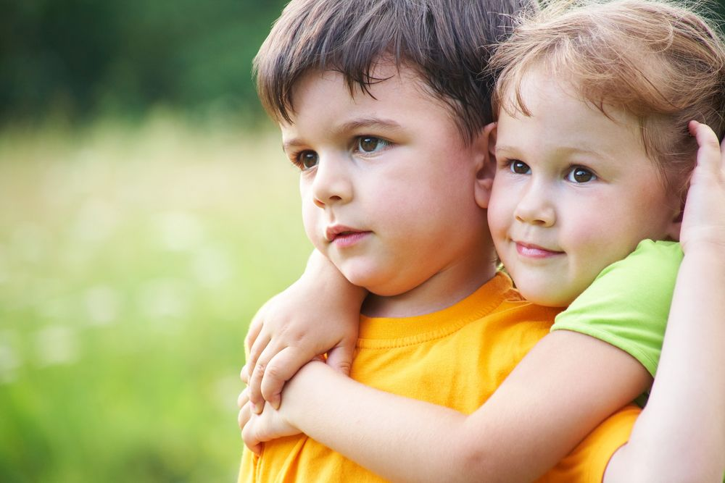
Level of Moral Reasoning Theory: Evaluation
Gilligan found that girls’ morality is centred on caring for others, whereas boys focus on justice and order. Kohlberg based his theory on an all male sample. Women commit less crimes than men
Use the information above to construct an evaluation of Level of Moral Reasoning Theory
The theory is beta biased. It may not apply to girls’ behaviour. It may be that girls do not use pre-conventional reasoning and this may explain the lesser rate of crime in females. The theory cannot be used to explain female offending behaviour

Slide 20
Level of Moral Reasoning Theory: Evaluation
Imagine that your job is to rehabilitate offenders. Consider the following case:
Carl has been stealing since he was 5 years old. He has previously received a caution for stealing cigarettes from his local convenience store. He then went on to steal handbags from elderly women while they were walking alone. He would run up behind them and snatch their bag and run off. When asked why he committed the crimes he said that he thought he would get away with it because his victims would not have time to see his face. He has now been sent to a young offenders institution
In pairs, knowing what you know about the Level of Moral Reasoning Theory, devise a strategy to rehabilitate Carl
What does your strategy suggest about the Level of Moral Reasoning Theory?

Slide 21
Cognitive Explanations of Offending Behaviour: Cognitive Distortions
According to this theory, criminal behaviour is the result of faulty information processing (in other words, how the individual thinks about and interprets a situation)
The two types of faulty information processing are:
Hostile attribution bias
minimalisation
On MWBs, define what each of these terms mean
Those who commit sexual offences
Do you remember what type of criminals are most likely to display minimalisation?

Slide 22
Cognitive Explanations of Offending Behaviour: Cognitive Distortions
Now consider the following scenarios. Are they an example of hostile attribution bias, minimalisation or neither?
“I stole the bike because it was left chained to a lamp post for days, so I decided that it probably wasn’t going to be missed anyway, and even if it was, the bike was expensive, the person obviously has enough money to get a new one”
Minimalisation

Slide 23
Cognitive Explanations of Offending Behaviour: Cognitive Distortions
Now consider the following scenarios. Are they an example of hostile attribution bias, minimalisation or neither?
“I know that it was wrong to punch her, but the amount of noise she made was ridiculous. I don’t believe that she was really hurt that much, it wasn’t a really hard punch. She was just trying to get sympathy. I don’t think it’s fair that I’m going to court for this”
Minimalisation

Slide 24
Cognitive Explanations of Offending Behaviour: Cognitive Distortions
Now consider the following scenarios. Are they an example of hostile attribution bias, minimalisation or neither?
“I took the purse because I thought I could get away with it. The lady was distracted by her dog trying to get closer to another dog in the park, so I just took the opportunity to dip into her bag and take the purse. I didn’t target her specifically, it was just the way it worked out”
Neither

Slide 25
Cognitive Explanations of Offending Behaviour: Cognitive Distortions
Now consider the following scenarios. Are they an example of hostile attribution bias, minimalisation or neither?
“I didn’t go out that night looking for a fight, but I felt I had no choice but to challenge him because from the moment I walked into the pub he was eyeing me up. I could feel him looking at me while I was at the bar and then I heard him laugh and I knew he was laughing at me, so I took my pint, threw it his face and then smashed the glass over his head”
Hostile Attribution Bias

Slide 26
Cognitive Explanations of Offending Behaviour: Cognitive Distortions
Now consider the following scenarios. Are they an example of hostile attribution bias, minimalisation or neither?
“I was really struggling for money. The rent was overdue and I had no way of paying it. I really didn’t know what I was going to do. I couldn’t let me and the kids get thrown out onto the street, and so when I was at my friends house – I knew where she had some money stashed away – so while she was in the toilet I went upstairs and took it. I didn’t see any other way to resolve the situation”
Neither

Slide 27
Cognitive Explanations of Offending Behaviour: Cognitive Distortions
Now consider the following scenarios. Are they an example of hostile attribution bias, minimalisation or neither?
“I had my annual review with my manager and I was dreading it. I knew she didn’t like me. She told me that some of my work was okay, but there were areas that I needed to improve. She was determined to find something wrong with my work and knew this was going to be used as an excuse not to promote me. On my way out of the car park I scratched my keys all the way along her new Mercedes.”
Hostile Attribution Bias

Slide 28
Cognitive Distortions: Exam Practice
Answer the following question, individually, without notes:
Keith was standing at the bus stop when a man came along and stood close to him eating a sandwich. He was humming the tune to ‘Who’s sorry now’. Keith’s football team had just lost. Keith believed the man was deliberately trying to antagonise him and so grabbed his sandwich out of his hand and threw it in the road. Arthur never buys his own stationery, he takes what he needs from work. Arthur doesn’t feel bad about this because the company make a lot of money and won’t miss a few pens and some paper.
Outline cognitive distortions as a theory of offending behaviour. Refer to Keith and Arthur in your answer (4 marks)
Now swap with the person sitting next to and award their answer a mark out of 4 according to the guidance on the following slide

Slide 29
Cognitive Distortions: Exam Practice
Cognitive distortions include hostile attribution bias, which is where the individual misinterprets the other person’s behaviour as confrontational when it is not (1 mark). This can lead to an aggressive response, as in the case of Keith where he believed the man was humming ‘who’s sorry now’ to antagonise him, and therefore reacted in an aggressive way by snatching his sandwich (1 mark). Another type of cognitive distortion is minimalisation, which is where the effects of the crime are downplayed by the offender (1 mark). This can be seen in Arthur’s behaviour where he is rationalising stealing from his employer by downplaying the effects his behaviour has on them, e.g. “the company make a lot of money” (1 mark)

Slide 30
Cognitive Distortions: Evaluation exercise
You will be given a card sort activity on the evaluation of cognitive distortion as an explanation of offending behaviour. There are two evaluation points for each type of cognitive distortion
Start by laying out the two headings
Then decide which cards go under each heading
Now split each pile of cards into two separate evaluation points
Lastly, order them in logical way
Once you have completed the task, check against the information pack (pgs 16 & 17) to see if you got it right
If not, re-order the points and write a brief summary of each for your notes

Slide 31
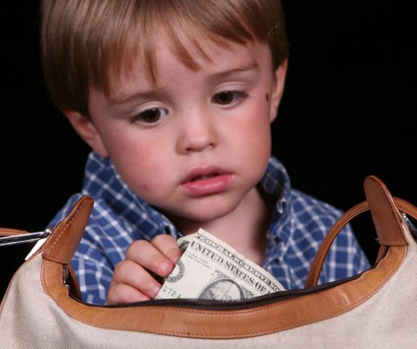
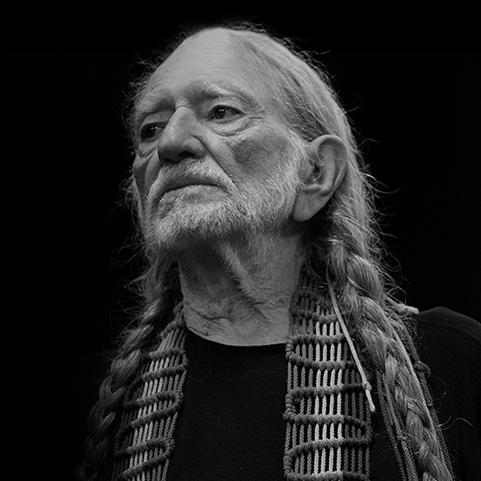
Differential Association Theory: Recap of key features
On MWBs write down four key features of this theory
Criminal behaviour is learnt
Individual learns the values, attitudes, motives and techniques for criminal behaviour through associations and interactions with significant others
If an individual is exposed to more pro-crime values and attitudes than anti-crime they will go on to offend
It is possible to predict offending behaviour
Watch the clips and list which features of DAT are shown or implied

Slide 32
Differential Association Theory: Exam practice
Answer the following question individually, without notes
Growing up, Gary was generally considered to be a good boy. He came from a stable background with supportive parents and always performed well at school.
Since turning 15, Gary has started to hang around with a new group of friends. Locally, the group has a reputation for being ‘the wrong crowd’. Apart from being told to stay away from these boys by his parents and his former friends, Gary continues to associate with them. Last week Gary was arrested for trying to steal a car. This was his first offence.
With reference to Gary, outline the main principles of differential association theory (6 marks)
Now award a mark to your answer using the guide on the next slide

Slide 33
Differential Association Theory: Exam practice Mark Scheme
DAT suggest that criminal behaviour is learned from significant others. Gary has learnt this criminal behaviour from his new friends, who are significant in his life (1 mark).
According the theory, the individual is likely to learn techniques that enable criminal behaviour to take place (1 mark). It is possible that Gary learned the technique of how to steal a car from his friends (1 mark).
Individuals who have frequent and prolonged exposure to pro-crime attitudes are more likely to go on to offend, than those who are exposed to anti-crime attitudes (1 mark). As Gary’s new friends have a reputation for being ‘the wrong crowd’, it is possible Gary’s new friends see stealing cars and anti-social behaviour as favourable (1 mark). This, coupled with a lack of contact/ less associations with his former friends (who are likely to have more anti-crime values and attitudes) increases the chances of him committing a cime (1 mark)

Slide 34
Differential Association Theory: Discussion
Discuss the following questions in your groups. Some are from the preparation work
According to DAT, criminals learn how to commit crimes. Give some examples of criminal acts that could be learnt
How could this link to high re-offending rates after release from prison?
Come up with some examples of pro-crime attitudes and anti-crime attitudes in specific groups. Try to think of a range of criminal acts

Slide 35
Differential Association Theory: Evaluation
DAT Provides an explanation for prevalence of crimes in certain areas or within certain groups in society unlike some other explanations, but fails to explain some types of crime
What crimes or criminal behaviour does DAT explain well, and which does it not explain so well?
Explains well
white collar crimes (e.g. fraud, tax avoidance), gang violence, burglary and theft
Doesn’t explain well
solitary or more violent crimes e.g. murder, sexual assault.

Slide 36
Differential Association Theory: Evaluation
Harry comes from a criminal family. His dad has been in and out of prison for burglary. His brothers have all been in trouble with the police for theft and shoplifting. His sister lost her last job as a cleaner after she stole a credit card from her employer’s purse and tried to use it to book a holiday.
Why might the differential association theory be problematic for Harry?

Slide 37
Differential Association Theory: Evaluation
Sarah’s family are very wealthy. Her parents ran a successful business and evaded paying tax on a lot of what they earned by using illegal tax evasion schemes. Sarah now runs a business of her own and also uses illegal tax evasion schemes to avoid paying tax on her companies profits.
Samira’s parents thought it was fine to steal from their employers. Both her mother and her father would regularly take stationery and other items from the office to use at home. Samira now has office job of her own, but doesn’t steal from her employer
What problem does the differential association theory have that is illustrated by the cases of Sarah and Samira?

Slide 38
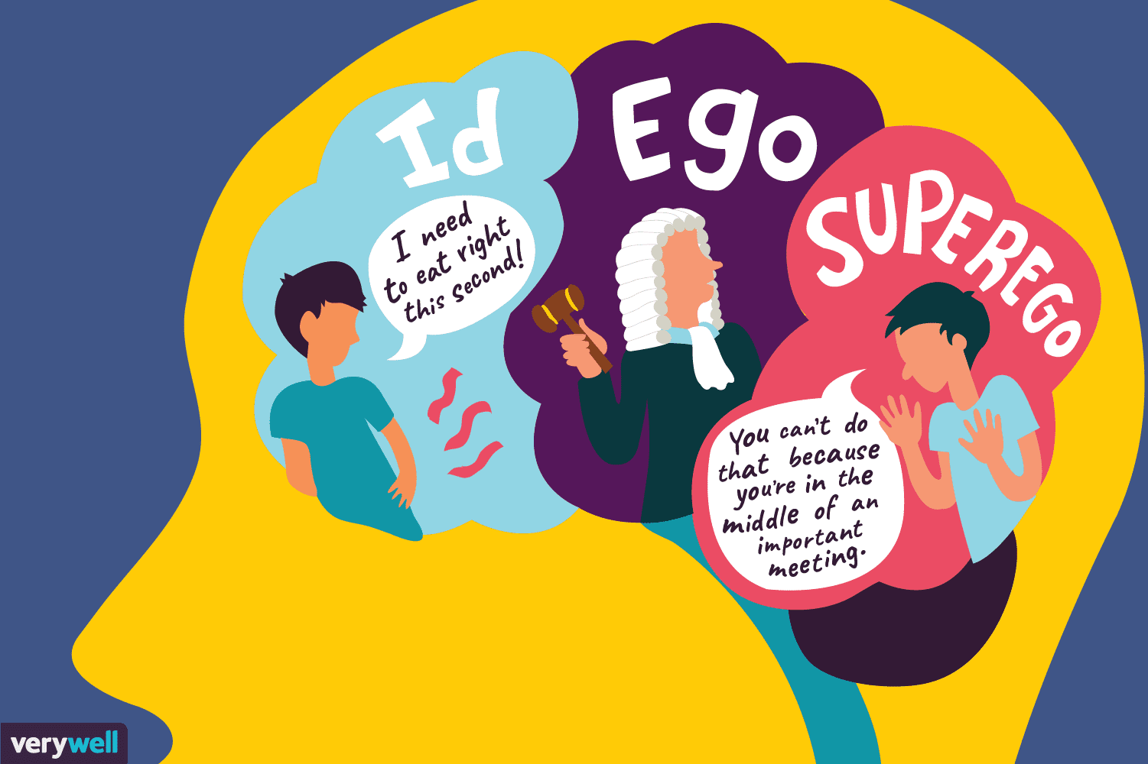
Psychodynamic Explanations of Offending Behaviour
Blackburn’s inadequate superego theory
Defence mechanisms

Slide 39
Psychodynamic Explanations of Offending Behaviour: Starter Questions
Answer the following questions, in pairs, on MWBs:
According to psychodynamic theory, what is the role of the superego?
There are three types of defective superego according to this theory. What are they called?
According to the theory, what is a healthy superego and what does it result from?
What type of superego results from the same-sex parent being absent from the household?
How does the type of superego you have identified in the last question lead to criminal behaviour?
What type of superego results from the parent lacking in morals or engaging in criminal behaviour?
How does the type of superego you have identified in the last question lead to criminal behaviour?
What type of superego is likely to be developed in those who have had a very strict upbringing?
How does the type of superego you have identified in the last question lead to criminal behaviour?
What is ‘displacement’ and how can it be used to explain offending behaviour?
What is ‘rationalisation’ and how can it be used to explain offending behaviour?
What is ‘sublimation’ and how can it be used to explain offending behaviour?

Slide 40
Psychodynamic Explanations of Offending Behaviour: Starter Questions
Answer the following questions, in pairs, on MWBs:
According to psychodynamic theory, what is the role of the superego?
There are three types of defective superego according to this theory. What are they called?
According to the theory, what is a healthy superego and what does it result from?
What type of superego results from the same-sex parent being absent from the household?
How does the type of superego you have identified in the last question lead to criminal behaviour?
What type of superego results from the parent lacking in morals or engaging in criminal behaviour?
How does the type of superego you have identified in the last question lead to criminal behaviour?
What type of superego is likely to be developed in those who have had a very strict upbringing?
How does the type of superego you have identified in the last question lead to criminal behaviour?
What is ‘displacement’ and how can it be used to explain offending behaviour?
What is ‘rationalisation’ and how can it be used to explain offending behaviour?
What is ‘sublimation’ and how can it be used to explain offending behaviour?
It is the moral side of the personality, the conscience
The weak superego, the deviant superego, the over-harsh superego
It is like a kind, but firm internal parent. It has rules, but can also forgive transgressions. It will result from kind, but firm parenting
Weak
Internalisation of moral values does not happen and therefore the id becomes dominant, and therefore selfish, immoral behaviours are likely to be displayed
Deviant
The child internalises deviant morality
Over-harsh
High levels of guilt leads to the child feeling that they deserve to be punished, and therefore they commit crime to be able to receive punishment
Directing unacceptable drives onto a more appropriate target, e.g. hostility towards same-sex parent leads to aggressive, violent behaviour
An attempt to justify your actions, e.g. believing that killing sex-workers is good for society
Where a drive is converted into a more acceptable behaviour, e.g. wishing to hurt someone physically, but stealing from them instead

Slide 41
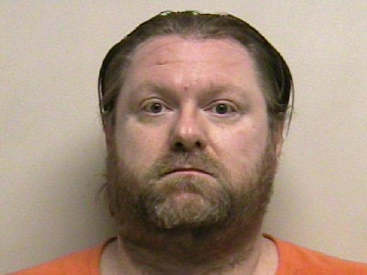
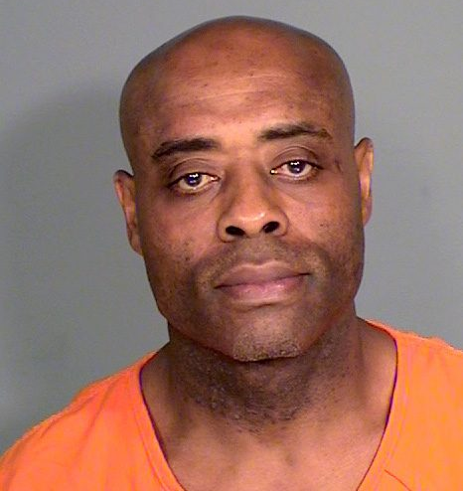
Psychodynamic Explanations of Offending Behaviour: The Inadequate Superego
Complete the card sort exercise by putting the cards into three piles according to whether they are relevant to Gary, David or Barry. Start with the cards with each man’s name on at the top and then work down from there
Gary
David
Barry

Slide 42
The Inadequate Superego: Did you get it right?
Over-Harsh Superego | Weak Superego | Deviant Superego
Gary’s parents have very traditional Victorian values about raising children | Barry’s mother was a single parent | David’s father has spent time in jail
His parents used very harsh punishments and are unforgiving of his bad behaviour | His father left home when he was a baby | He remembers seeing his father preparing for his next burglary job
He has developed a very strong sense of morality | He steals cars because he loves fast cars and he can’t afford to buy one | There would be a bag full of tools in the living room and some dark clothing in a bag under the stairs
He feels constantly guilty | He doesn’t think about whether his behaviour is right or wrong | His dad told him that you need to make your own luck in life, in whatever way you can
This leads to a feeling that he needs to be punished | This is because he is focused on the pleasure he gets, rather than the consequences to the victim | He thinks it is fine to steal things
He robbed a bank because he knew he would get caught |  | It is a job, like any other

Slide 43
Psychodynamic Explanations of Offending Behaviour: Exam Practice
Answer the following question, individually, without notes:
By the age of 20, Gary, David and Barry are all serving prison sentences. Gary’s parents are extremely strict, yet Gary is always in trouble with the police; it is almost as if he enjoys being in trouble. David does live with his dad, but his dad earns all of his money through burglary. Barry has never met his dad; his dad left his mum before he was born
Explain what is meant by an inadequate superego. Refer to Gary, David and Barry in your answer (6 marks)
Now swap with the person sitting next to you and award a mark to their answer using the guidance on the next slide

Slide 44
Psychodynamic Explanations of Offending Behaviour: Mark Scheme
The inadequate superego can take three forms. Firstly the weak superego which is likely to result from the same-sex parent being absent and thus the child not internalising morality (1 mark). This could be the case with Barry as his dad left before he was born, meaning that his id has become dominant causing him to commit crime (1 mark). Secondly, the deviant superego results from the parents holding immoral or criminal attitudes, resulting in a morality that supports criminal behaviour (1 mark). This may be the case for David, as his dad makes his money through burglary, and therefore David has internalised this as part of his morality (1 mark). Lastly, the over-harsh superego is where the super-ego is too strong and therefore the individual commits crime to satisfy their desire to be punished (1 mark). This could be the case for Gary, as he has strict parents and therefore he is likely to have a very strong superego (1 mark)

Slide 45
Psychodynamic Explanations of Offending Behaviour: Defence Mechanisms
Read the following scenario and then, in pairs, decide which woman is using which defence mechanism and explain why
Alice, Roberta and Dorinda have all committed crimes.
Alice works as a clerk for an accountant. She has found a way of diverting funds from customers’ accounts to her own bank account. She only transfers small amounts at one time to avoid detection. She feels that her behaviour is acceptable because her clients are all very rich and they take advantage of tax avoidance schemes. Plus, she doesn’t get paid very much money but feels she does a good job and deserves a bit of a bonus
Roberta had a really nasty argument with her girlfriend. She was feeling really angry because she felt that her girlfriend had not taken her feelings into consideration. She stormed out of the house and went to the pub. While in the pub, she noticed a young man being pestered by an older man he was trying to get away from. She picked up a chair and went over to where the two were standing and hit the older man across the back with the chair.
Dorinda has been experiencing violent fantasies. She has become obsessed with the idea of creeping up behind somebody and then stabbing them many times with a knife. The other day, Dorinda quietly crept up behind a young woman, snatched her bag and ran away with it.
Rationalisation
Displacement
Sublimation

Slide 46
Psychodynamic Explanations of Offending Behaviour: Evaluation
For each evaluation point, in pairs, you need to decide which statement out of the three presented is correct. Write the number of that statement on MWBs
1
2
3
According to Freud, women develop a superego just like boys which would imply that females should be just as prone to criminal behaviour as males. This notion is not supported by evidence or by statistics on the ratio of male and female inmates in prisons. Therefore, this theory fails to explain the differences between the genders
According to Freud, women develop a weaker superego than boys which would imply that females should be more prone to criminal behaviour than males. This notion is not supported by evidence or by statistics on the ratio of male and female inmates in prisons. Therefore, this explanation can be criticised for adopting an alpha bias
According to Freud, women develop a stronger superego than men which would imply that males should be more prone to criminal behaviour than females. This notion is supported by evidence and by statistics on the ratio of male and female inmates in prisons. Therefore, this evidence can be used as support for the theory

Slide 47
Psychodynamic Explanations of Offending Behaviour: Evaluation
For each evaluation point, in pairs, you need to decide which statement out of the three presented is correct. Write the number of that statement on MWBs
1
2
3
There is some evidence that children raised without a same-sex parent are less law-abiding as adults. The idea that someone would commit a crime because they feel large amounts of guilt and are thus seeking out punishment seems plausible. Some offenders behave in ways that make it more likely they will be caught and it is logical that having a strong sense of guilt would lead to the person engaging in criminal behaviour
There is strong evidence that children raised without a same-sex parent are less law-abiding as adults. There is also support for the idea that some criminals experience high levels of guilt, which is consistent with the idea that they are thus seeking out punishment. Therefore, although the theory may seem implausible on the surface, it is backed up by strong scientific evidence
There is very little evidence that children raised without a same-sex parent are less law-abiding as adults. The idea that someone would commit a crime because they feel large amounts of guilt and are thus seeking out punishment seems implausible. Most offenders go to great lengths to avoid being caught. Also, having a strong sense of guilt should mean the person is less likely to engage in criminal behaviour

Slide 48
Psychodynamic Explanations of Offending Behaviour: Evaluation
For each evaluation point, in pairs, you need to decide which statement out of the three presented is correct. Write the number of that statement on MWBs
1
2
3
This explanation suggests individuals have no control over their offending behaviour as the defence mechanisms that cause them to act the way they do are determined by the unconscious which they have not control over. This raises the question as to whether individuals should be punished for a crime that they have no free will over however this viewpoint is not adopted by the criminal justice system
This explanation suggests individuals have some free will over their offending behaviour as they are able to choose which defence mechanisms they use, and therefore do not have to engage in criminal behaviour. This is a good thing, as it encourages the individual to take responsibility for their actions and makes them aware that it will be difficult to fall back on this as a defence in a criminal case
This explanation suggests that individuals have complete free will over their behaviour, as the Psychodynamic approach does not advocate determinism. This approach suggests that the individual is in control over the unconscious, as well as the conscious mind, and they have the ability to choose the how they behave. This is a strength of the theory as it encourages the individual to take responsibility for their actions

Slide 49
Exam Practice
Work in pairs, but make an individual plan for the following essay:
Discuss one or more psychological explanations of offending behaviour (16 marks)

