Slide 1
Dealing With Offending Behaviour
The aims of custodial sentencing, its psychological effects & recidivism

Slide 2
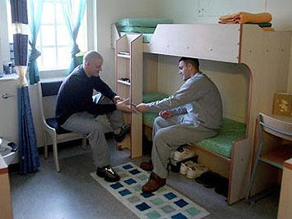
Custodial Sentencing
Answer this question, in groups, on MWBs:
What do we mean by custodial sentencing?
Custodial Sentencing involves a convicted offender spending time in prison or another closed institution (e.g a young offenders institution or secure psychiatric hospital)

Slide 3
Custodial Sentencing
There are four main reasons why society uses custodial sentencing
Using what you remember from your preparation homework, but without looking at your notes, write down on MWB what you think they are
What do each of these terms mean?
Did you get: Deterrence; Incapacitation; Retribution; Rehabilitation

Slide 4
Custodial Sentencing: Evaluation
In order to evaluate the use of custodial sentencing, we may look at how effective it is
What do you think effectiveness might mean in this context? In your groups on MWBs, write down what we might expect to find if custodial sentencing is an effective way of dealing with crime
Did you get:
A general reduction in crime rates
Low rates of reoffending
What is it about custodial sentencing that might make re-offending less likely?

Slide 5
Custodial Sentencing: Evaluation
Task: Each group will be allocated one reason for custodial sentencing: Deterrence, Incapacitation, Retribution or Rehabilitation
Split your group into two. On BWBs, one half are going to be arguing for why custodial sentencing is an effective strategy, linked specifically to that reason, and one half are going to argue against it being effective (you will need to split your BWB into two)
You will then feed back to the class
You have two minutes

Slide 6
Custodial Sentencing: Evaluation
Did you get these?
 | Deterrence | Incapacitation | Retribution | Rehabilitation
Effective | Clearly some offenders are deterred by prison, as not all go on to reoffend | Ensures that the offender cannot commit more crimes while they are in prison | It provides ‘closure’ for the family | Many prisoners access education and training whilst in prison There are also treatment programs such as anger management and social skills training
Ineffective | High recidivism rates suggest that offenders are not deterred by the punishment of custodial sentencing prison became ‘home’ to some prisoners (Hollin). | They may commit crimes within the prison | We might argue that retribution has no place in a civilised society, and that the sole aim of custodial sentencing should be to rehabilitate | Prison could serve as a place in which inmates learn how to commit crimes from one another Rehabilitation is expensive and many prisons do not have effective programs

Slide 7
Custodial Sentencing: Evaluation
Watch the video and note down the following on MWBs:
Examples of support for Custodial Sentencing
Examples of challenge to Custodial Sentencing
Suggestions that other method(s) might be more effective

Slide 8
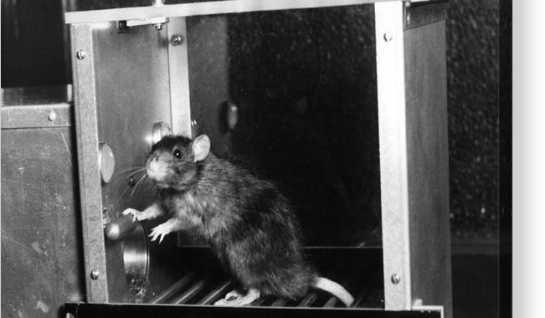
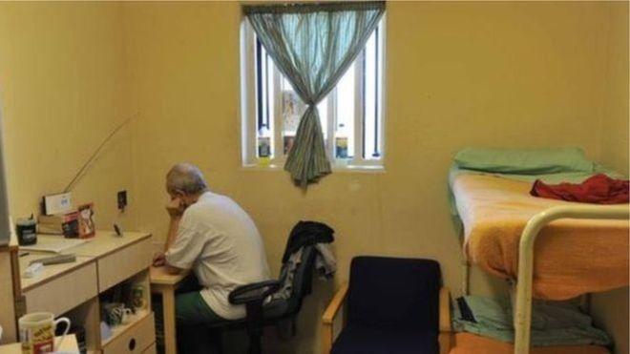
Custodial Sentencing: Evaluation
The concept of deterrence is based on the Behaviourist approach, which suggests that if offending behaviour is punished it is less likely to be repeated
Which behaviourist theory is being described?
From what you saw in the clip:
Was there evidence that prison acts as a deterrent?
How could the principles of learning theory counteract the argument that prison is a deterrent?
How could Learning theory explain reoffending?
Operant conditioning

Slide 9
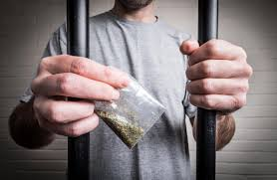
Custodial Sentencing: Evaluation
Removing an individual from society prevents the offender from committing more crimes while they are in prison. This relates to the concept of incapacitation
From what you saw in the clip:
Was there any evidence against the idea that offenders are incapacitated?

Slide 10
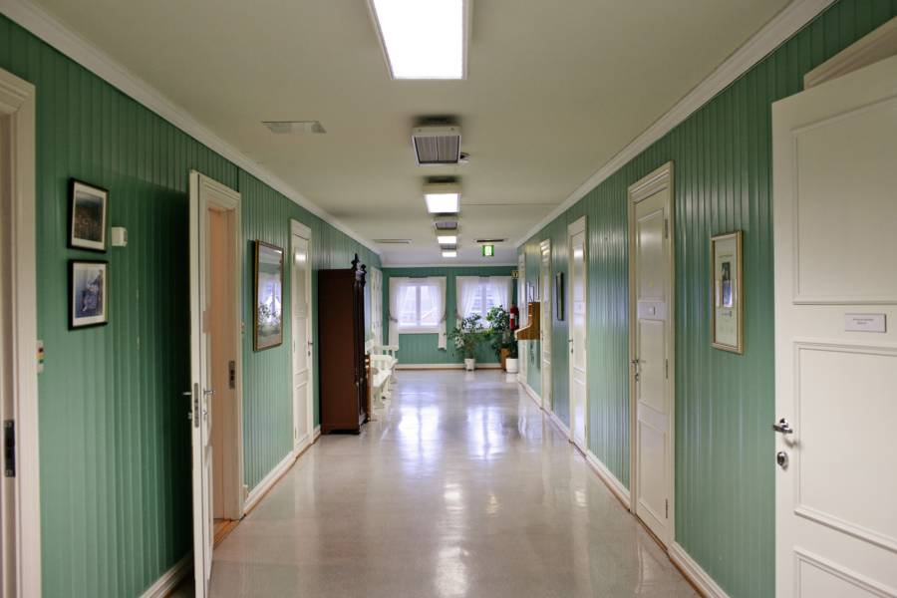
Custodial Sentencing: Evaluation
If rehabilitation is effective, then we would expect re-offending rates to be low
What percentage of offenders in the UK go on to re-offend within one year of leaving prison?
57%
What does this suggest about rehabilitation?
Apart from rehabilitation being at the forefront of the Norway system, what other reason may there be for low recidivism rates, that are not connected to the prison system?
Watch the clip on Norway’s Bastoy Prison, where re-offending rates are 16%
Why do you think re-offending rates in Bastoy are so low in comparison to UK prisons?
Why do you think the UK are not following the Bastoy model?

Slide 11
Custodial Sentencing: Exam Practice
Answer the following question individually, without notes:
Following a series of riots in cities all over England, a politician was interviewed on the radio. He said, ‘Rioters and looters should be sent to prison. We must send a clear message that this sort of behaviour is not acceptable. Society expects such behaviour to be severely punished.’
Briefly discuss two roles of custodial sentencing identified in the politician’s statement.
(4 marks)
Now swap with the person sitting next to you and give their answer a mark out of 4 using the guidance on the next slide
Note that there is no application required in this question!

Slide 12
Custodial Sentencing: Mark Scheme
AO1
Up to two marks for knowledge of relevant roles of custodial sentencing. Given the context, students are most likely to focus on deterrence (individual and/or general), retribution or possibly incapacitation.
Deterrence - seeing / experiencing the negative consequence means that the offending behaviour should be avoided in the future; prison as negative reinforcement; avoidance learning; vicarious learning - seeing peers go to prison; punishment acts such that negative consequences will be avoided in future.
Retribution – society exacting revenge for unacceptable conduct.
Incapacitation – sending to prison removes the offender from society, putting the offender out of action.
Maximum 1 mark for simply naming two relevant roles

Slide 13
Custodial Sentencing: Mark Scheme
AO3
Up to two marks for brief discussion of the two roles presented
For full marks students must comment briefly on each role
Relevant discussion points include:
Recidivism rates indicate prison does not deter (approximately 70% of young male offenders re-offend within two years);
Exacting retribution does not change the offender’s behaviour (alternatives to prison may be better than straightforward punishment, eg restorative justice)
Retribution often occurs as a result of the political imperative to appear to be tough on crime; We may consider that it has no place in a civilised society
Incapacitation is only temporary in most cases; even people in prison can continue to commit crime so incapacitation is not complete

Slide 14
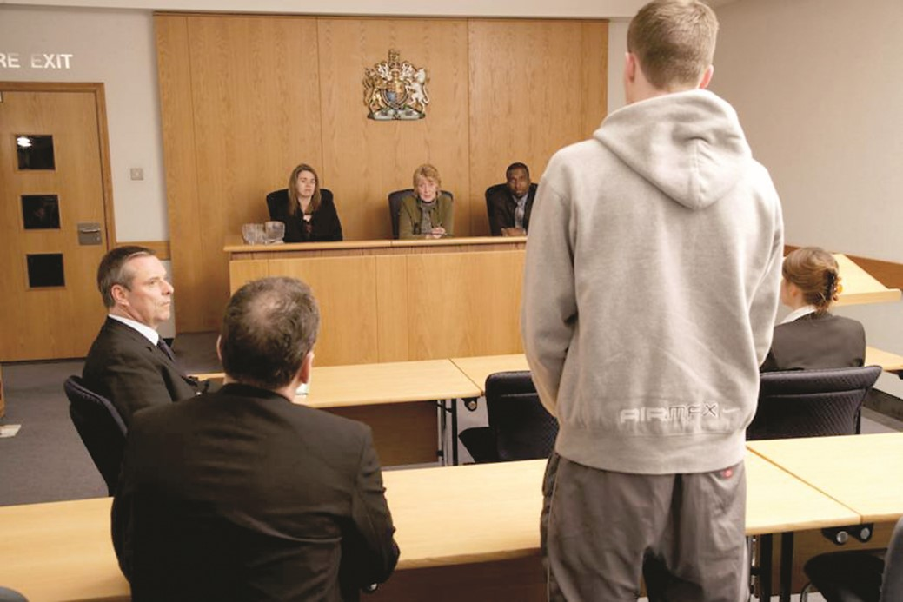
Reasons for Recidivism (Re-offending)
In groups, on MWBs, list all of the reasons why someone might re-offend (try to remember what you read about as part of the prep)
Psychological Effects: Stress and Depression
Institutionalisation
Prisonisation
Mental Health and Addiction issues
Labelling

Slide 15
Reasons for Recidivism (Re-offending)
Each member of the group will be given a different case study
Read pages 25 & 26 in the information pack and then answer the following questions about your case (jot your answers down):
What reasons for reoffending are evident in the case study? Support your answer with a quotation from the pack
What research is there to support this? (write down brief details)
Now take it in turns to present your case to your peers, giving details of the case and the reasons why reoffending is likely

Slide 16
Exam Practice: Snap plan
Write a snap plan for the following essay title. Try to do it individually without looking at your notes. If you get stuck, look at your notes/the pack and then close them again before you write your plan
Outline and evaluate the aims of custodial sentencing (16 marks)

